Slide 1
Climatology and Climate Change in Athena Simulations
Project Athena Team
ECMWF, June 7, 2010
Notes:
Change colors

Slide 2
Qualitative to Quantitative: Beyond Animations
Athena Catalog
8 NICAM (7 km) Boreal summer cases
9 IFS T2047 (10 km) Boreal summer cases
20 IFS T2047 13-month hindcasts
48 IFS 13-month hindcasts at T1279 (16 km), T511 (40 km), T159 (128 km)
47 year IFS AMIP runs at T1279, T159
47 year IFS timeslice runs at T1279, T159
Multiple ensemble members for select seasons at T1279, T511, T159
Sufficient data for quantitative, climatological analysis
Notes:
Previously tthis type of animation represented the majority of high resolution analysis, certainly for NICAM. Just not enough data. To review what we have…

Slide 3
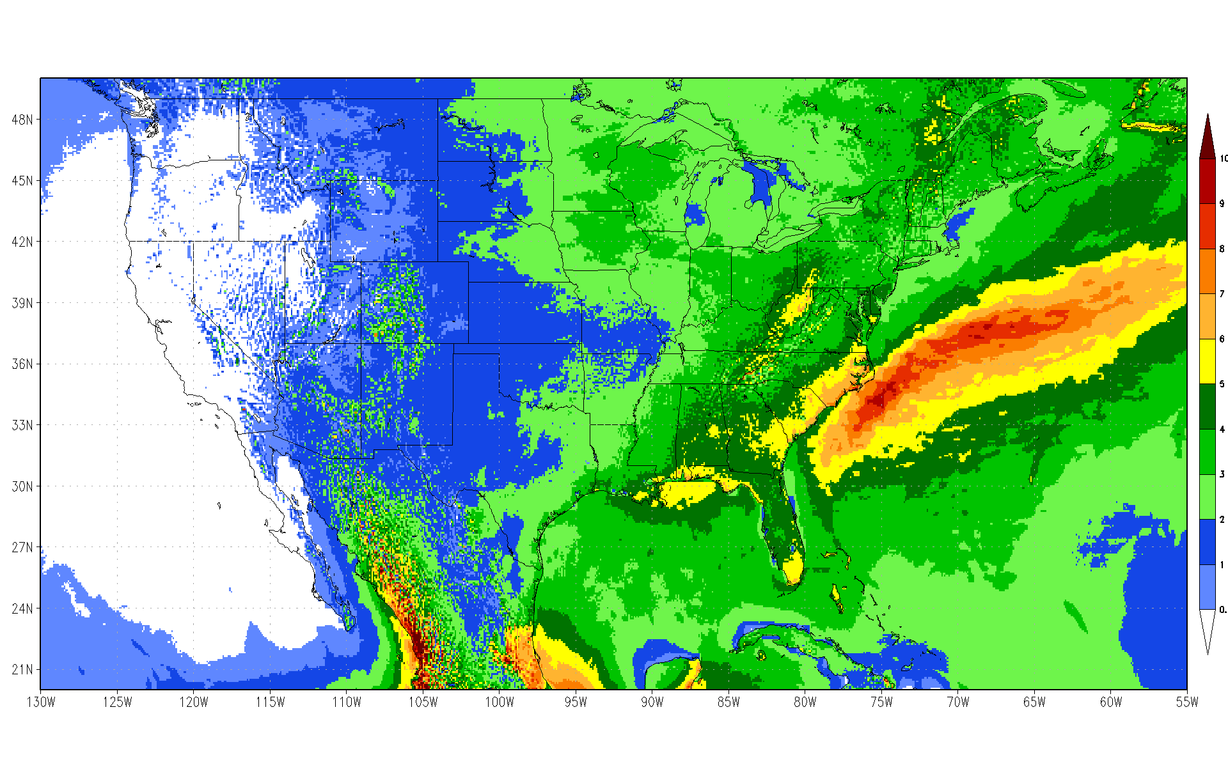
10km: IFS T2047 JJA Mean Rainfall at native resolution (8 seasons)
Notes:
Terrain features are clearly visible, SE precip max, enhanced precip over Great Plains

Slide 4
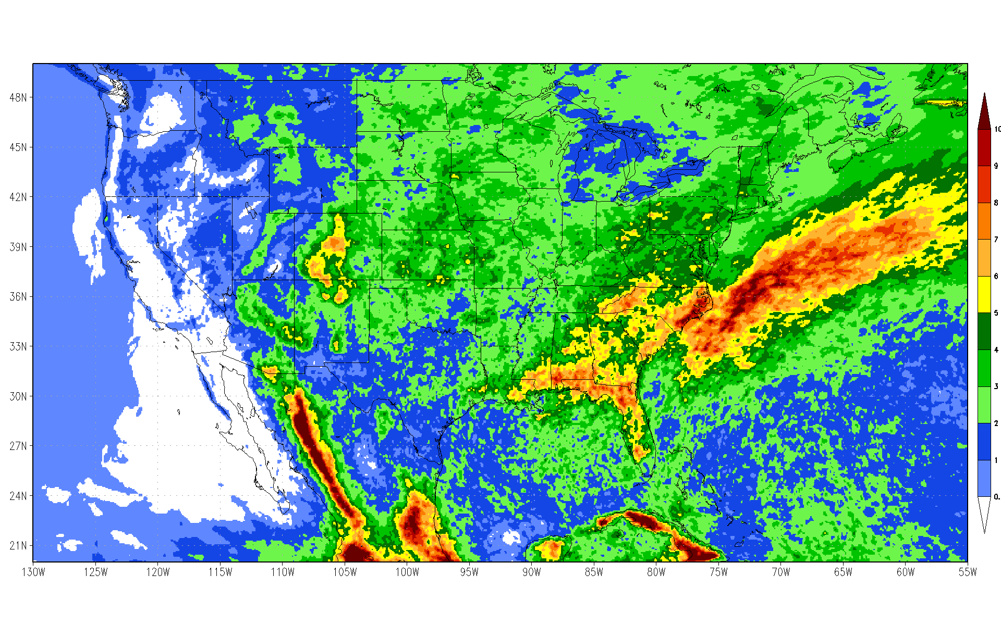
7km: NICAM JJA Mean Rainfall at native resolution (8 seasons)
Notes:
Terrain features are clearly visible, SE precip max, enhanced precip over Great Plains

Slide 5
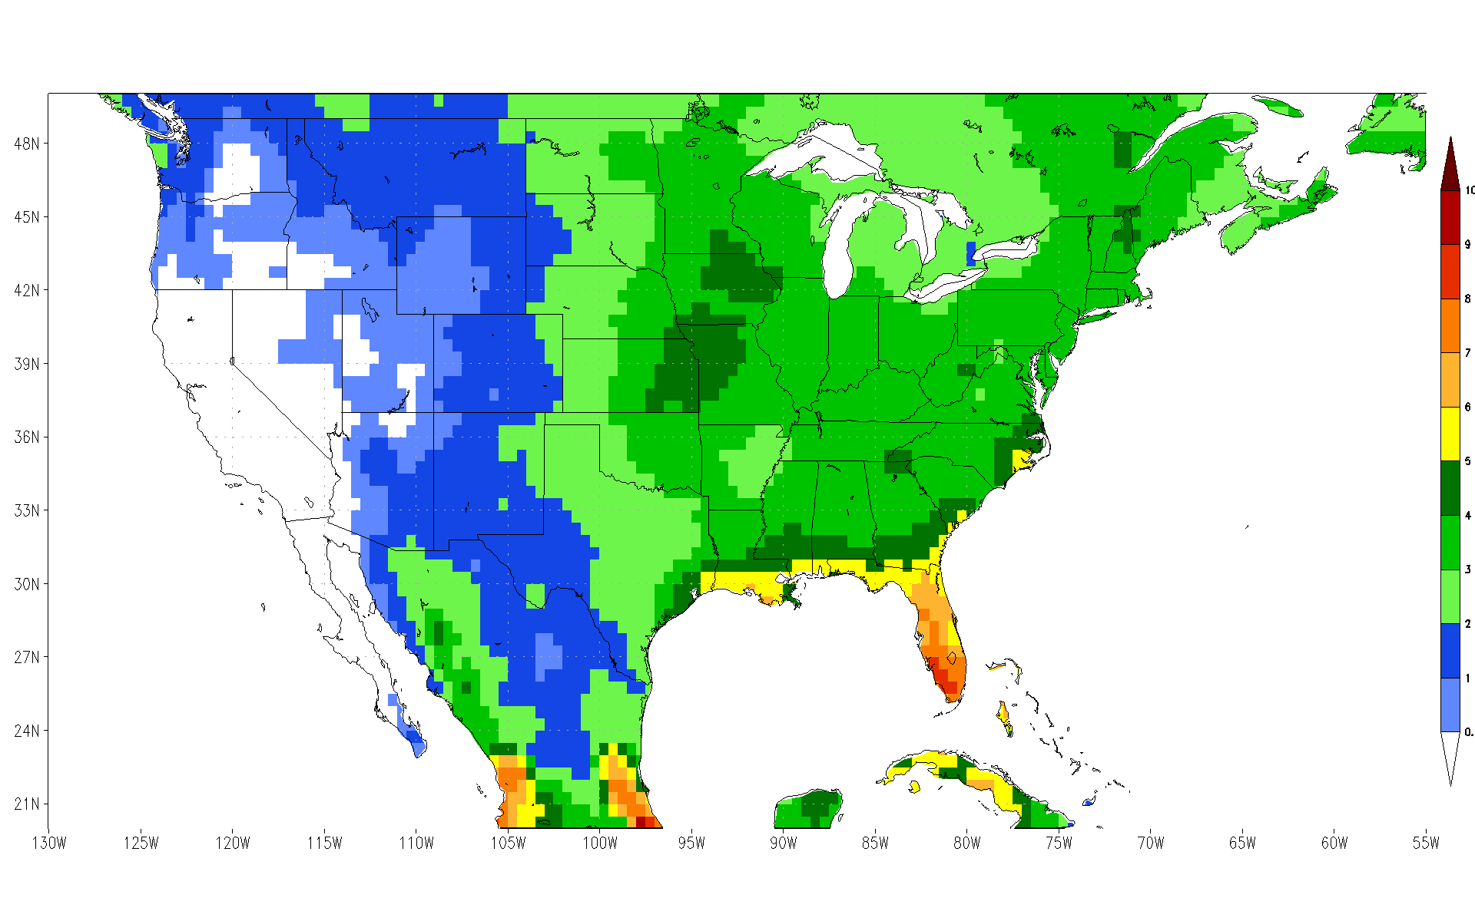
40 km: Chen et al. 0.5 degree JJA Mean Rainfall (8 seasons)
Notes:
So, we would like to know how accurate the models are… what do we compare them to?
Relatively high resolution gridded product rain-gauge product, but terrain features are barely visible. Location bias for gauges?

Slide 6
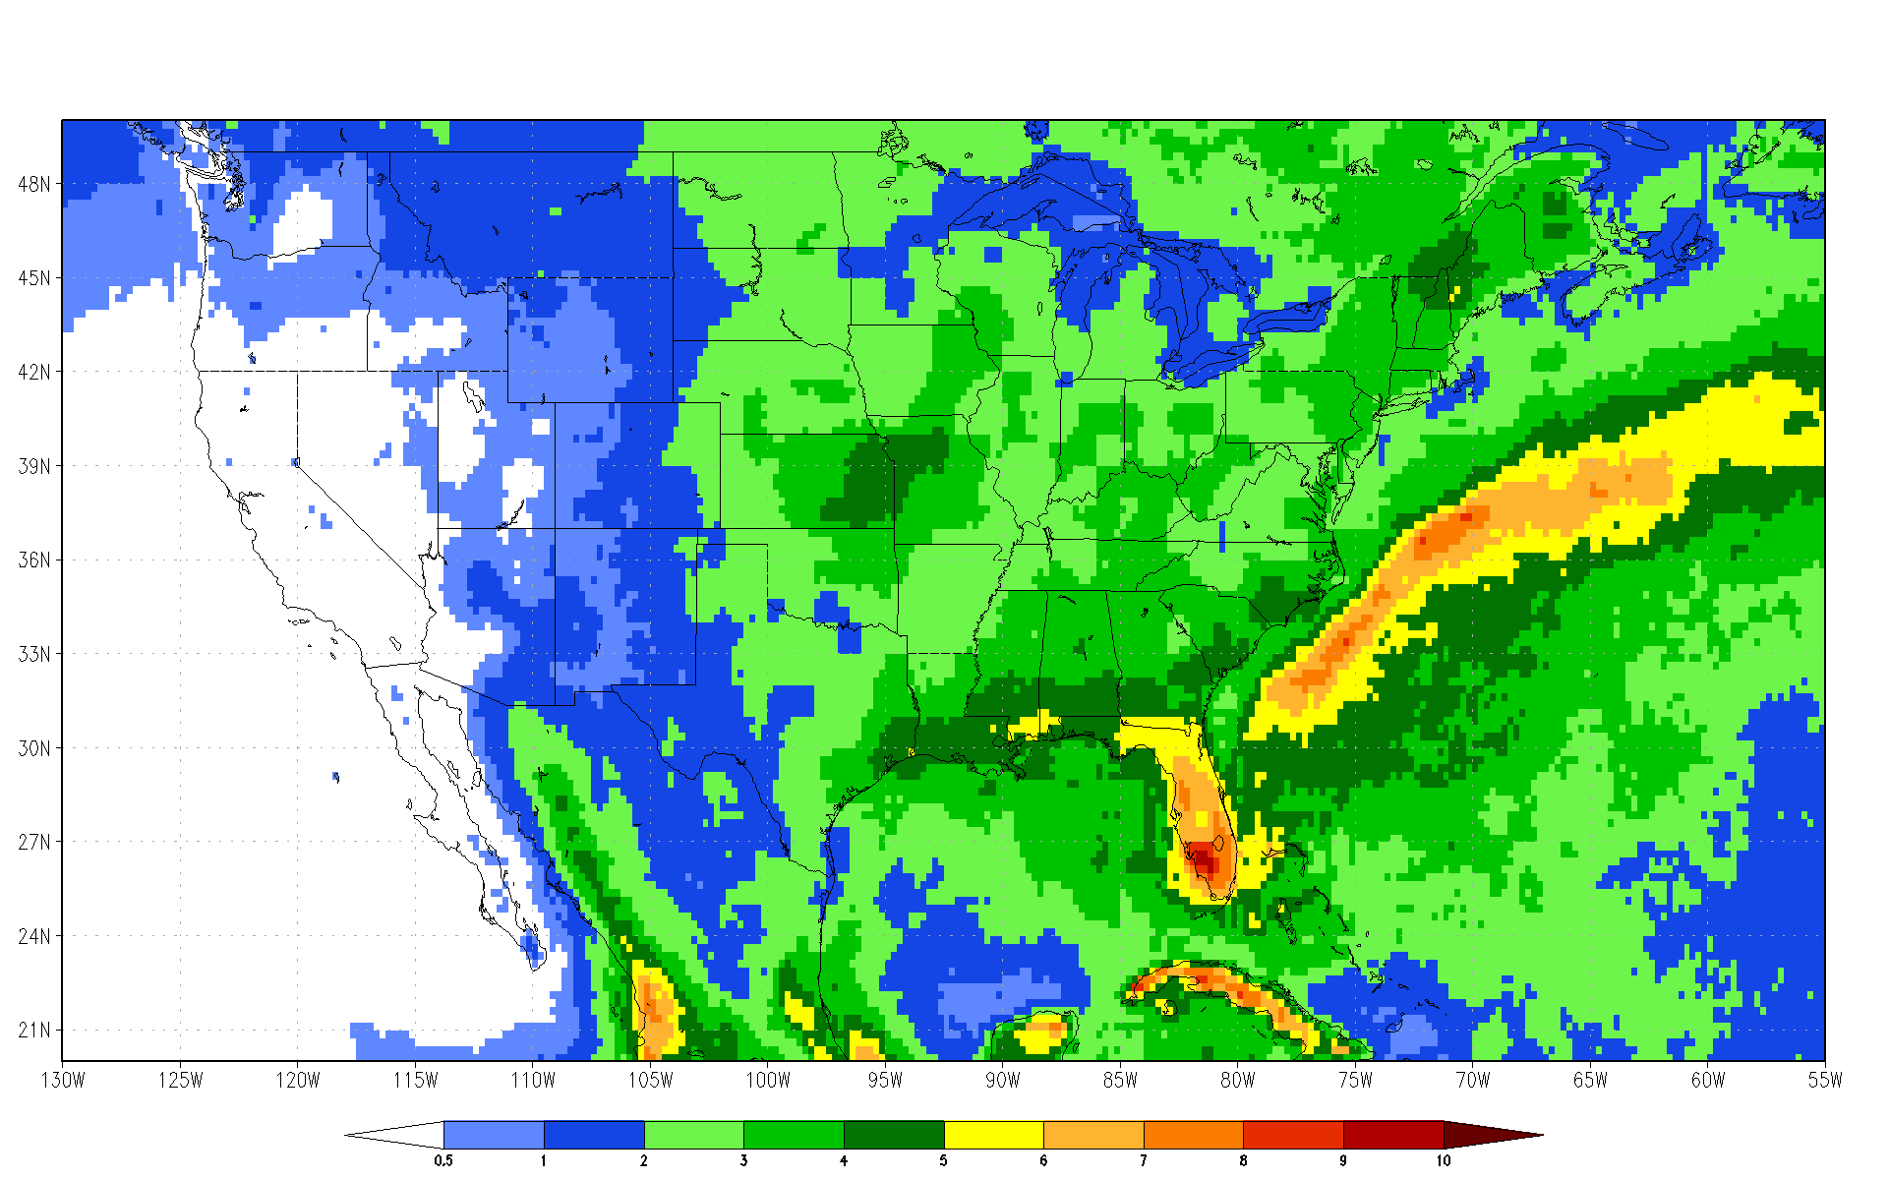
25 km: TRMM JJA Mean Rainfall (8 seasons)
Notes:
Gauge corrected microwave product… still factor of 2-4 coarser than models.

Slide 7
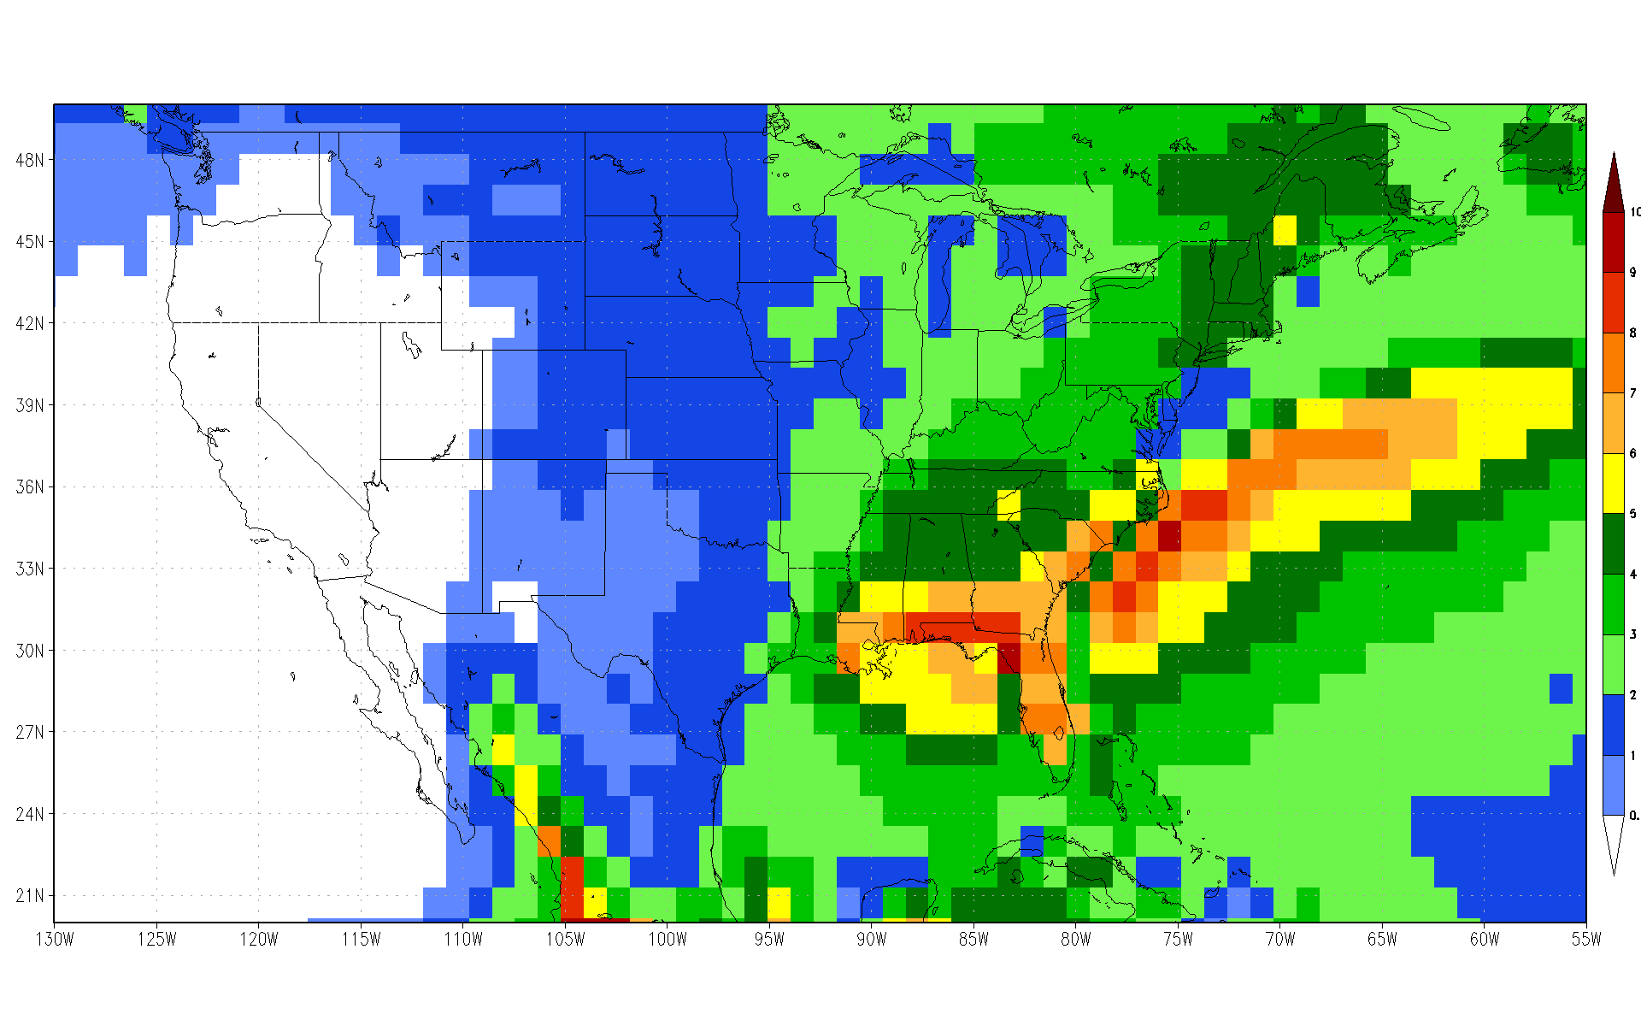
128 km: IFS T159 JJA Mean Rainfall native resolution (8 seasons)
Notes:
For reference, this is the T159 version of the climatology… again, by most standards this is a reasonably high resolution model, but it can only capture gross features.

Slide 8
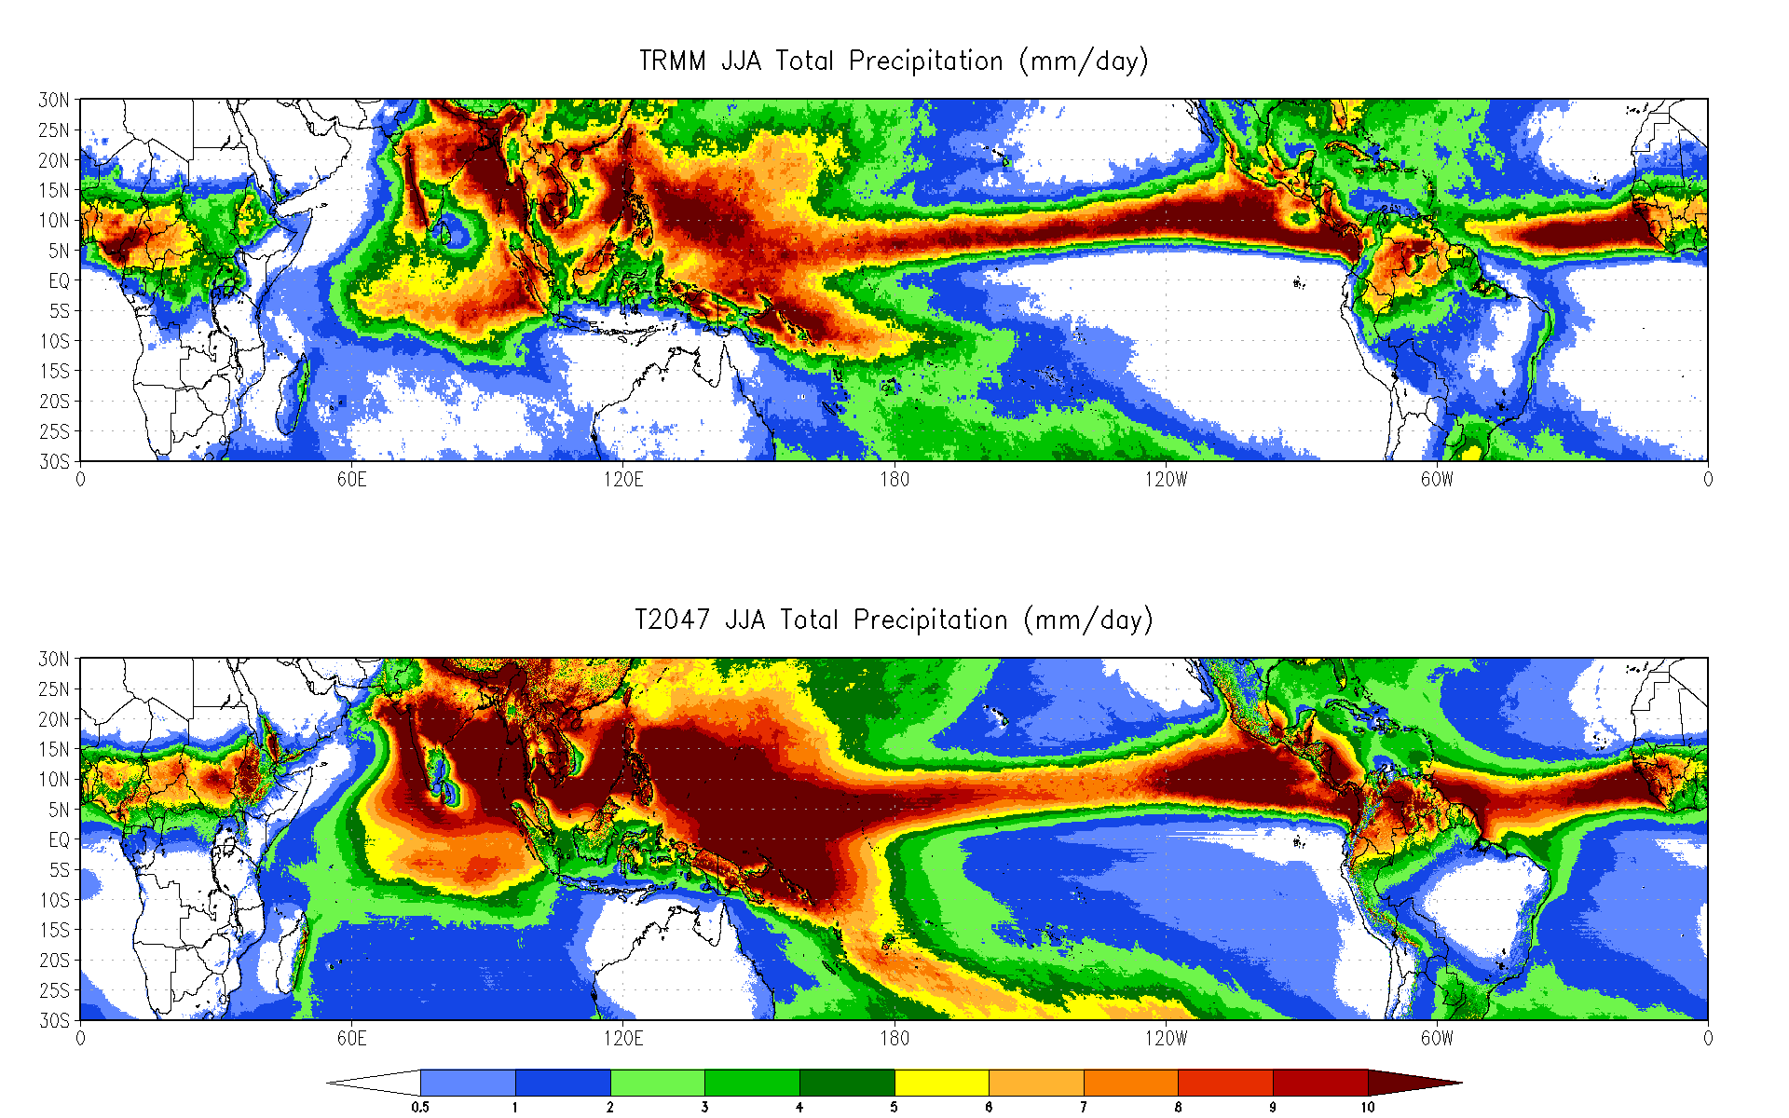
Notes:
Obviously the answer to this is no.

Slide 9
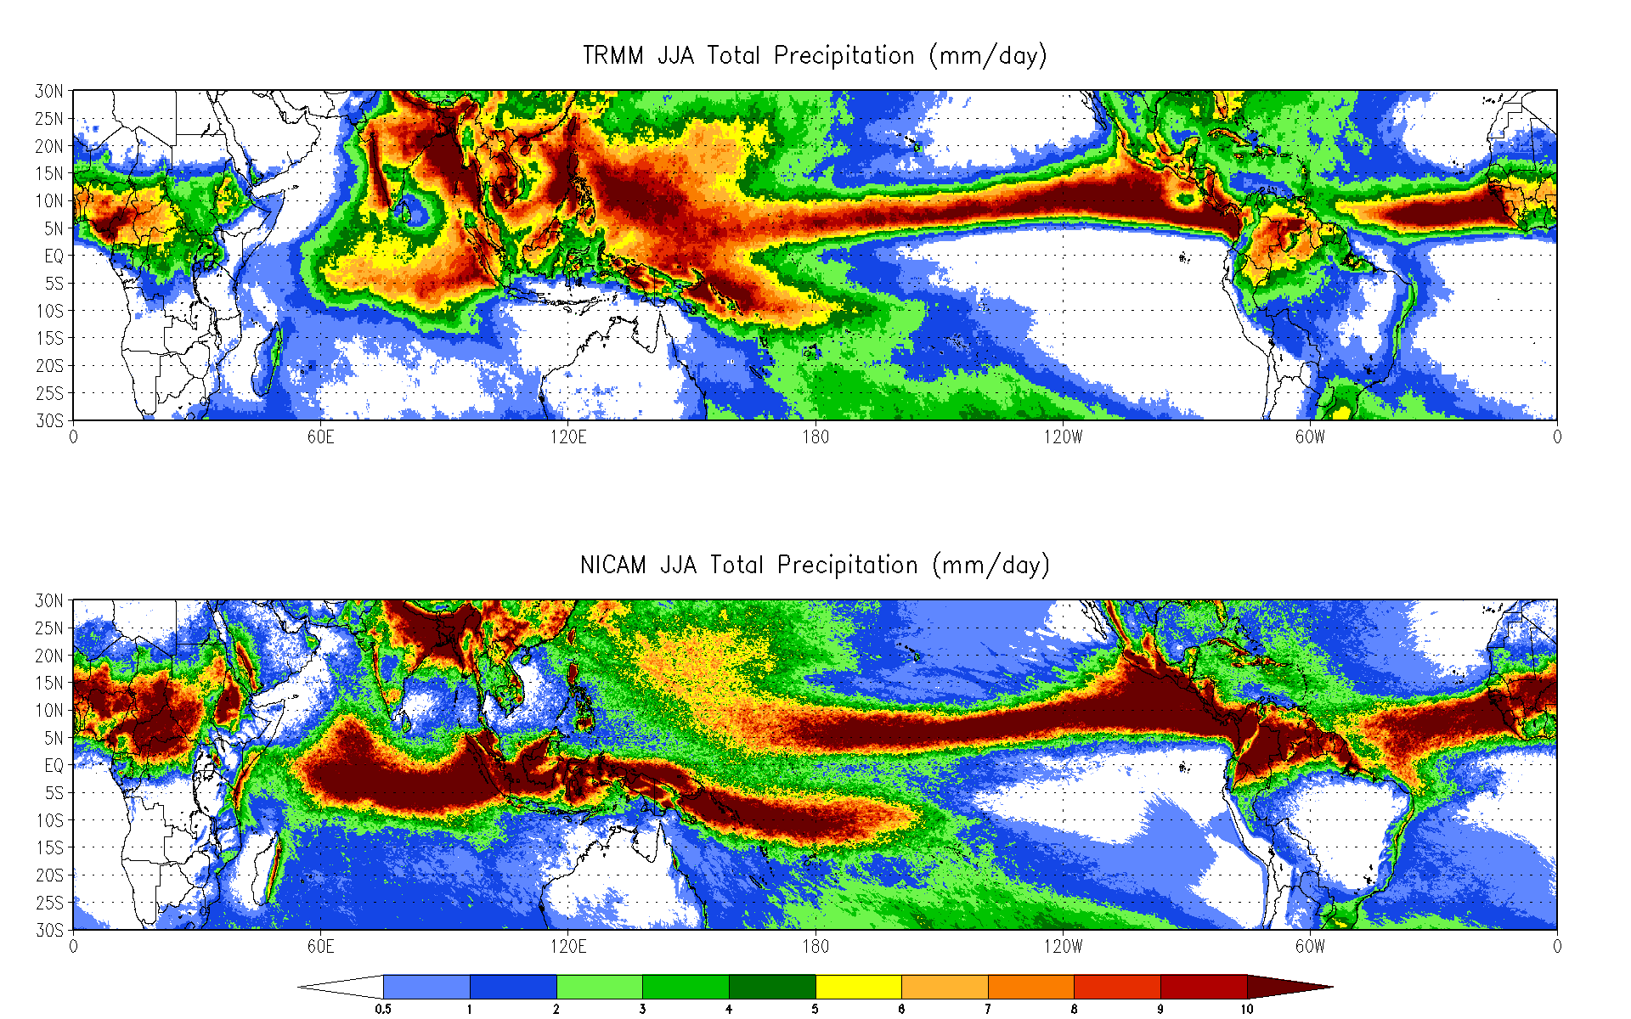
LARGE BIASES REMAIN
Notes:
Very substantial biases remain, particularly in tropical rainfall. IFS and NICAM together seem to bracket the observations, with the systematic bias in NICAM being particularly acute.

Slide 10
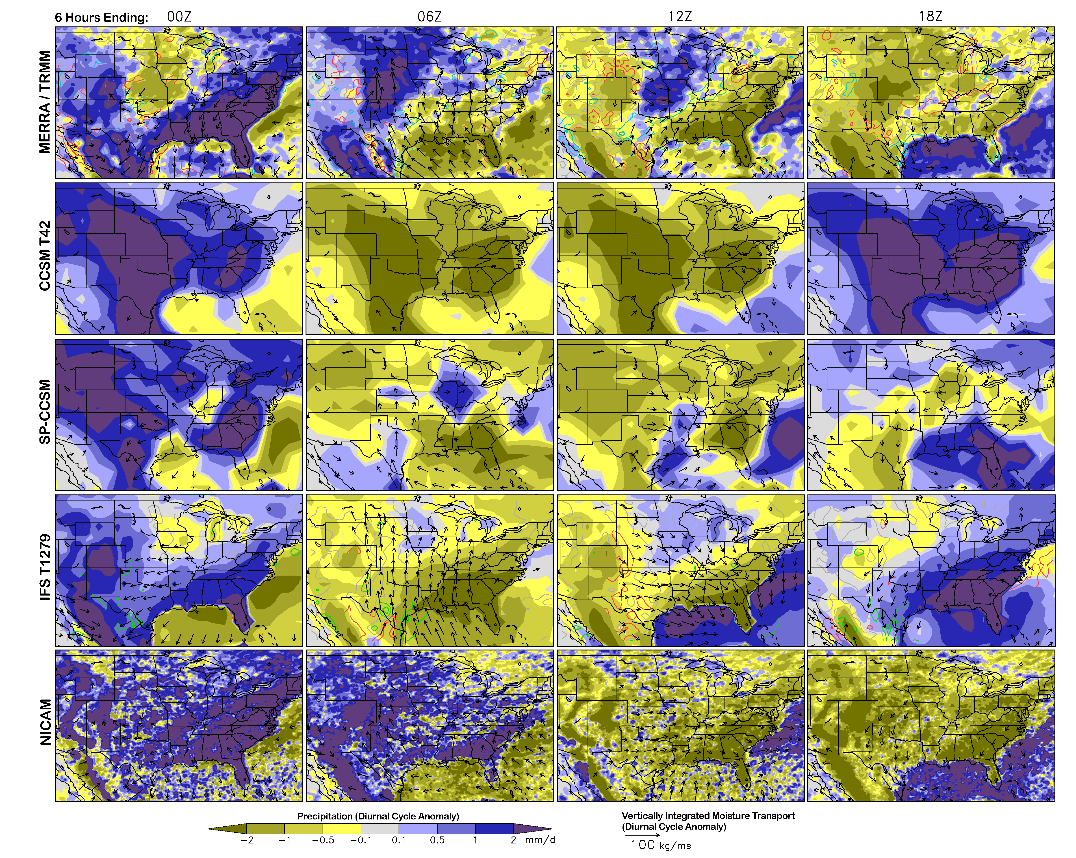
Diurnal Cycle of Precipitation
Large variations between models
Standard GCM is locked to the sun
SP-CCSM captures some aspects of DC.
Hi-res IFS gets N. Plains right for wrong reason, locks to sun over SE US.
NICAM is noisy, but does best job of capturing diurnal cycle structure.

Slide 11
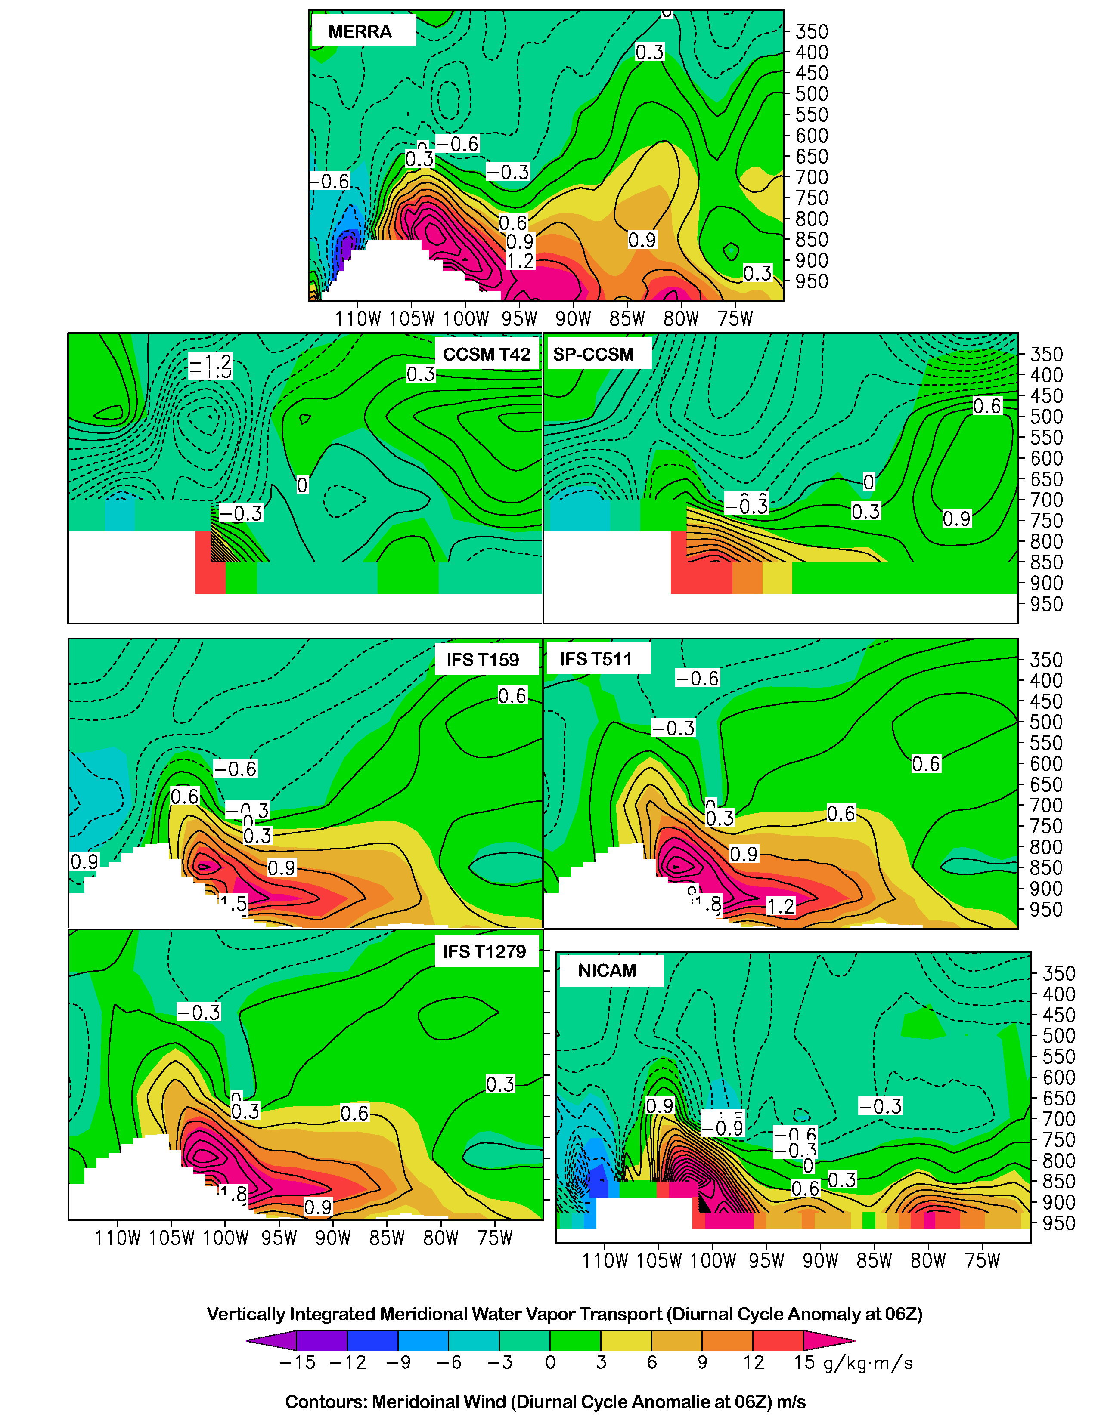
Low Level Jet
Low-level jet is a critical component of Great Plains maximum
All higher resolution models are reasonably accurate
Dynamics do not explain differences in phase and amplitude
Suggests representation of convection is responsible

Slide 12
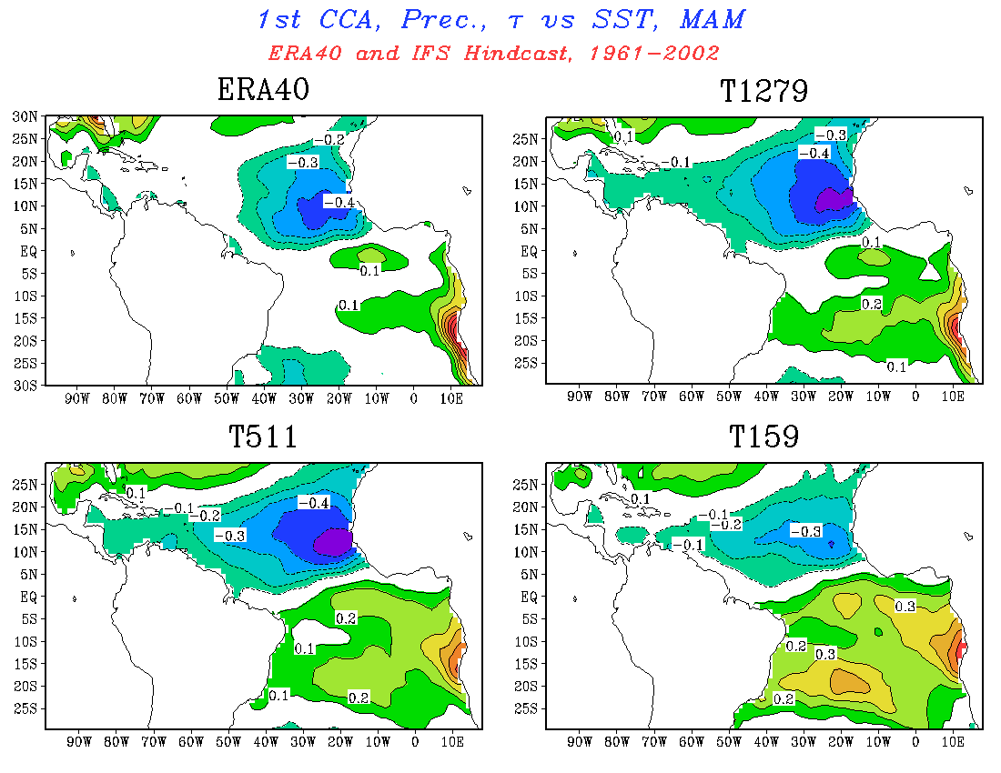
Atmosphere-Ocean Interactions
All data at T159
Modest improvement with resolution
Notes:
Switching gears a bit, we are moving from precip to air-se interactions… CCA between

Slide 13
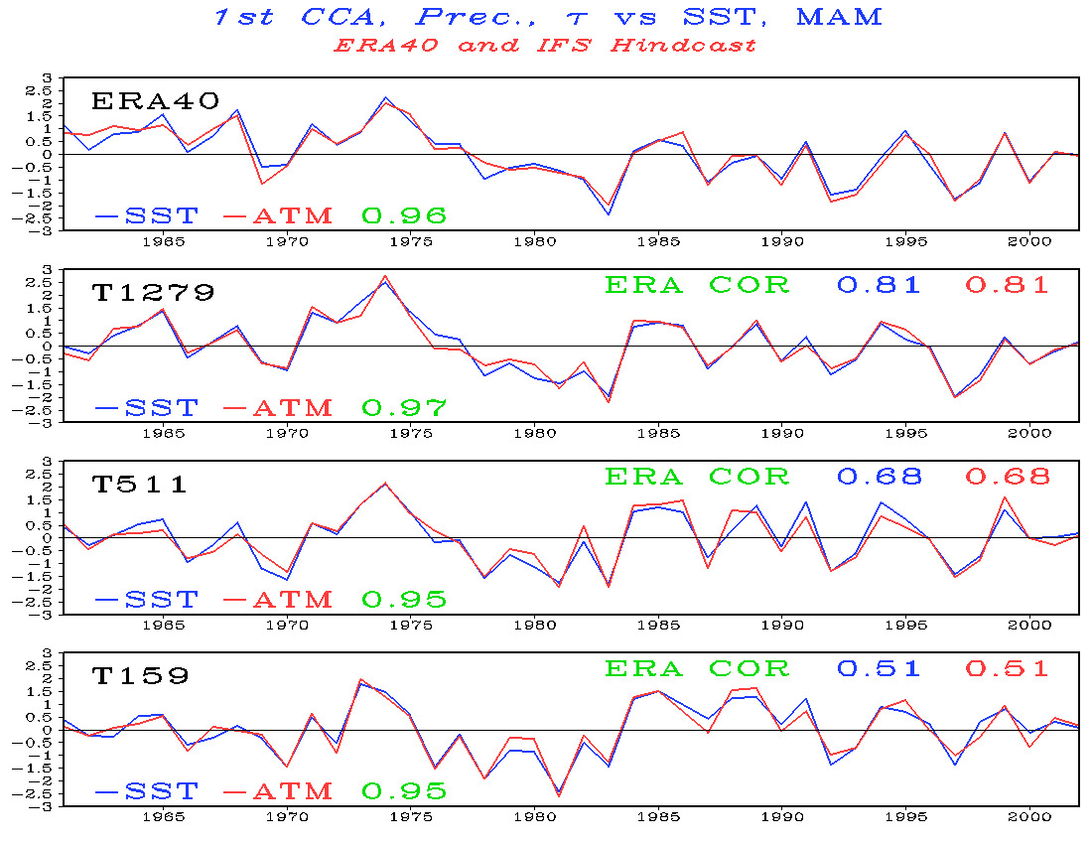
Clear improvement in representing interannual variability

Slide 14
AMIP and Timelice Experiments
AMIP Experiment
1961-2007, observed boundary conditions
Timeslice Experiment
SST/Sea ice anomaly added to AMIP boundary conditions
Anomaly taken from CCSM3.0 2xCO₂ IPCC integration
Same length of integration, ‘2071-2117’
Annual means analyzed here
Large seasonal variations in forcing anomaly
New ice-free regions during DJF
Notes:
Previously tthis type of animation represented the majority of high resolution analysis, certainly for NICAM. Just not enough data. To review what we have…

Slide 15
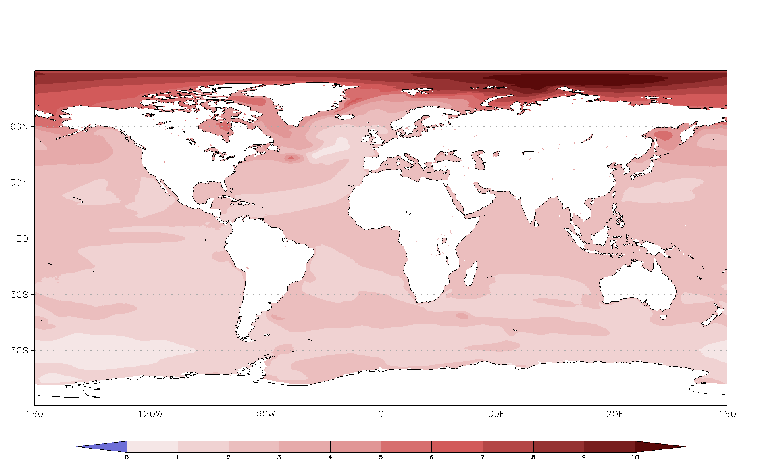
Annual Mean Time Slice Forcing
(CMIP3 CCSM3 2xCO2 - Control

Slide 16
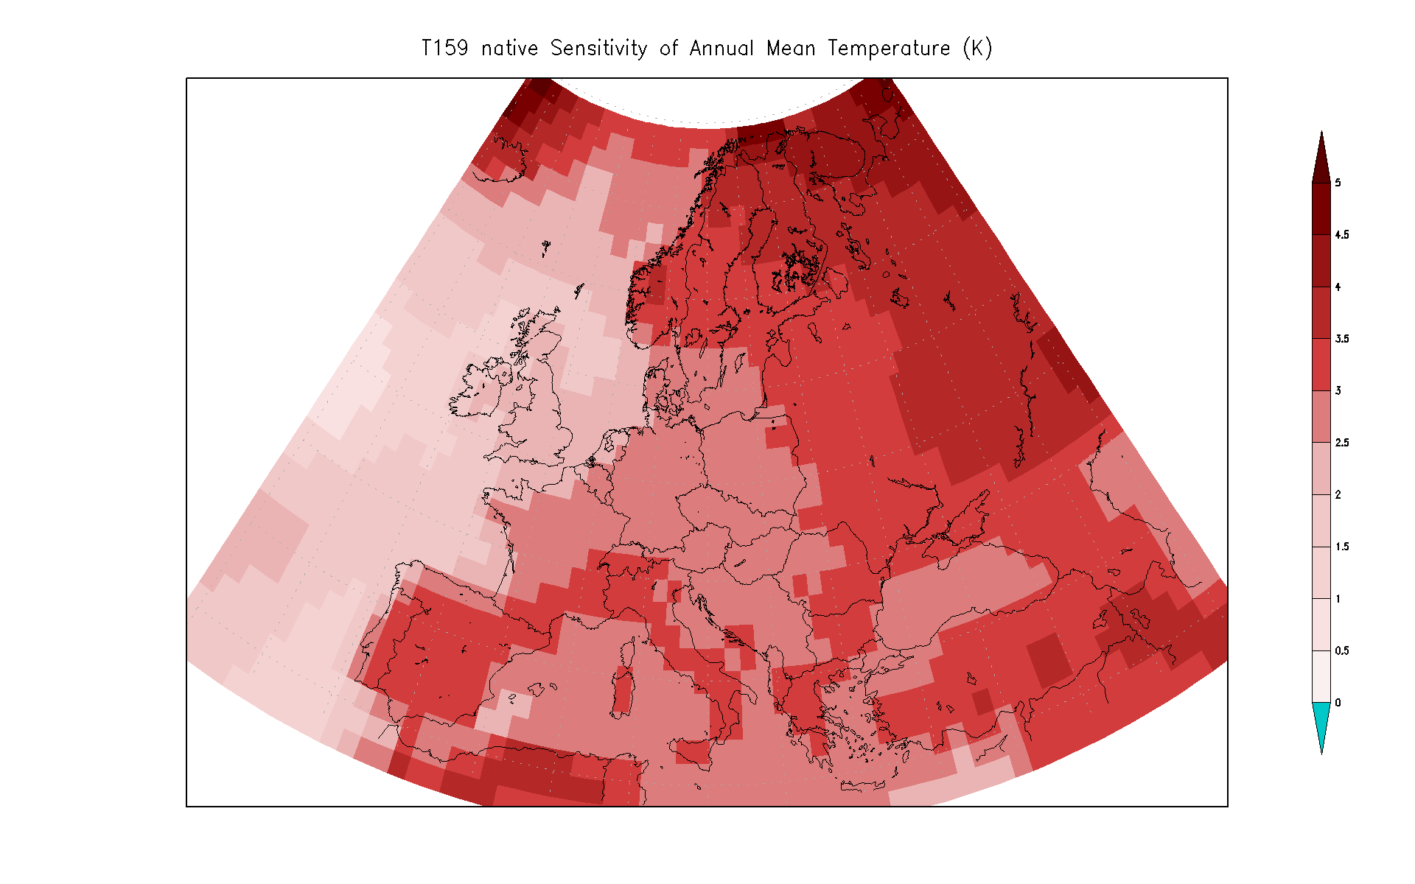

Slide 17
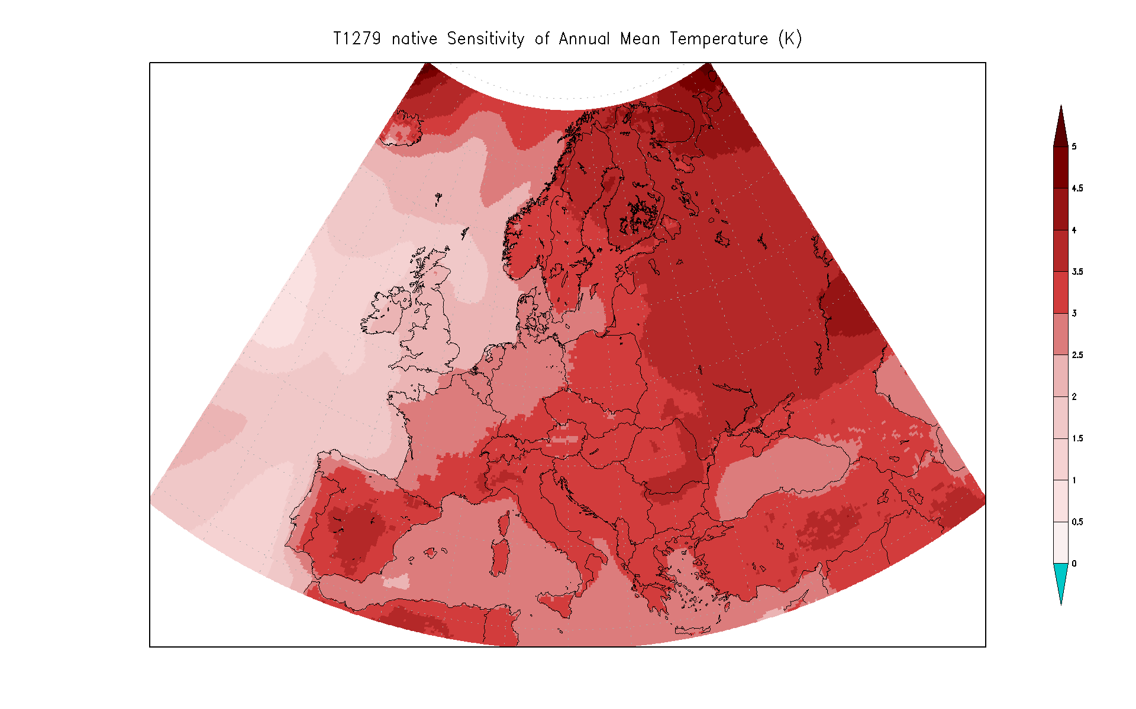

Slide 18
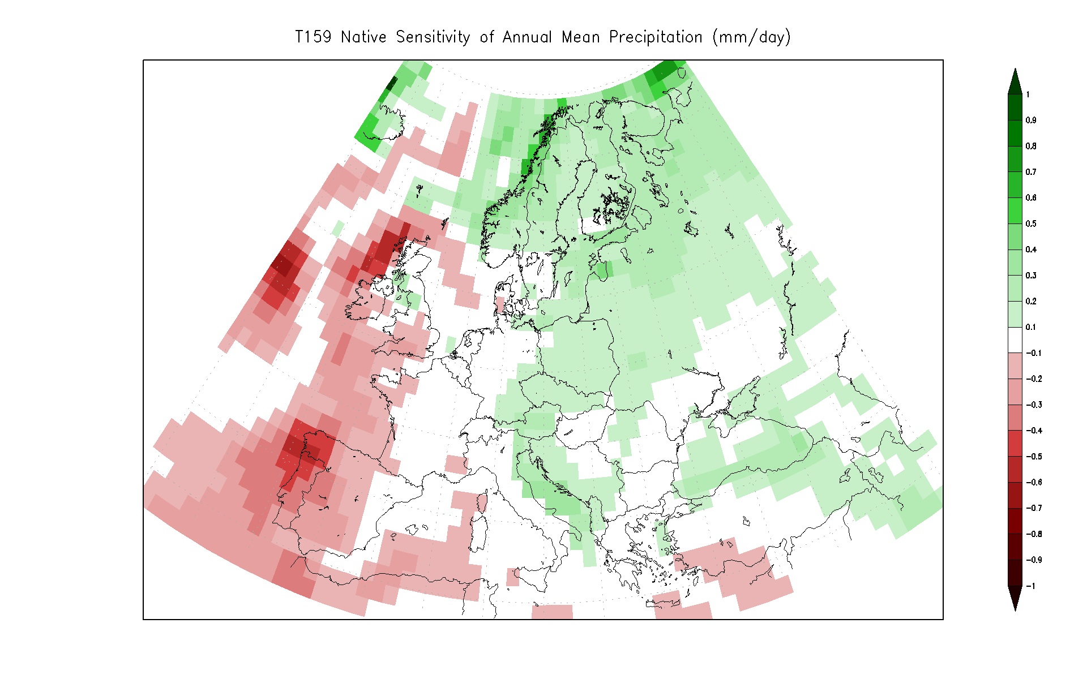
Annual Mean Time Slice Forcing
(CMIP3 CCSM3 2xCO2 - Control

Slide 19
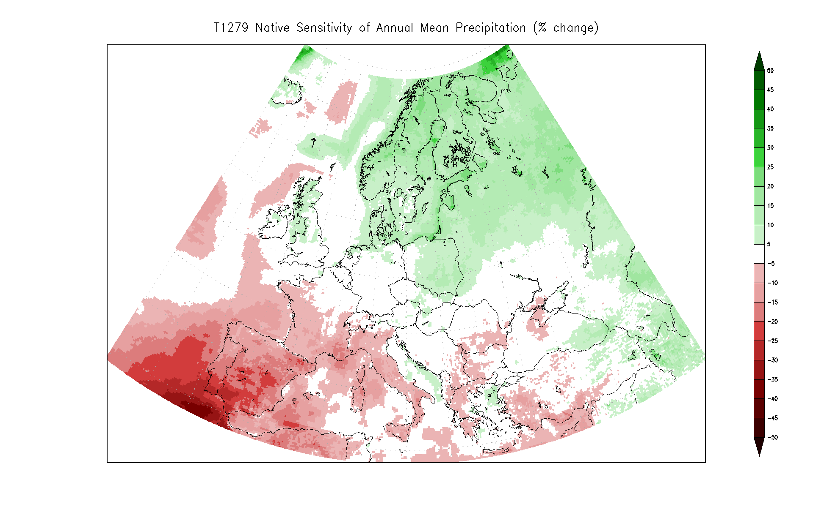
Annual Mean Time Slice Forcing
(CMIP3 CCSM3 2xCO2 - Control

Slide 20
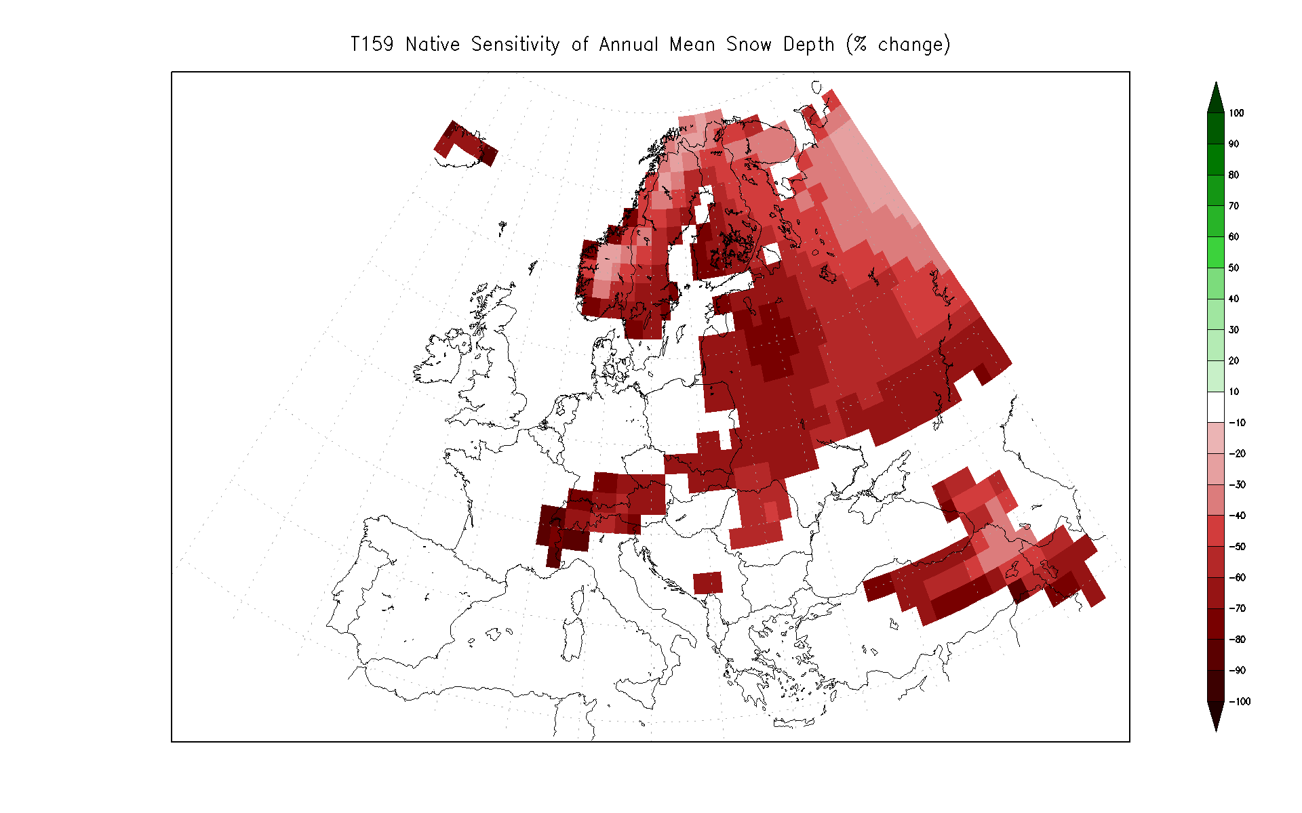
Annual Mean Time Slice Forcing
(CMIP3 CCSM3 2xCO2 - Control

Slide 21
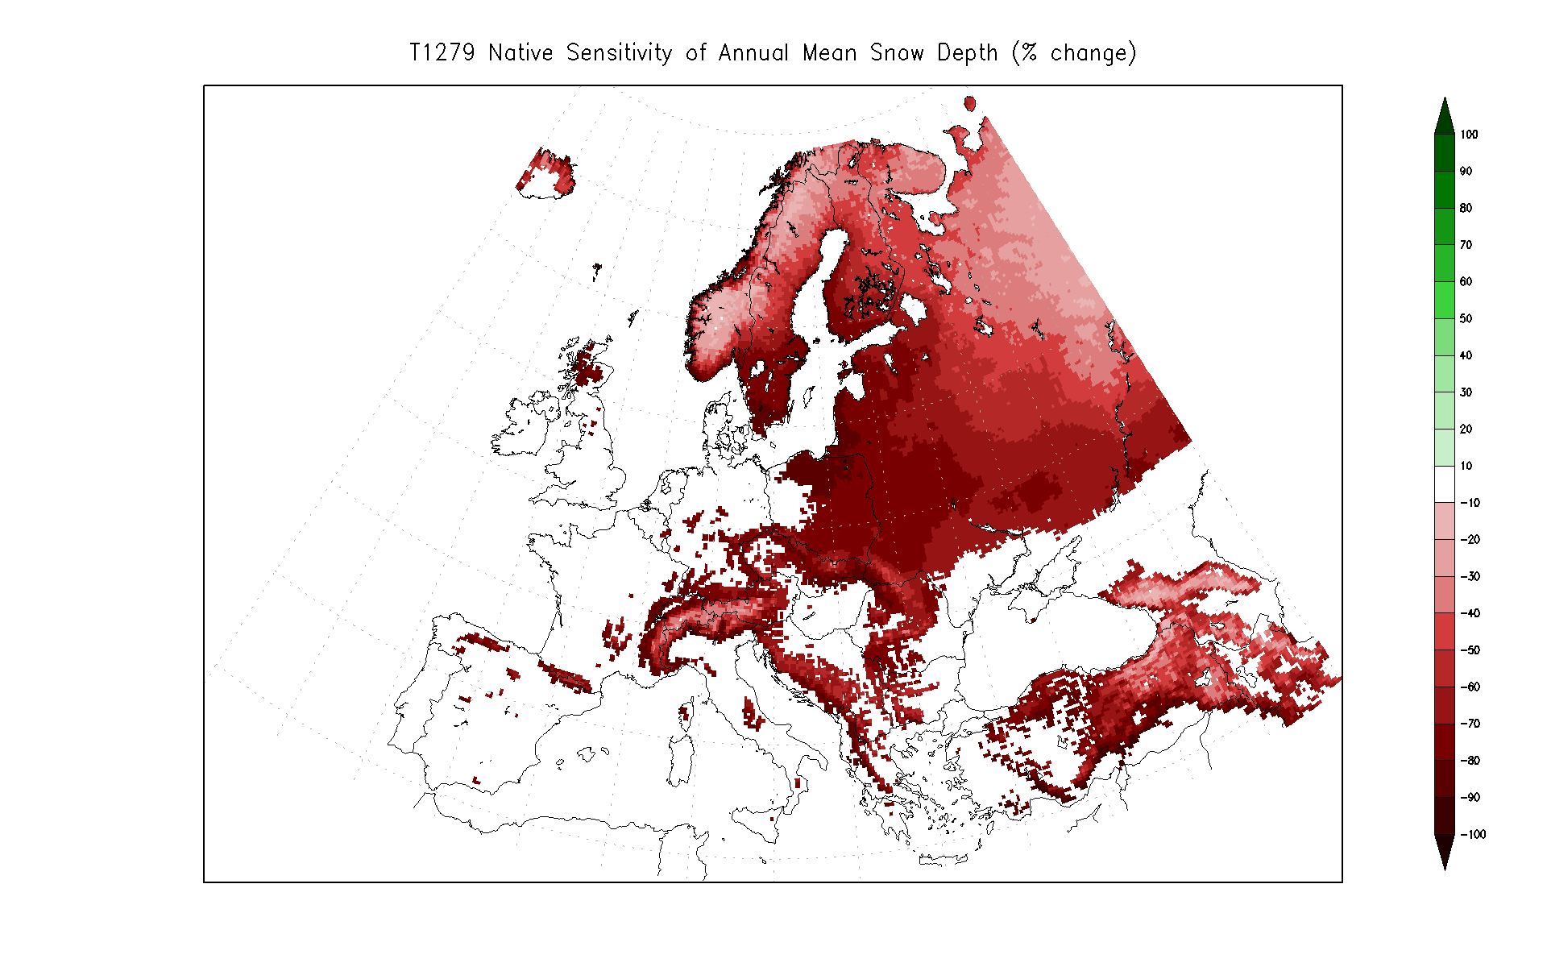

Slide 22
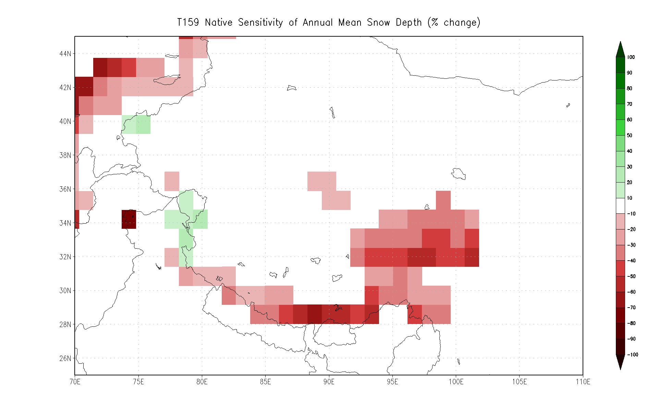

Slide 23
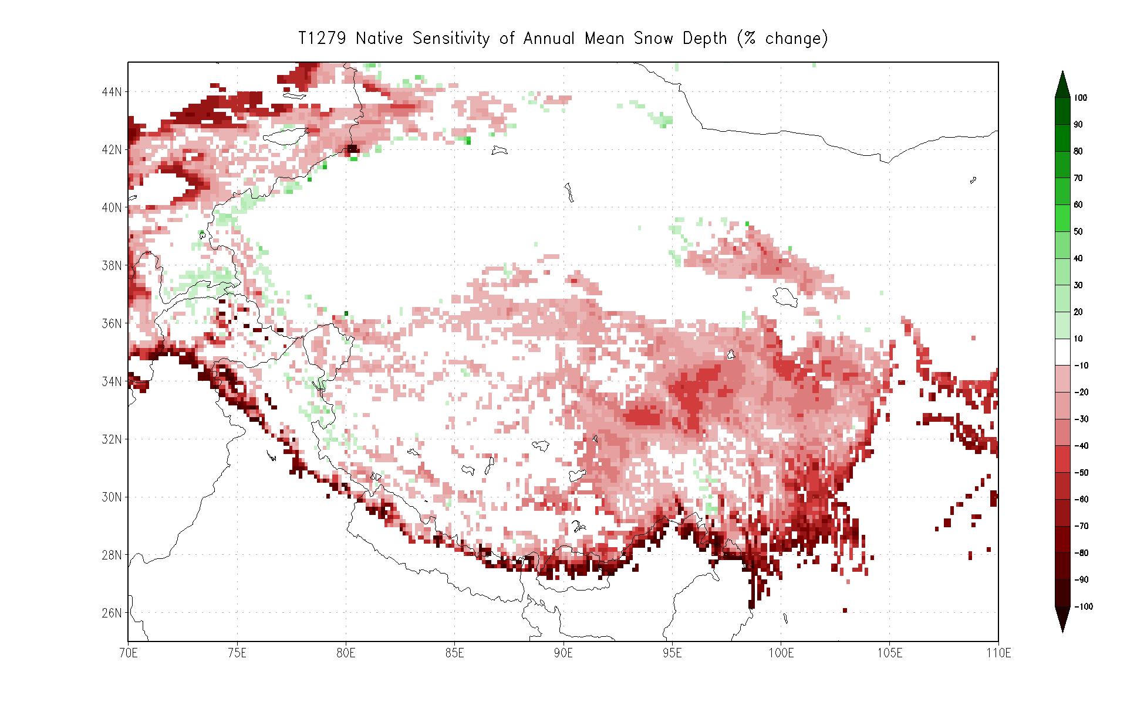

Slide 24
Summary
Unique data set and analysis opportunities
Small fraction at COLA
Full catalog in archive at NICS
Data to become available to the community
Impact of Resolution
Orographic features clearly improved
Diurnal cycle can be well-represented
Plateau in benefit of resolution with parameterized convection?
Some improvements seen with non-parameterized convection
Large tropical biases remain
More than increased resolution needed

Slide 25
Summary (cont’d)
Impact of Resolution on Large Scales
Improved blocking and synoptic statistics
Atlantic air-sea coupling
Climate Change
Increased warming seen over Europe with higher resolution
Dramatically improved representation of orographic precipitation, snow depth
Sensitivity to choice of forcing anomaly?

