Slide 1
Extra-tropical Cyclones in Recent Re-Analyses
Kevin Hodges
Lennart Bengtsson and Robert Lee

Slide 2
Motivation
Extra-tropical cyclones:-
Important components of the general circulation.
How should they be verified for distribution and properties?
Observations are highly inhomogeneous.
No long term observational record.
Re-analyses:-
Best available, 4D, homogeneous data sets constrained by observations.
What are the uncertainties?

Slide 3
New Re-Analyses
ERA-Interim (ECMWF)
T255L60 (~80km) spectral, 4D Var., 1989-2009.
Modern Era Retrospective Re-Analysis (MERRA)
0.5⁰x0.67⁰L72(~74km) finite volume, Grid-point Statistical Interpolation (GSI, 3D Var.), 1979-2009.
Japanese 25 Year Re-Analysis (JRA25)
T106L40 (~125km) spectral, 3D Var., 1979-2009.
NCEP Coupled Re-analysis
T382L64 (~38km), GSI, 1979-2009.
20th Century Re-Analysis
Surface only observations, 1891-2008, ensemble kalmen filter, T63.

Slide 4
Comparison Methodology
Identify and track cyclones – synoptic.
MSLP – T63.
ξ₈₅₀ – T42.
Compare using:-
INTERIM as base (1989-2006).
Spatial statistics.
Intensity pdf’s.
Cyclone matching.
Composites.

Slide 5
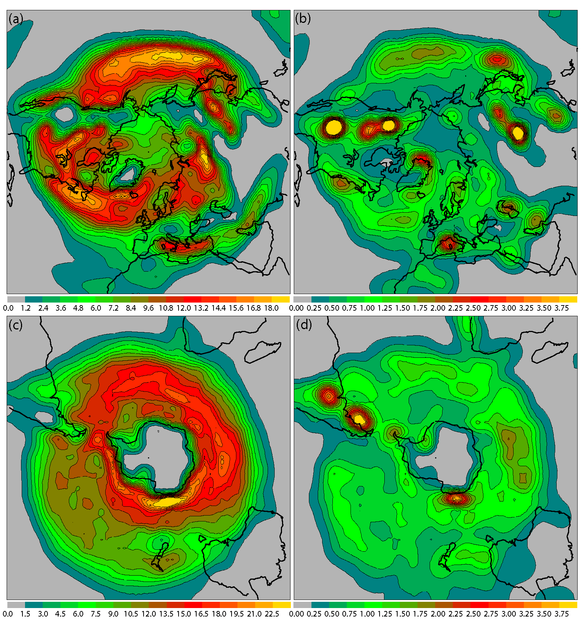
Spatial Statistics
NH, DJF
SH, JJA
Track Density
Genesis Density

Slide 6
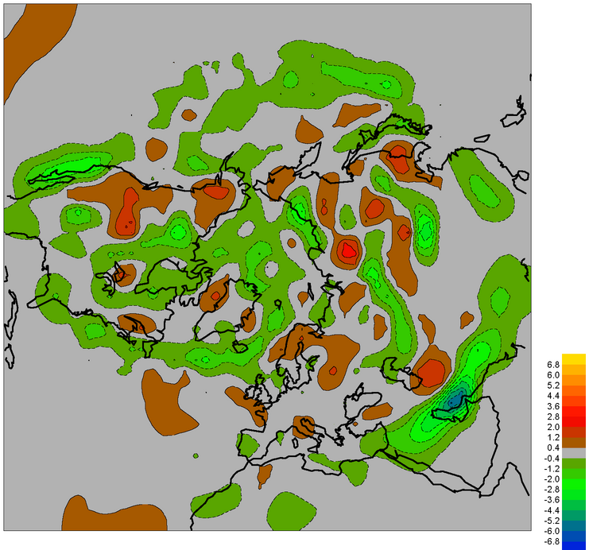
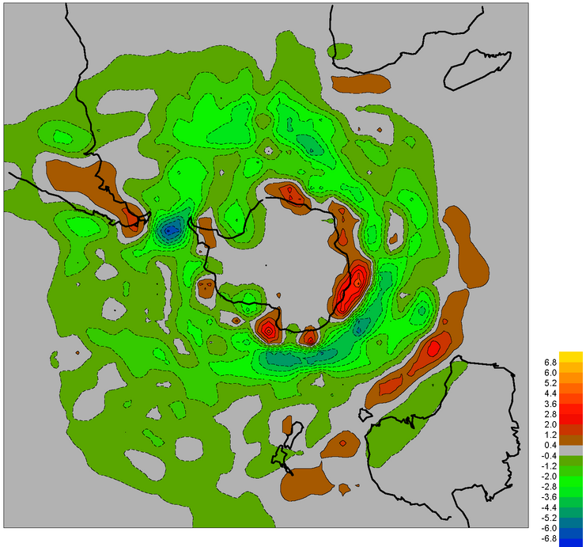
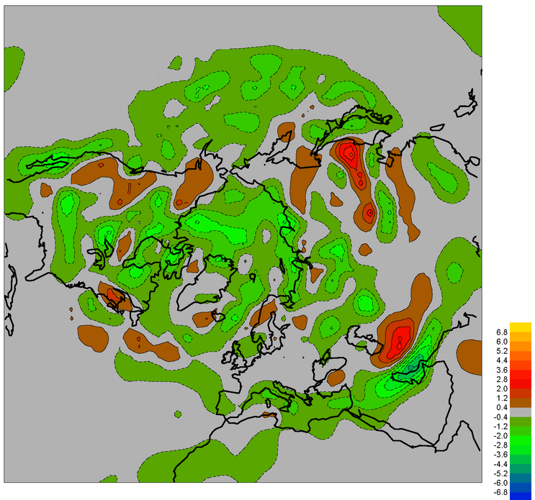
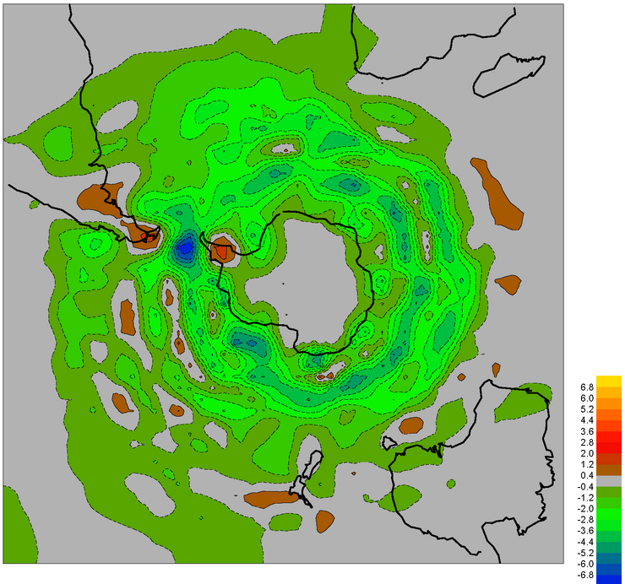
Older Re-analyses
JRA25-ERA40
NCEP-ERA40
NH
SH
Track Density Differences (1979-2002)

Slide 7
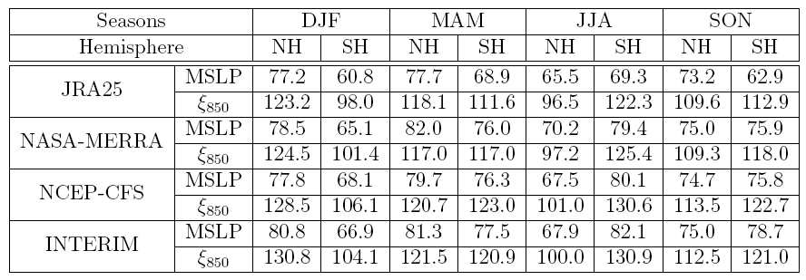
General Results
Number per month

Slide 8
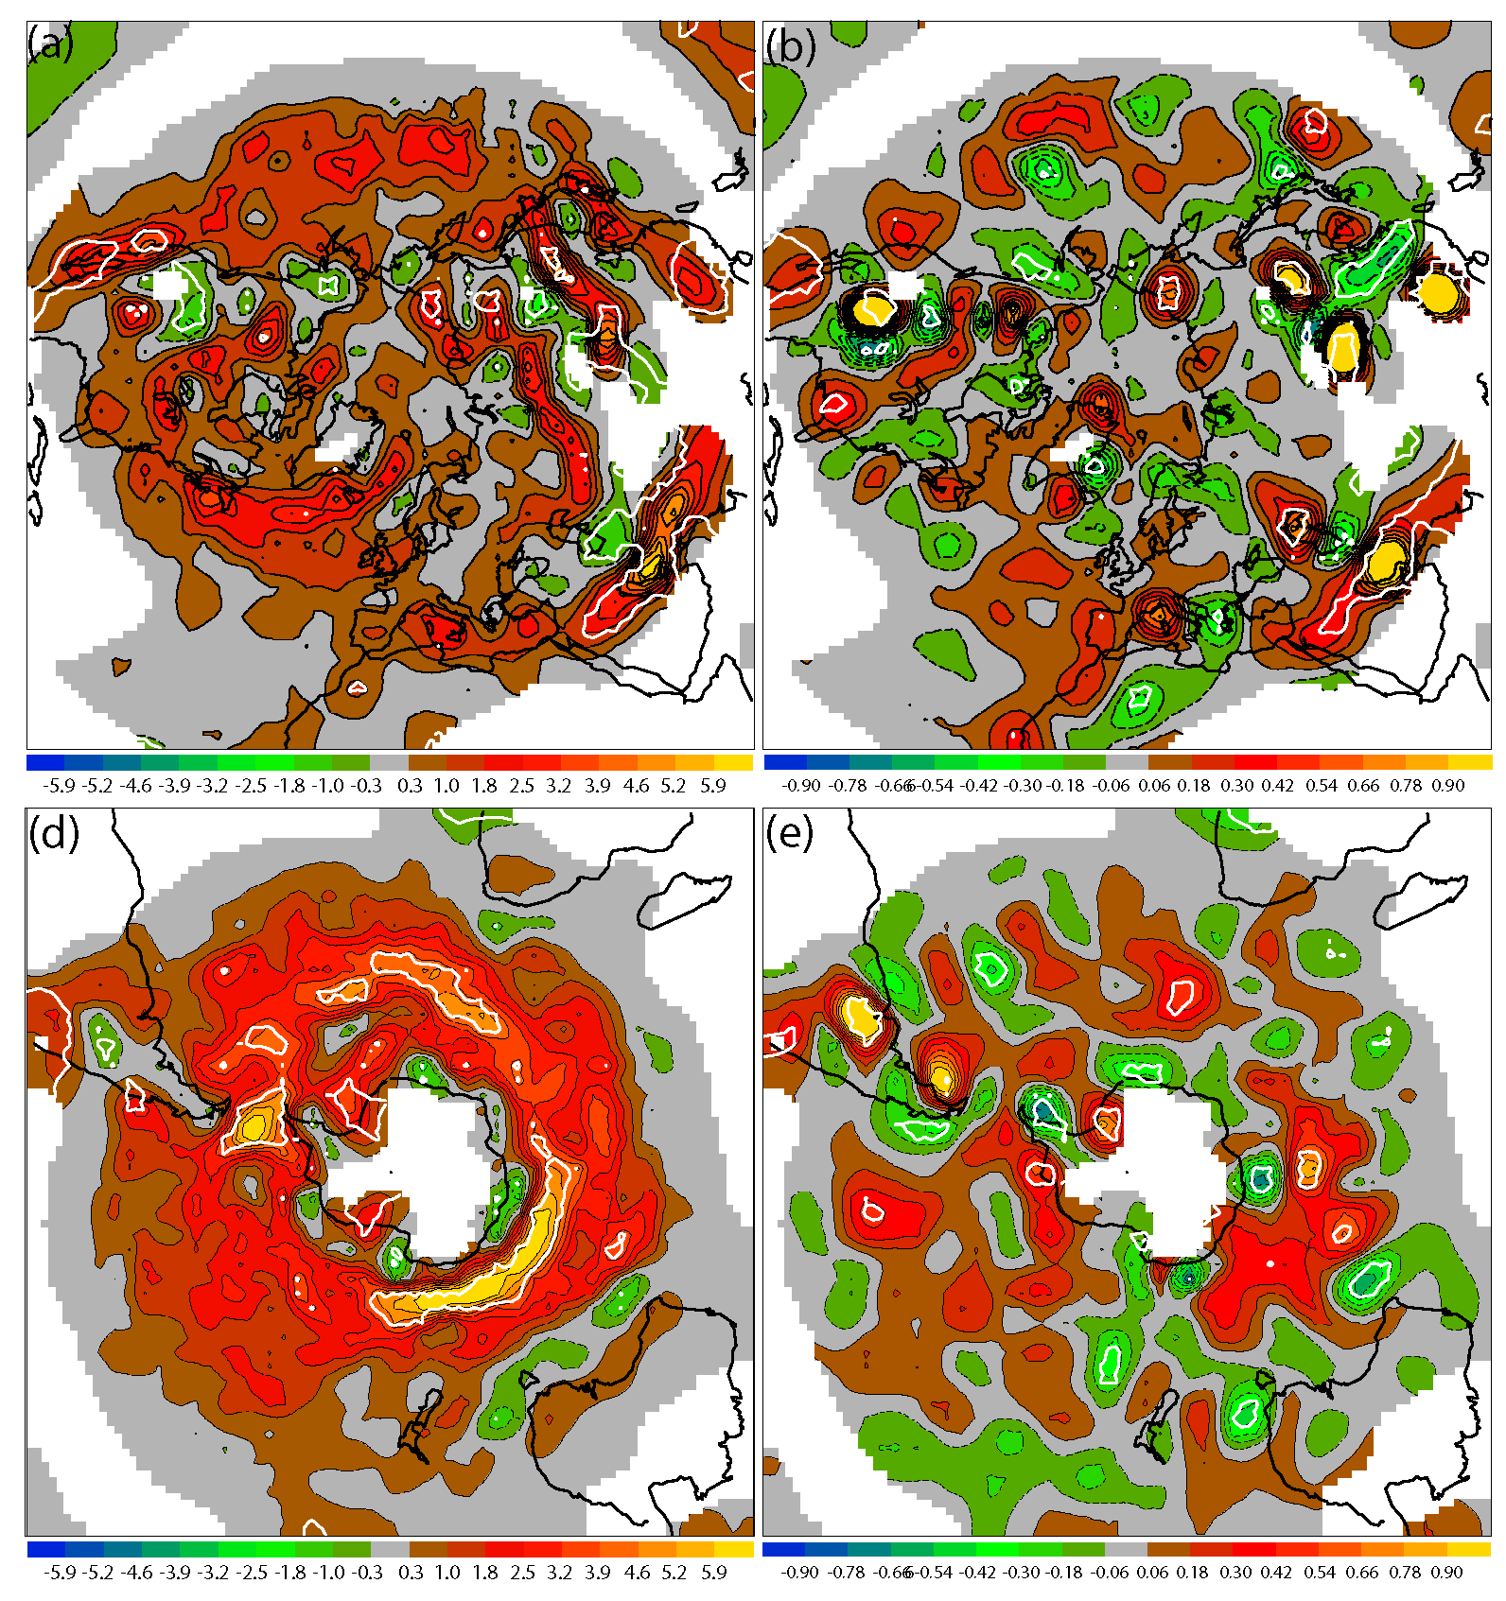
INTERIM-JRA25
NH, DJF
SH, JJA
Track Density
Genesis Density

Slide 9
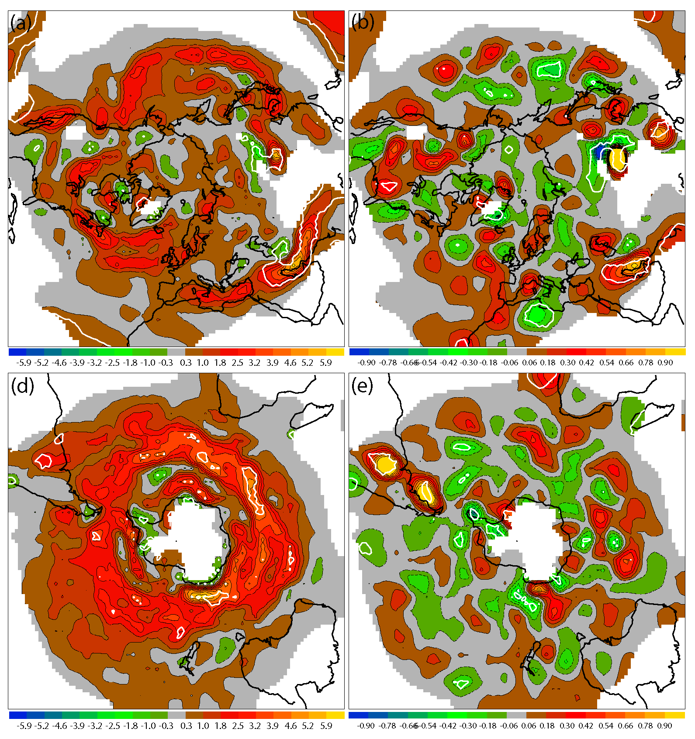
INTERIM-MERRA
NH, DJF
SH, JJA
Track Density
Genesis Density

Slide 10
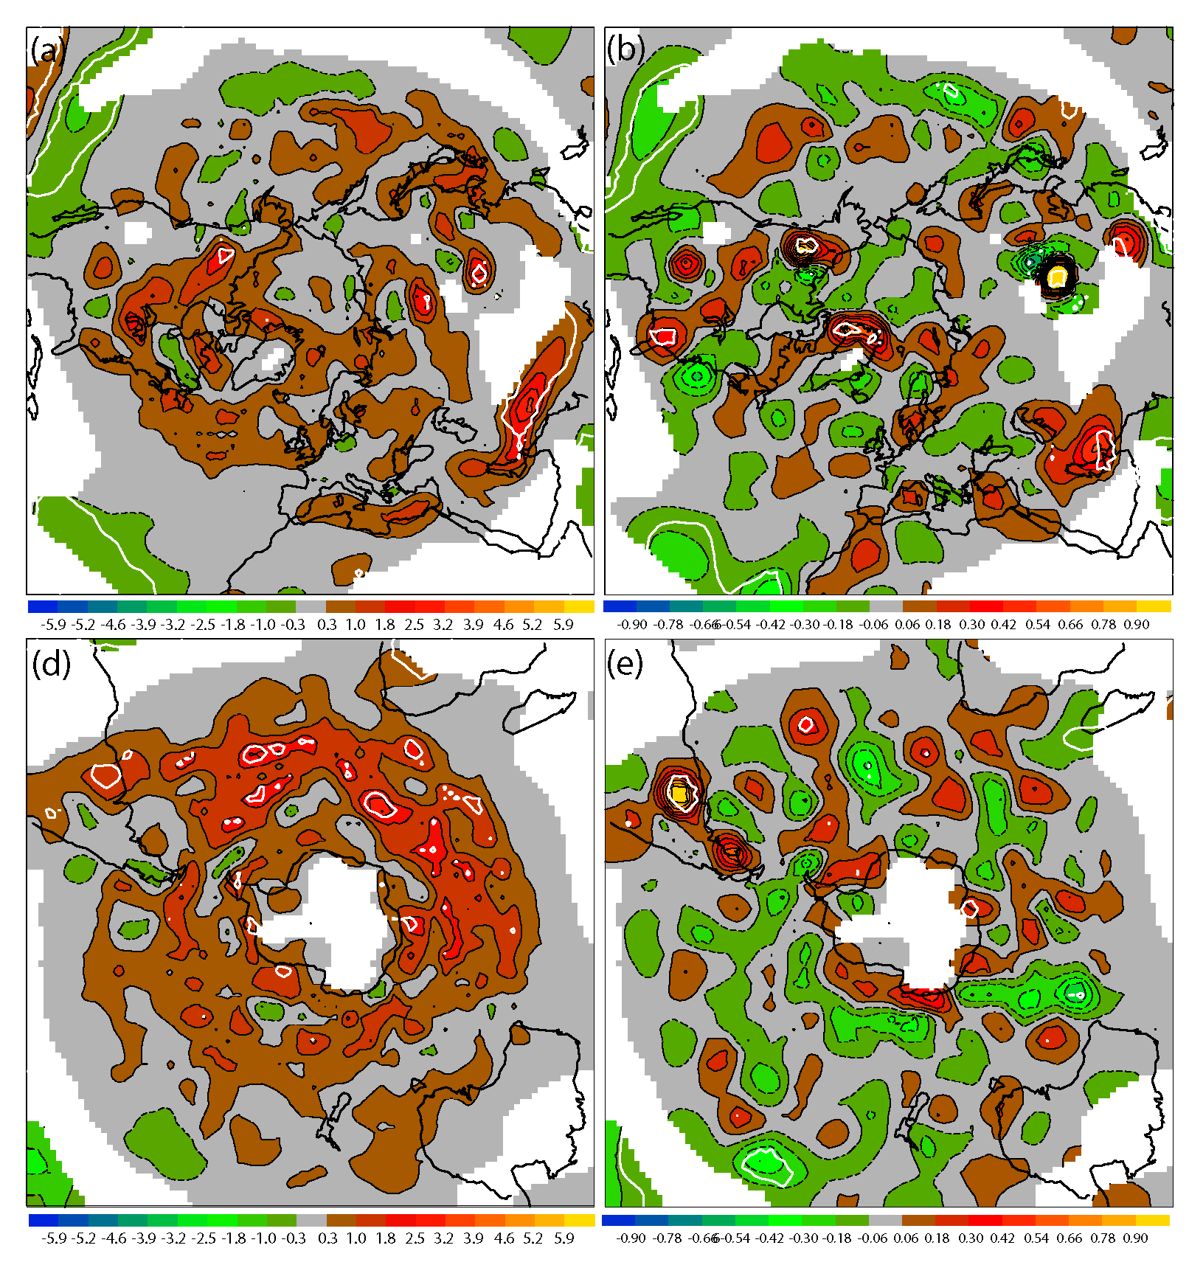
INTERIM-NCEP
NH, DJF
SH, JJA
Track Density
Genesis Density

Slide 11
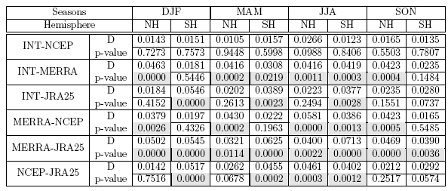
Intensity-MSLP
NH, DJF
SH, JJA

Slide 12
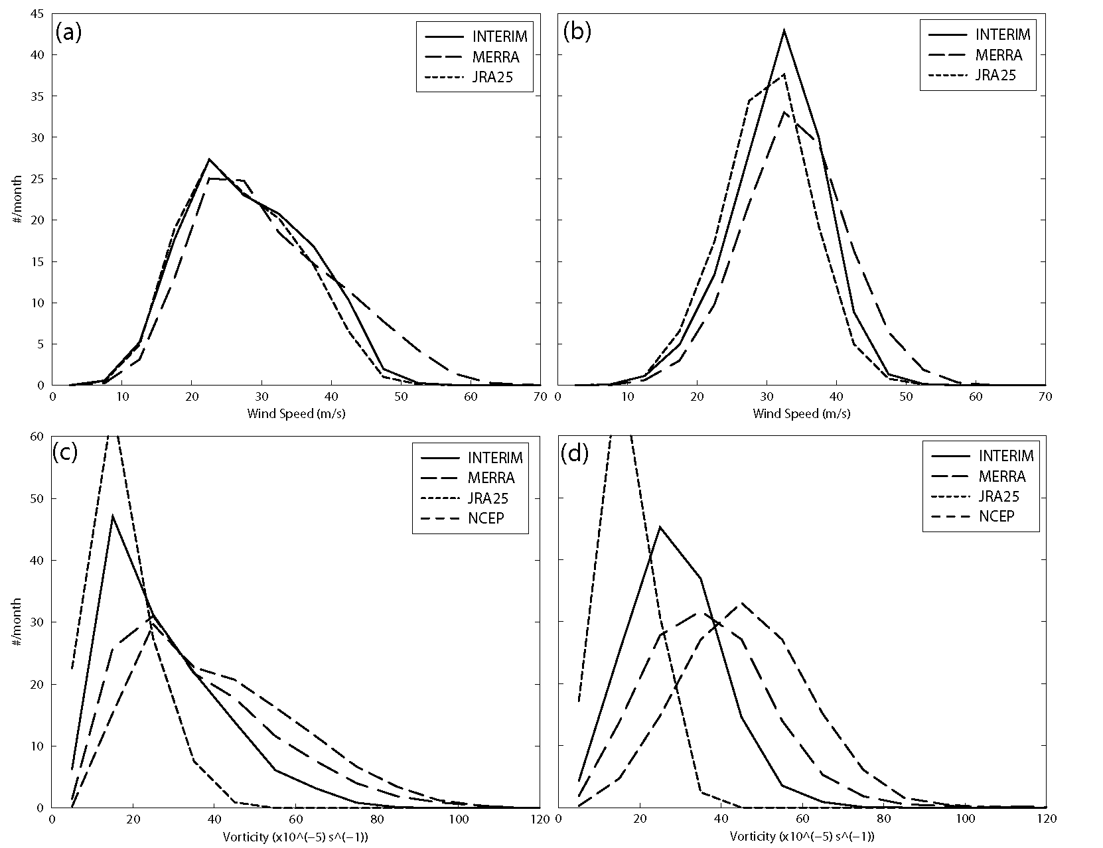
Intensity Winds, Vorticity
925hPa Winds
850hPa Vorticity
NH
SH

Slide 13
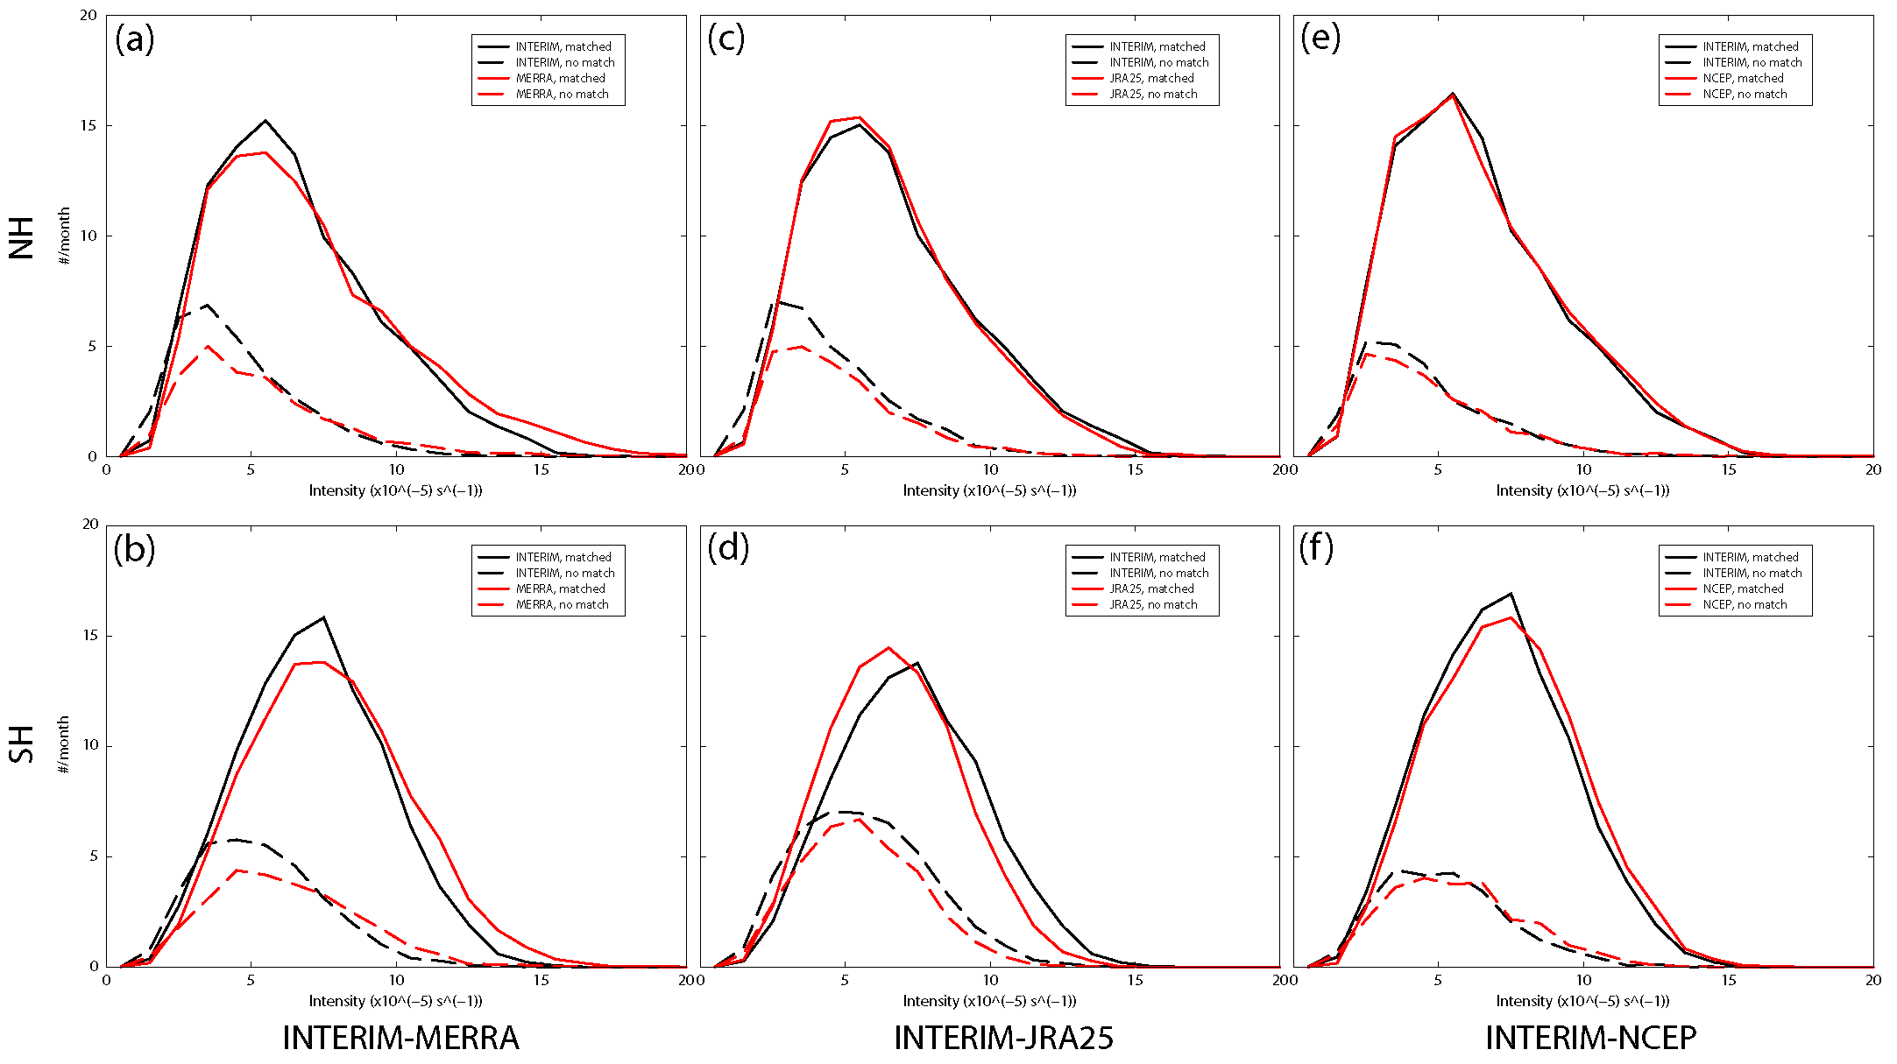
Cyclone Matching
Vorticity,T42 Intensities
Mean seperation ≤ 4⁰
Time overlap > 60% points

Slide 14
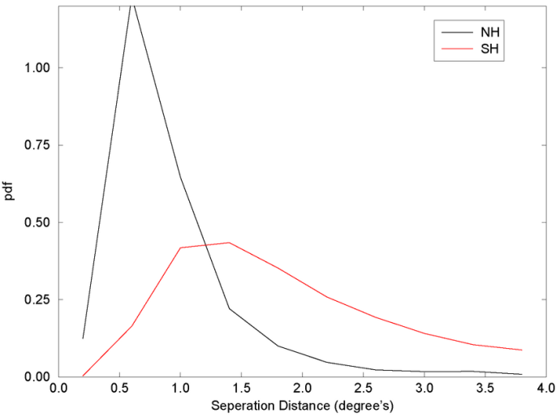
Separation, Vorticity
NH DJF
SH JJA
JRA25-ERA40, 1979-2002.

Slide 15
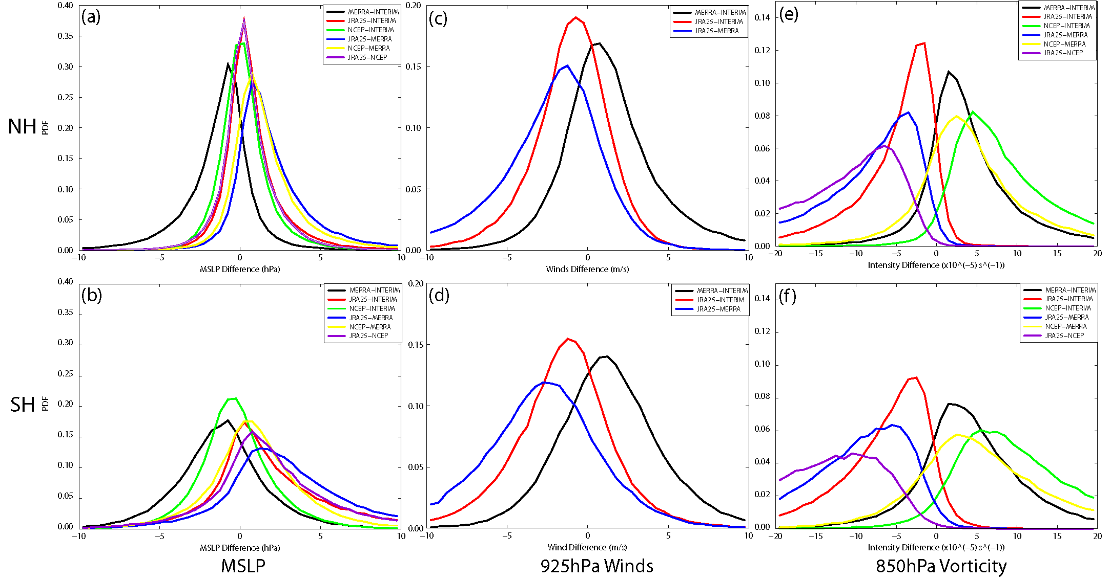
Intensity

Slide 16
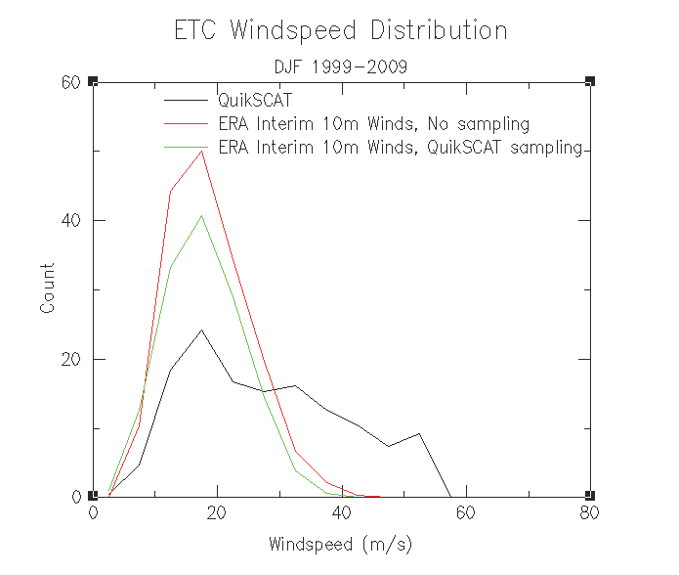
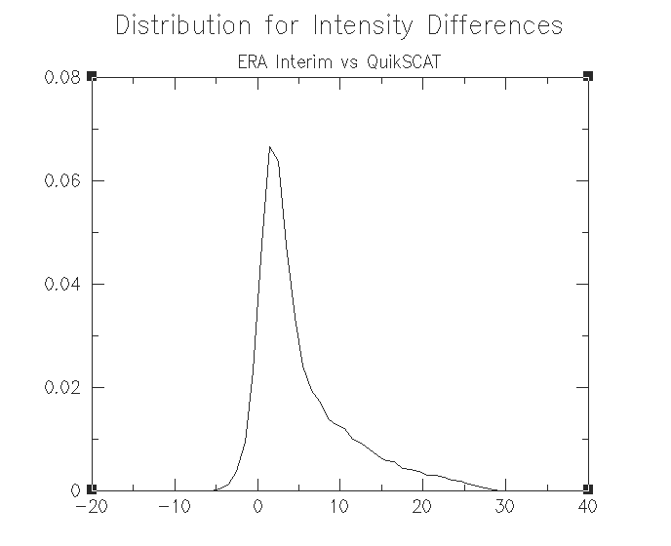
Observations-Quickscat
Max. Intensities
Instantaneous Differences

Slide 17
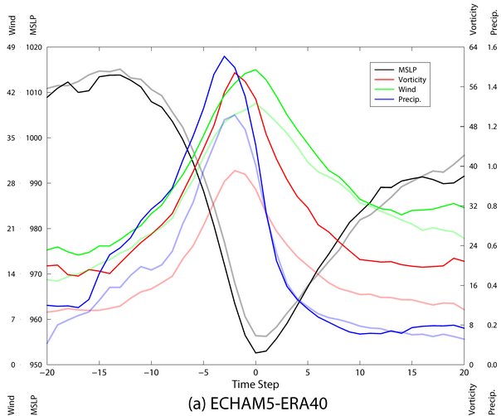
Lifecycles

Slide 18
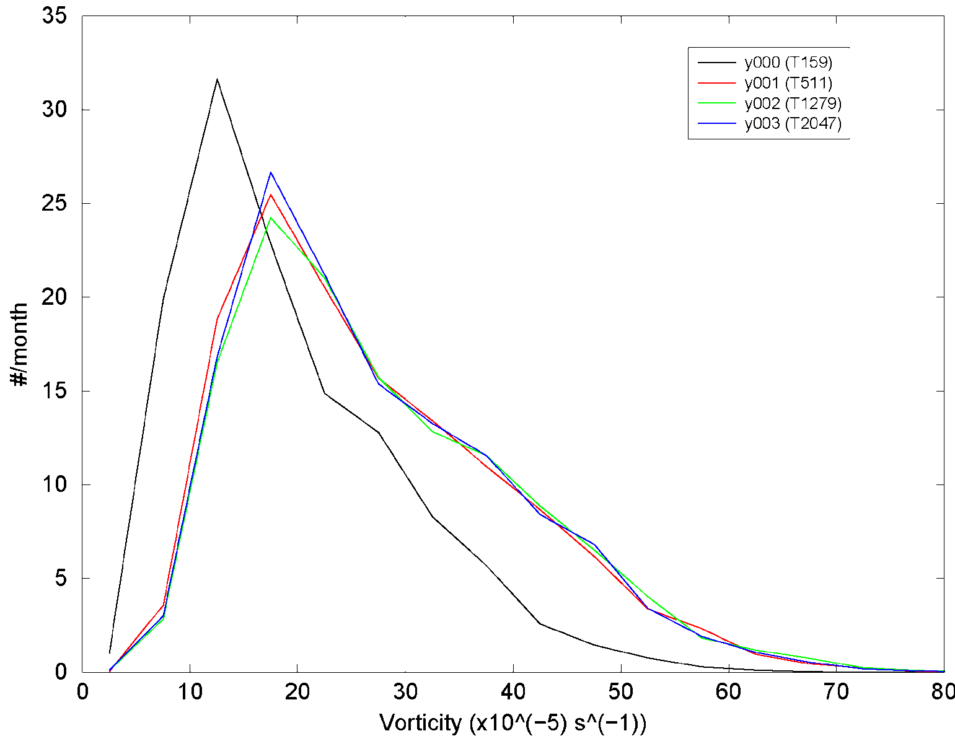
ATHENA-Intensities
T159 Intensities

Slide 19
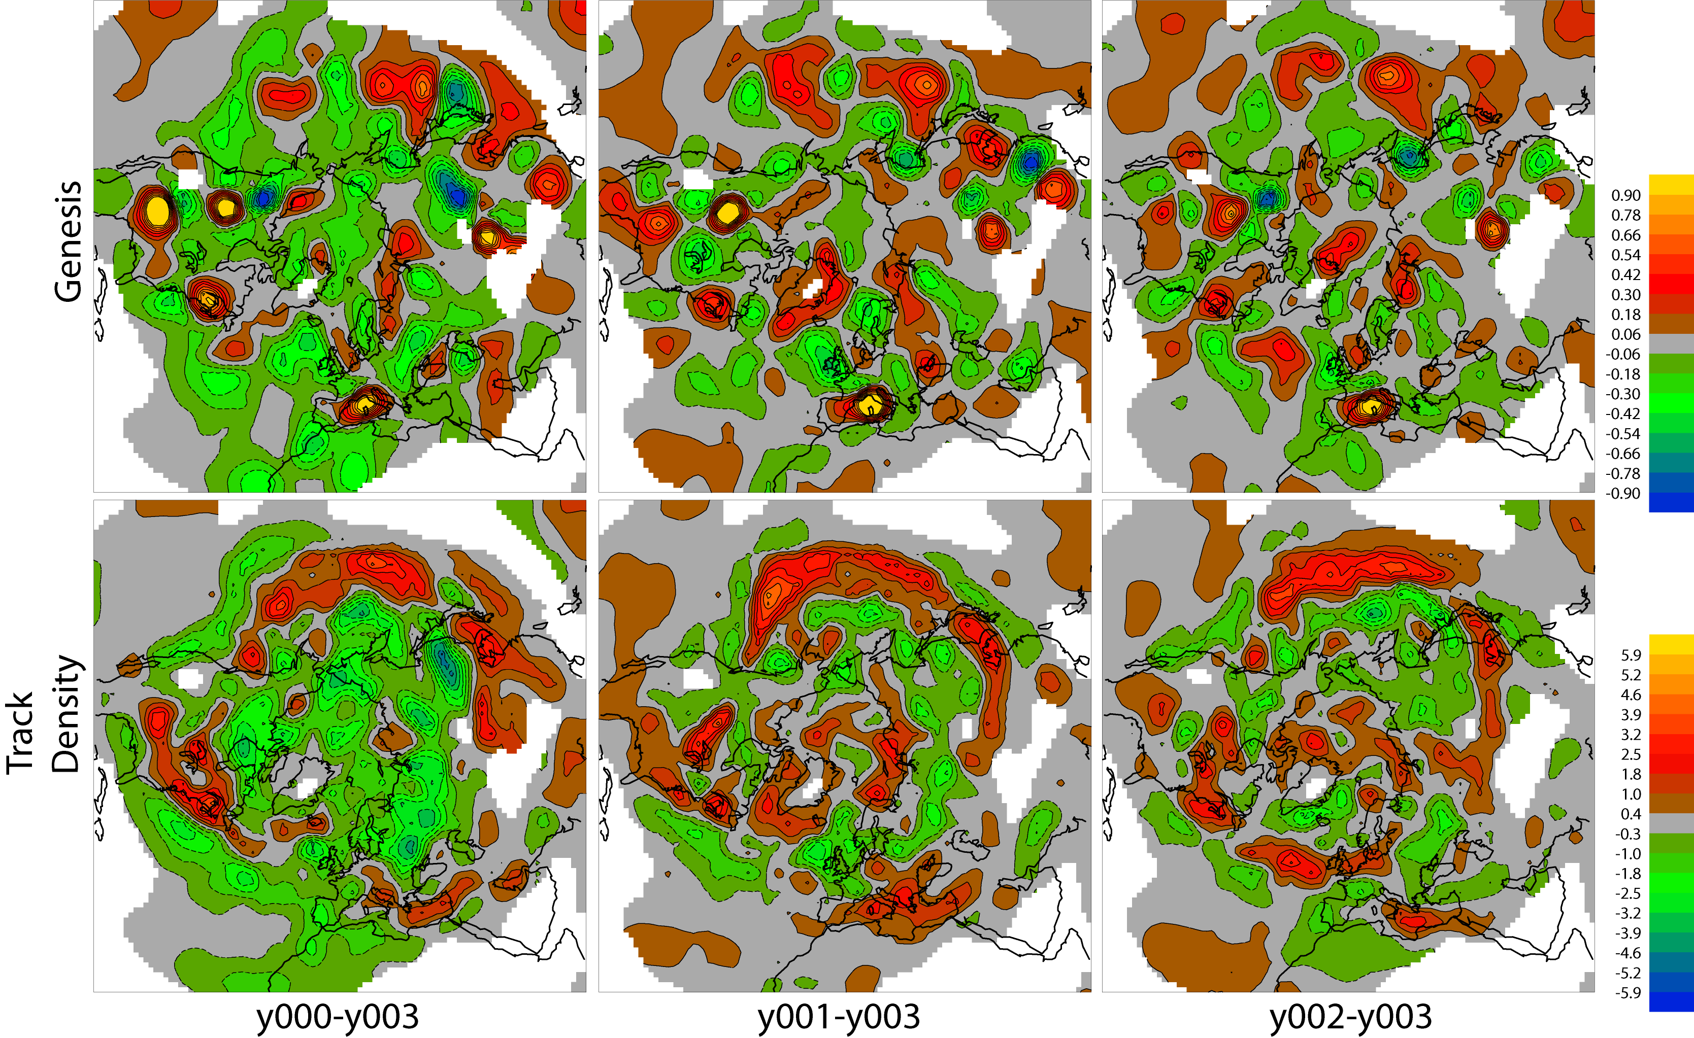
ATHENA-Distributions

Slide 20
Future Work
Apply same methods directly to satellite data to verify cyclone structure in NWP (directly) and climate models (statistically).
Apply to other weather system types, e.g. TC including examining the transition of EW to TC; the extra-tropical transition of TC and polar lows.
Extend to energetics.

