Slide 1
Project Athena: Overview
Team Workshop
7-8 June 2010
ECMWF – Reading, UK

Slide 2
Project Athena
  NSF impetus: Supercomputer availability and interest in outcome of 2008 World Modeling Summit
  Hypothesis: Exploring high spatial resolution and process-resolving models can dramatically alter simulation of climate
  COLA role: formed and led an international collaboration involving over 30 people in 6 groups on 3 continents
  Two state-of-the-art global AGCMs at the highest possible spatial resolution
  Dedicated supercomputer at NICS for Oct’09 – Mar’10
    Data ~900 TB total
    Long term - model output data will be invaluable for large community of climate scientists (unprecedented resolution and simulation duration) and computational scientists (lessons learned from running dedicated production at nearly petascale)

Slide 3
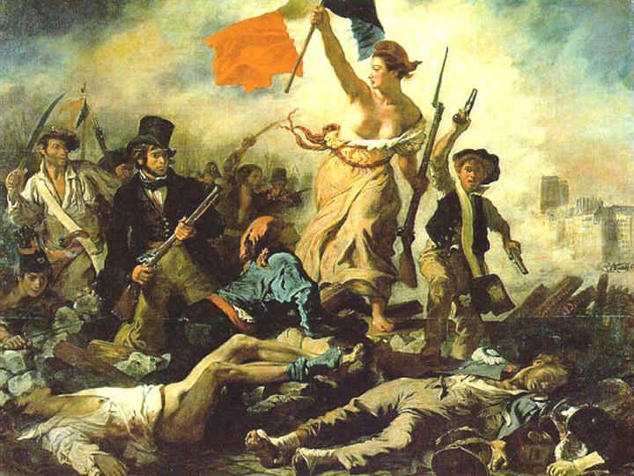
Revolutionizing Climate Modeling
2008 World Modeling Summit Established Requirements for Climate Change Modeling:
Dedicated High-End Computing
International Collaboration
Apologies to Eugene Delacroix

Slide 4
Origin of Project
  The World Modeling Summit (WMS) in May 2008 at ECMWF called for revolution in climate modeling to more rapidly advance improvement in climate model resolution, accuracy and reliability
  The WMS recommended petascale supercomputers dedicated to climate modeling at at least 3 international facilities
    Dedicated petascale machines are needed to provide enough computational capability and a controlled environment to support long runs and the management and analysis of very large (petabyte) data sets
  The U.S. National Science Foundation, recognizing the importance of the problem, realized that a resource (Athena supercomputer) was available to meet the challenge of the World Modeling Summit and offered to dedicate the Athena supercomputer over a six-month period in 2009-2010
  An international collaboration was formed among groups in the U.S., Japan and the U.K. to use Athena to take up the challenge

Slide 5
Science Goals
Hypothesis: Increasing weather and climate model resolution to accurately resolve mesoscale phenomena in the atmosphere (and ocean and land surface) can dramatically improve the fidelity of the models in simulating the mean climate, the variances and covariances, and the representation of extreme events (already demonstrated that it improves the fidelity of cloud systems).
Hypothesis: Simulating the effect of increasing greenhouse gases on regional aspects of climate, especially extremes, may, for some regions, depend critically on the spatial resolution of the climate model.
Hypothesis: Explicitly resolving important processes in the atmosphere (and ocean and land surface), without parameterization, can even further improve the fidelity of the models, especially in describing the regional structure of weather and climate.

Slide 6
Collaborating Groups
COLA - Center for Ocean-Land-Atmosphere Studies, USA (NSF-funded)
ECMWF - European Center for Medium-range Weather Forecasts, UK
JAMSTEC - Japan Agency for Marine-Earth Science and Technology, Research Institute for Global Change, Japan
University of Tokyo, Japan
NICS - National Institute for Computational Sciences, USA (NSF-funded)
Cray Inc.
Codes
NICAM: Nonhydrostatic Icosahedral Atmospheric Model
IFS: ECMWF Integrated Forecast System
Supercomputers
Athena: Cray XT4 - 4512 quad-core Opteron nodes (18048)
  #30 on Top500 list (November 2009) – dedicated Oct’09 – Mar’10
Kraken: Cray XT5 - 8256 dual hex-core Opteron nodes (99072)
  #3 on Top500 list (November 2009) replaced Athena – allocation of 5M SUs

Slide 7
Many Thanks To …
ECMWF
  Mats Hamrud
  Thomas Jung
  Martin Miller
  Tim Palmer (co-PI)
  Peter Towers
  Nils Wedi
NICS
  Phil Andrews (co-PI)
  Troy Baer
  Matt Ezell
  Christian Halloy
  Dwayne John
  Bruce Loftis
  Kwai Wong
Cray
  Pete Johnsen
  Per Nyberg
JAMSTEC/U. Tokyo
  Chihiro Kodama
  Masaki Satoh (co-PI, U. Tokyo)
  Hirofumi Tomita (co-PI, JAMSTEC)
  Yohei Yamada
NSF
  AGS: Jay Fein
  OCI: Steve Meacham, Rob Pennington
COLA
  Deepthi Achutavarier
  Jennifer Adams
  Eric Altshuler
  Ben Cash
  Paul Dirmeyer
  Bohua Huang
  Emilia Jin
  Jim Kinter (PI)
  Larry Marx
  Julia Manganello
  Cristiana Stan
  Tom Wakefield

Slide 8


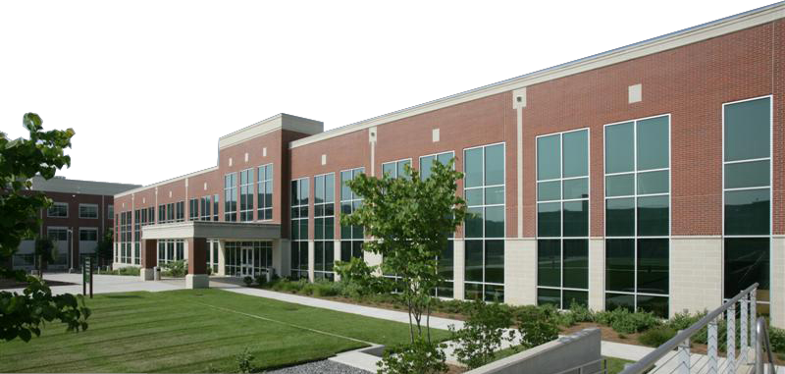



National Institute for
Computational Sciences
University of Tennessee and ORNL partnership
NICS is funded by the National Science Foundation, is located at Oak Ridge National Lab, and is managed by the University of Tennessee
NICS operates the first academic petascale supercomputer in the world
Leverages the capabilities of the ORNL
computing complex
Managed by UT-Battelle for the Department of Energy

Slide 9
NICS and Athena
NICS provides and supports computational resources for academic researchers: Cray XT5 and XT4, SGI UltraViolet for visualization and data analysis, CPU-GPU cluster, scratch and archival storage, …
The Cray XT4 – Athena – the first NICS machine in 2008
  Replaced by Cray XT5 – Kraken – in March 2009
  4512 nodes @ 4 gigabytes RAM & 1 AMD 2.3 GHz quad-core processor
  17.6 terabytes aggregate memory & 18,048 cores
  165 teraflops peak performance
  Other resources: 85 TB Lustre file system, 258 TB auxilliary file system (called Nakji) and a 5-node 16-core 128 GB RAM system (called Verne) to help with data management

Slide 10
NICS Support for COLA Team
The Athena project by COLA received an extraordinarily high-level of direct support.
  Contract with Cray provided hardware support during business hours.
  NICS systems staff (Matt and Rick) and computational science staff (Kwai, Christian, Dwayne) attentive almost 24/7.
  NICS management and staff were committed to making this project a success.
  COLA was our partner not our customer.
Direct support was smoother because the COLA team was so well prepared for the challenges.

Slide 11
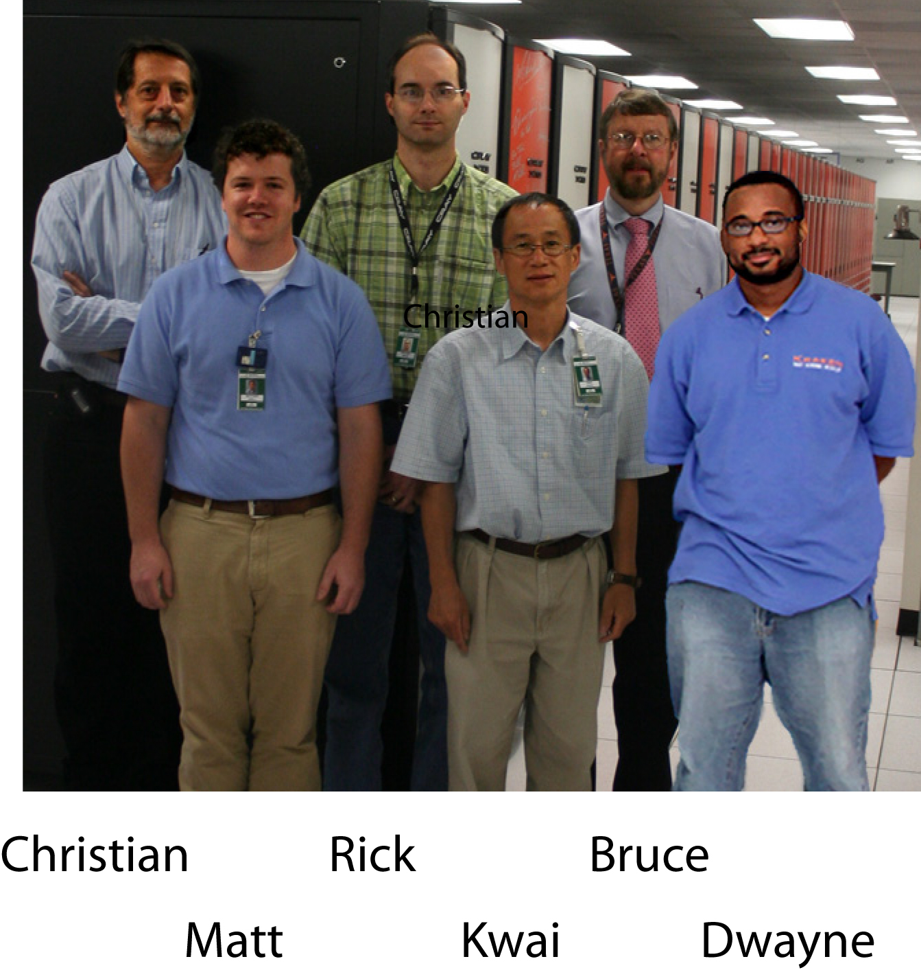
Precision NICS Athena Support Team

Slide 12
Production Computing
Supporting a single project on Athena provided some flexibility not otherwise available. NICS could change priorities and queuing parameters to be more effective.
Supercomputer Tetris Problem: keeping the scheduler busy running 2 codes and using extra nodes for post-processing.
COLA and ECMWF staff used ~70M hours over 6 months on
Athena – out of a total of ~79M hours over the period.
Athena has been
very reliable.

Slide 13
NICS Lessons Learned
Dedicated usage of a relatively big supercomputer greatly enhances productivity
Dealing with only a few users and their requirements allows for more efficient utilization
Challenge: Dedicated simulation projects like Project Athena can generate enormous amounts of data to be archived, analyzed and moved around. NICS (and TeraGrid) do not currently have enough storage capacity. Data management is a big challenge and should be studied carefully.
Preparation time: 2 or 3 weeks at least are needed before the beginning of dedicated runs to test and optimize the codes and to plan strategies for optimal use of the system. Communication throughout the project is essential: (weekly telecons, email lists, personal calls, …)
Project Athena was a valuable experience, demonstrating the value of developing good teamwork practices - COLA was our partner not our customer.
NICS has submitted a proposal to NSF for continued funding to support computing on Athena.

Slide 14
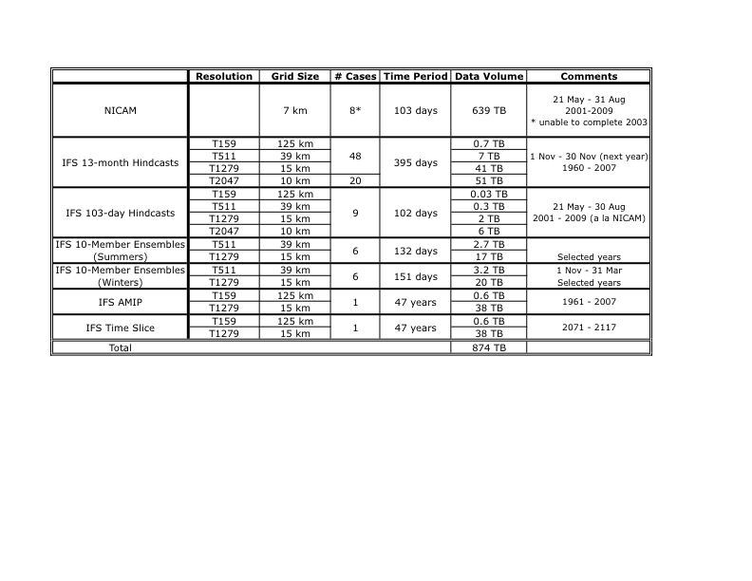
Athena Experiments
http://iges.org/grads/athena

Slide 15
Public Sharing of Athena Data via ESG
NSF requires that data must eventually be publicly available
The Earth System Grid (ESG) is a network of data nodes and gateways at national labs and research centers in the US that collectively allow secure access to massive distributed data sets
ESG can publish data that reside on tape under HPSS
ESG also provides “Extending Services” (metadata search, subsets, server-side analysis, etc.)
ESG Services are currently limited to data on spinning disk
in CF-compliant NetCDF format
Discussions have begun to serve a small subset of Athena data
on a trial basis

Slide 16
Selected Results
Kinetic energy spectra
QBO
Resolution dependence of snow
NICAM simulation (21 May – 31 August 2009)

Slide 17
Global Kinetic Energy Spectra of High Resolution Models
Observations suggest that the globally integrated kinetic energy spectrum of the atmosphere has two “regimes”, one for synoptic scales (~1000-3000 km), and one in the mesoscales (~10-100 km). If the globally integrated kinetic energy E_{ke} is given as:
where k is the magnitude of the dimensional wavenumber, then
E(k) ~ k⁻³ for the synoptic range
E(k) ~ k^{-5/3} for the mesoscale range
(in general E(k) ~ k^{-n})
Some controversy exists about this result:
  the observations are not straightforward to interpret
  there is no satisfactory theory explaining both regimes
  models/ reanalyses don’t get precisely n = -3 and -5/3

Slide 18
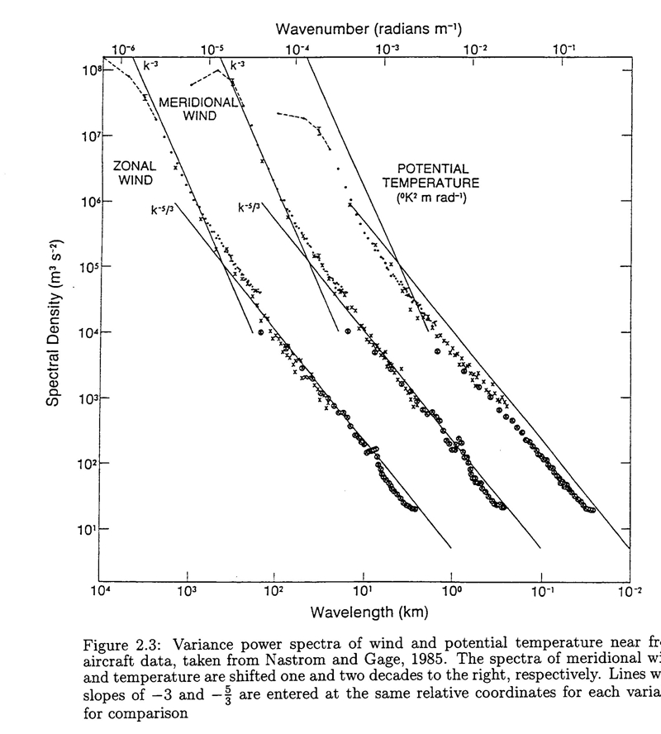
Aircraft observations showing spectra of wind components and T, plotting log(E) vs. log(k), so that the slope of the straight lines indicate the exponent n in the previous slide.

Slide 19
Preliminary Results from NICAM and IFS T1279
One NICAM run JJAS 2009
One IFS T1279 run JJAS 1981 (from Nov 1980 start)
Results likely to be sensitive to inter-annual variability:
spectra of stationary (time-mean) flow (not shown)
spectra of transient flow at large scales (small wavenumbers; not shown)
Results not likely to be sensitive to inter-annual variability:
spectra of transient flow at synoptic and smaller scales (see next slide)
estimated slope n of spectra at synoptic and smaller scales

Slide 20
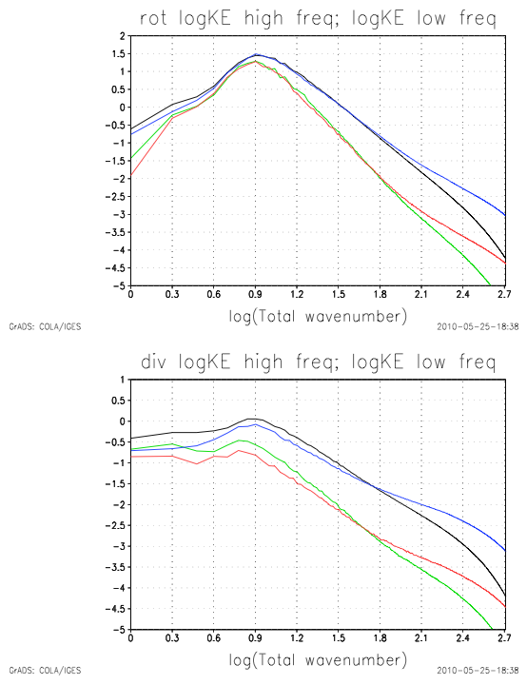
Energy Spectra
(analysis at T512 - smaller scales show mostly dissipation)
Transient with periods less than 8 days:
Black IFS Blue NICAM
Transients with periods greater than 8 days:
Green IFS Red NICAM
Note how NICAM has much more energy at smaller scales!! High frequency energy dominates for both models
Log(EKE-rotational)
Log(k)
Log(EKE-divergent)
Log(k)

Slide 21
Least squares fit to slope, n
(E(k) ~ k^{-n})
(analysis at T512 - smaller scales show mostly dissipation)
Transient with periods < 8 days:
Black IFS Blue NICAM
Transients with periods > 8 days:
Green IFS Red NICAM
NICAM shows two spectral regimes for dominant transients (periods < 8 days):
n=2.8 in synoptic range, n=2.3 in mesoscale range.
IFS shows only one spectral regime for black curve.
Slope(EKE-rotational)
Log(k)
Slope(EKE-divergent)
Log(k)

Slide 22
KE Spectra - Tentative Conclusions
IFS T1279 and NICAM both dissipative for scales less than those resolved by T512
NICAM has greater divergent and rotational kinetic energy for small scales, for transients of either time scale
The dominant transient energy – high frequency rotational kinetic energy (periods < 8 days) shows two regimes in NICAM (although the slopes are not the classical n = 3 and n = 5/3). This is not the case in IFS.
Low frequency flow (periods > 8 days) also shows interesting behavior
Importance of non-hydrostatic dynamics

Slide 23
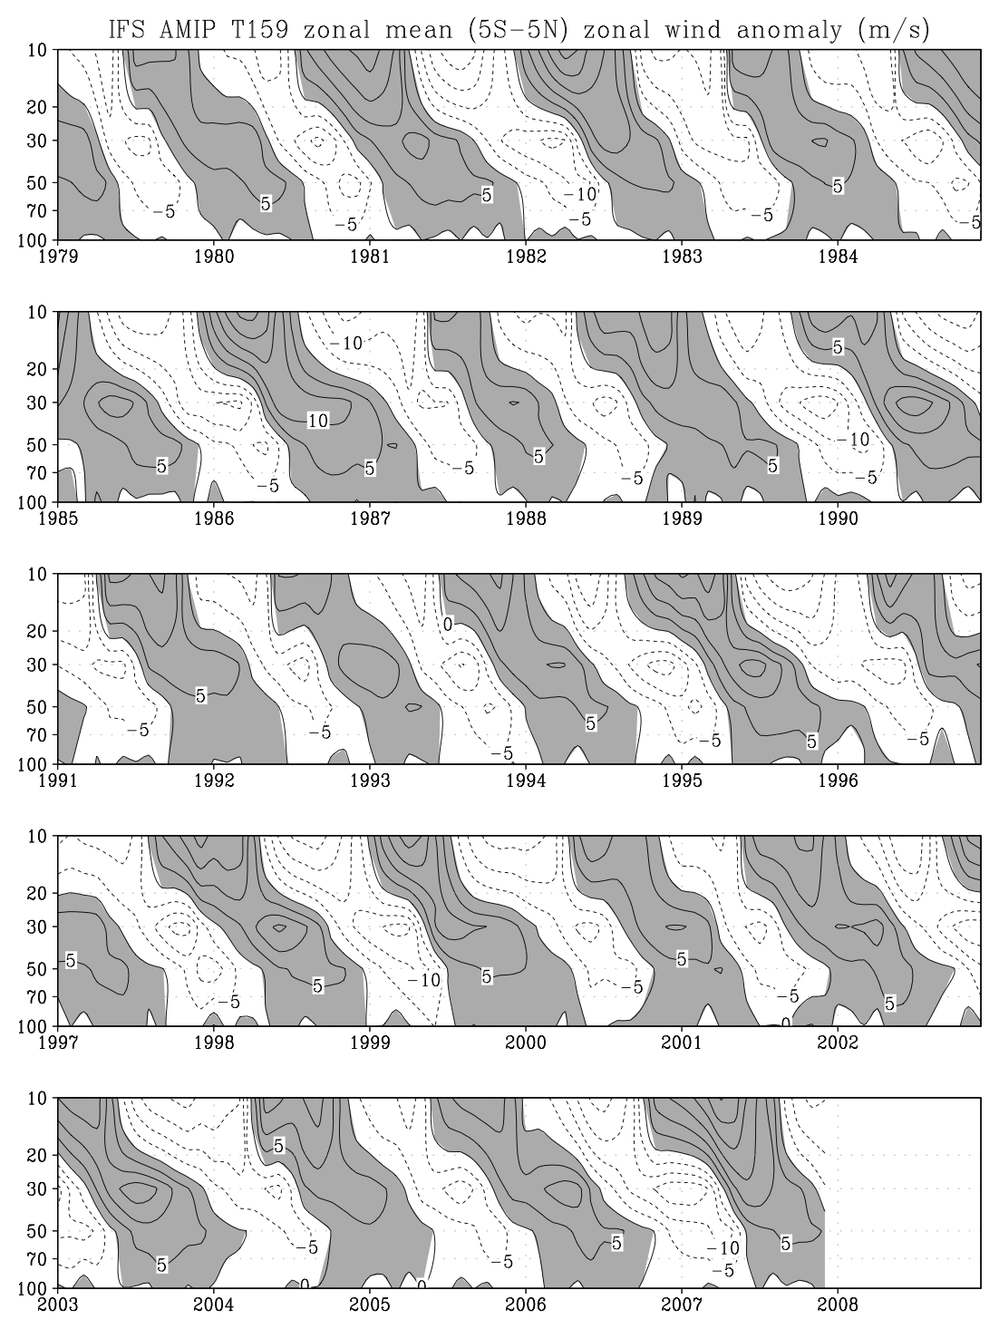
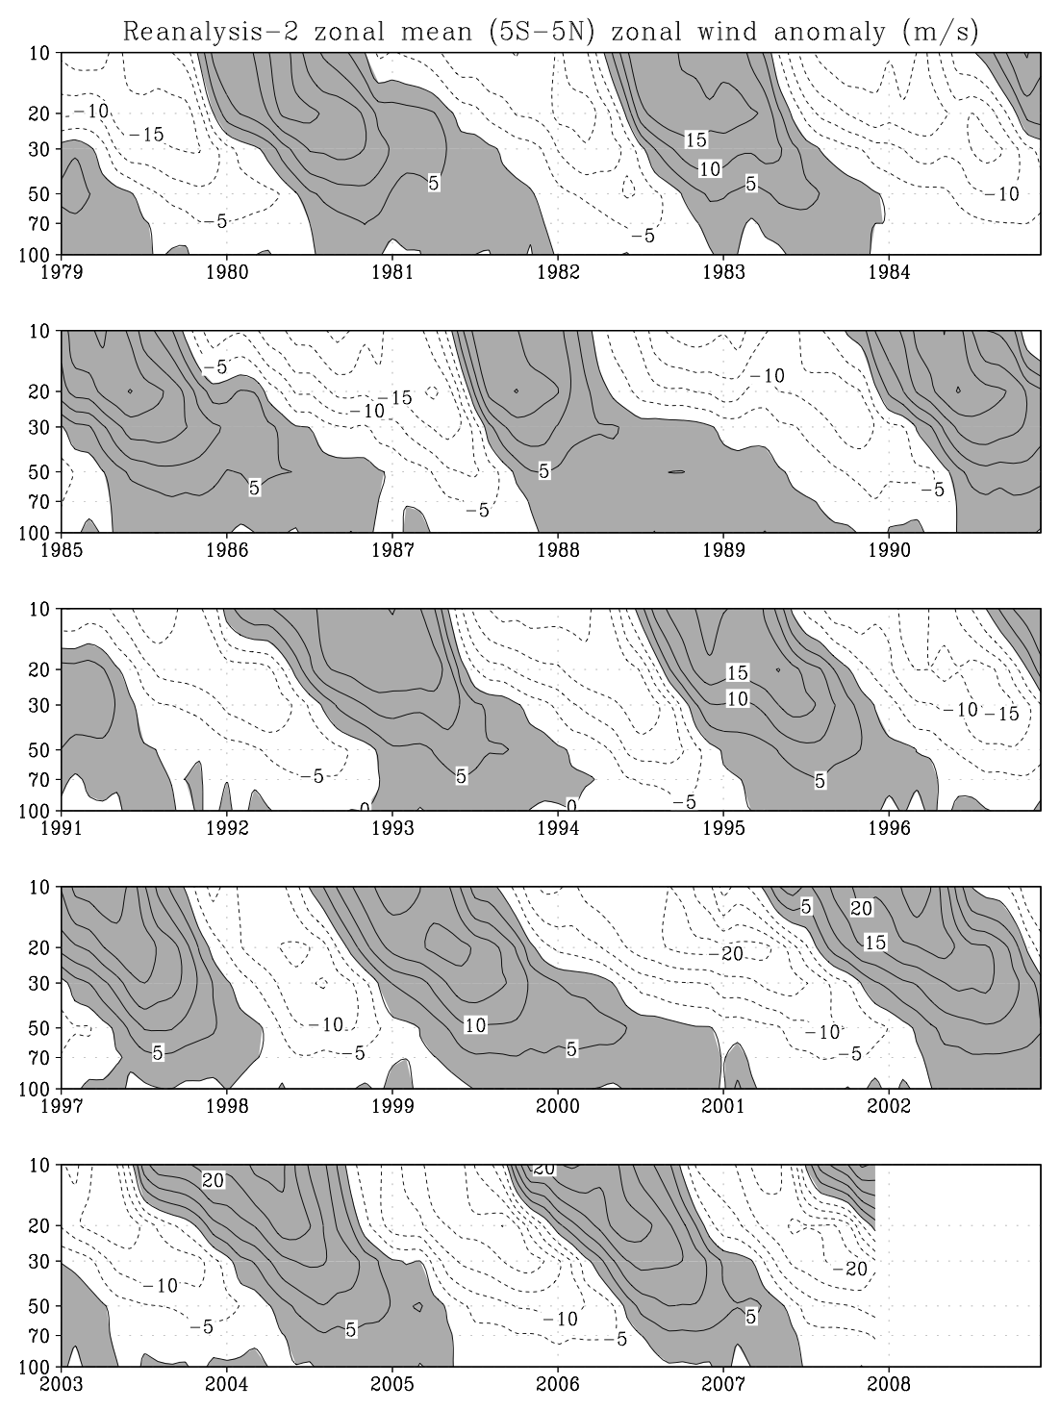
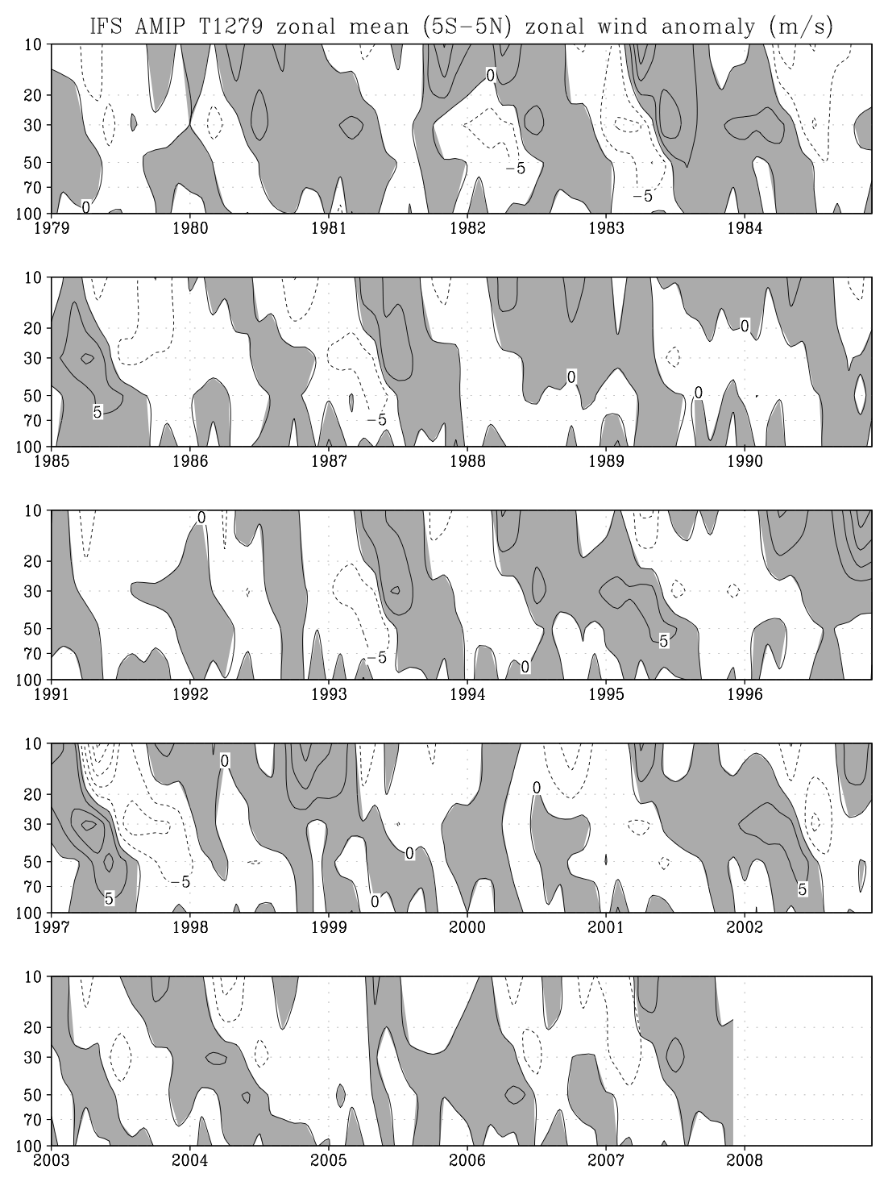
Quasi-Biennial Oscillation
Zonal Mean Zonal Wind (5S-5N) Anomaly
IFS T159
Rean-2
IFS T1279

Slide 24
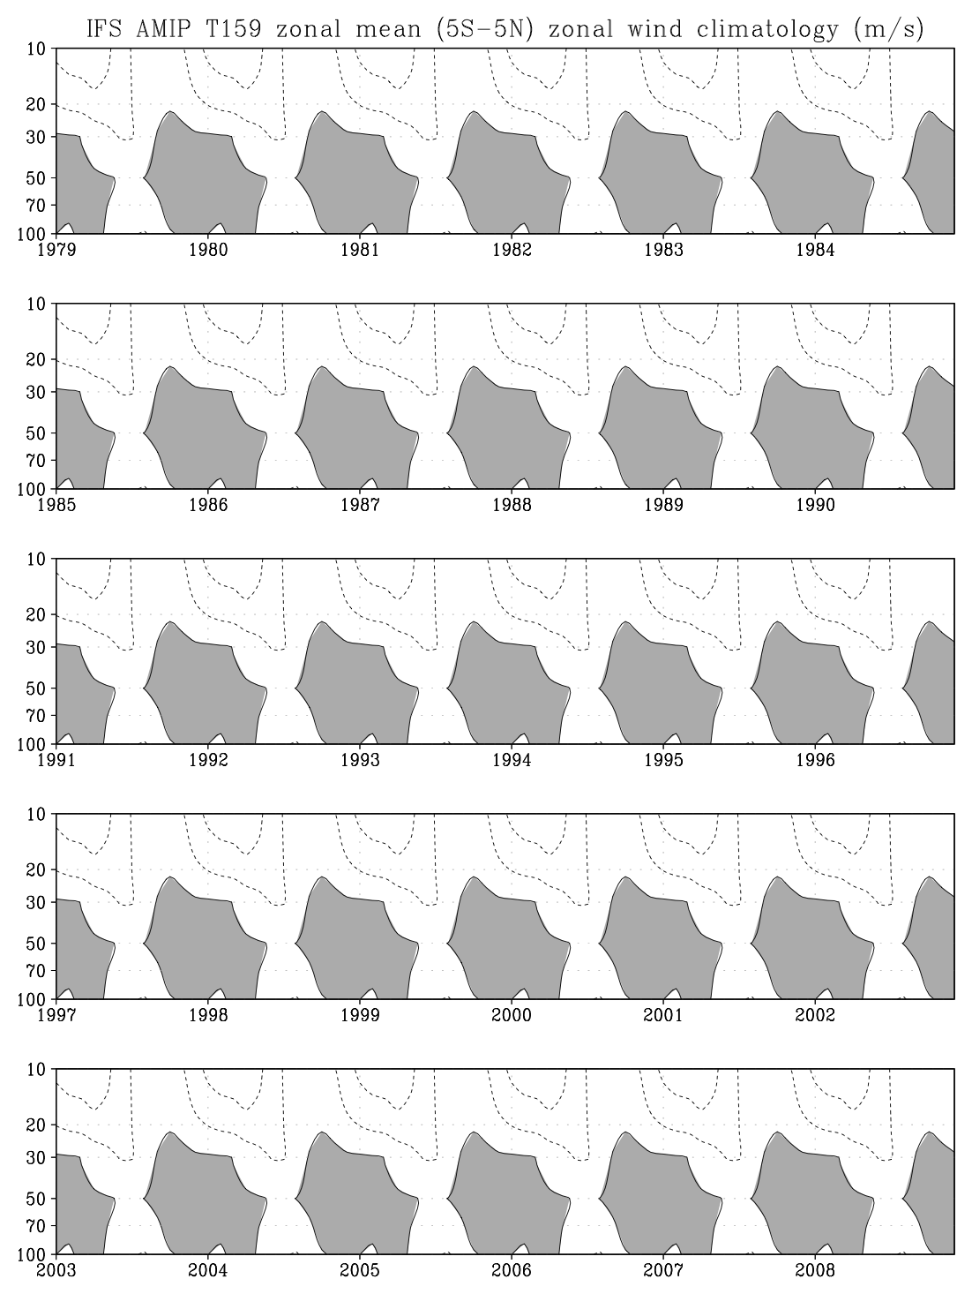
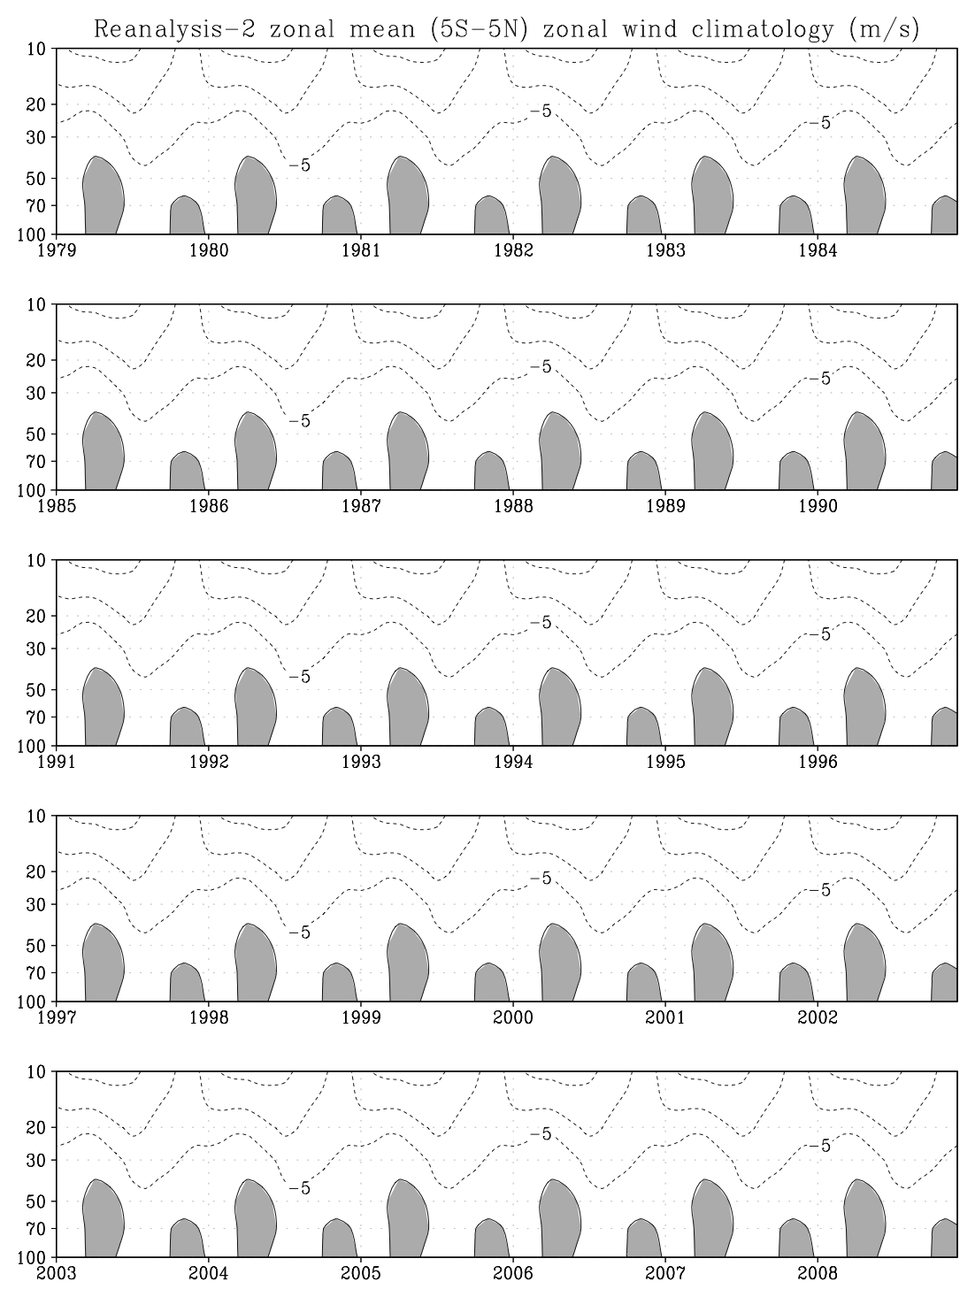
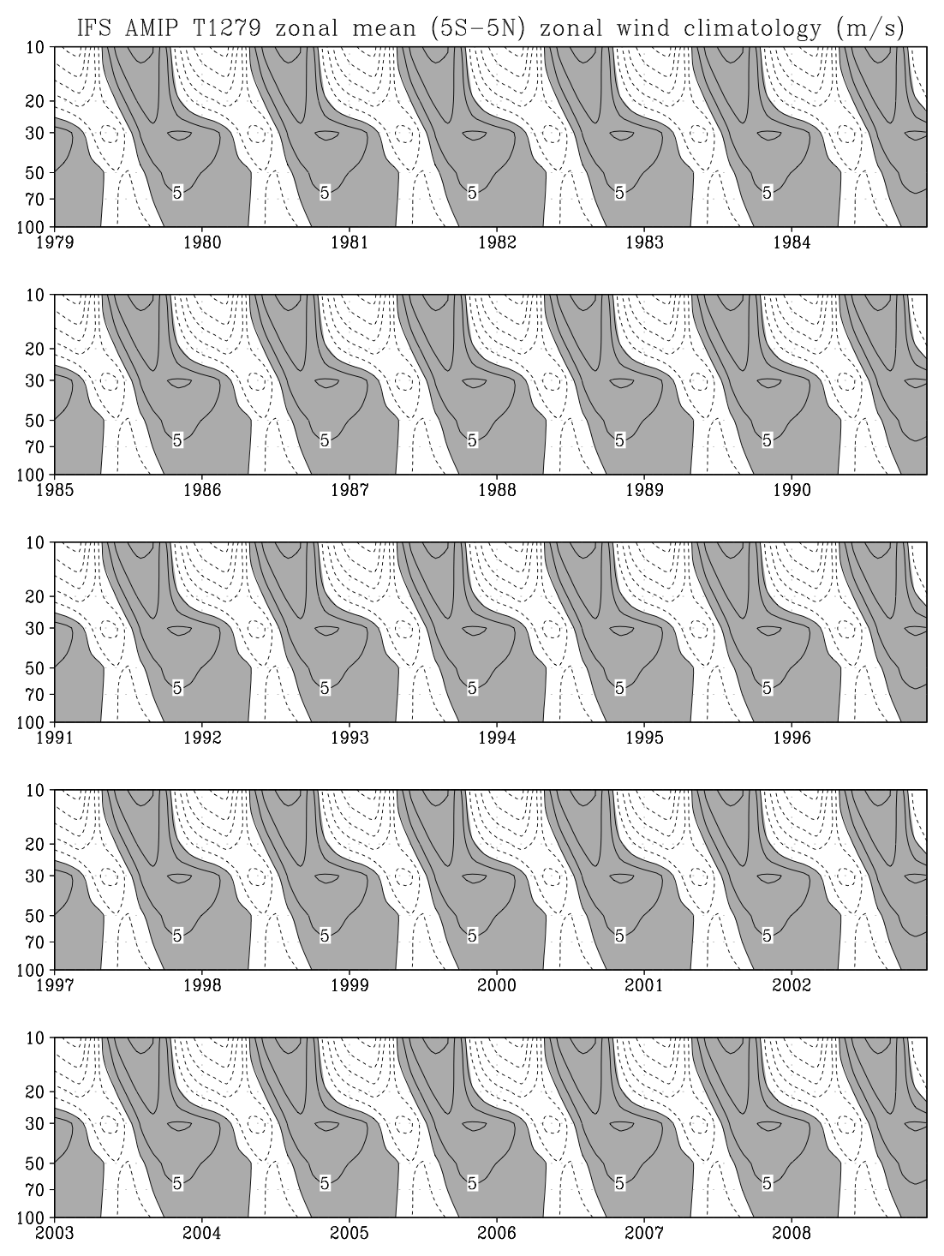
Quasi-Biennial Oscillation
Zonal Mean Zonal Wind (5S-5N) Mean Annual Cycle
IFS T159
Rean-2
IFS T1279

Slide 25
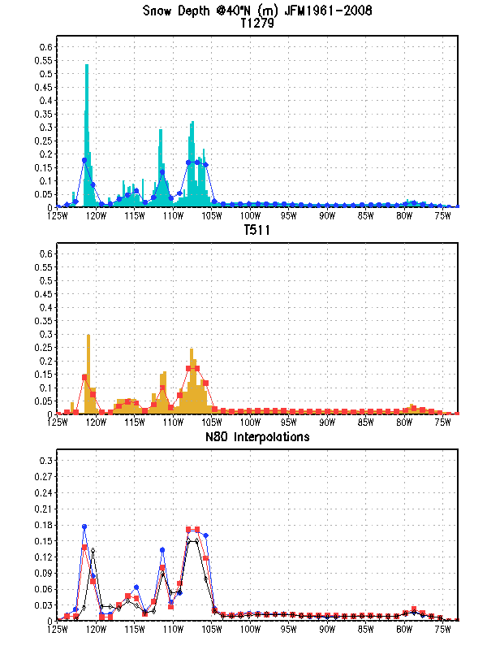
IFS JFM Mean Snow Depth
CONUS Transect at 40 N
Interpolated high-resolution agrees with native T159
Orographic features are not represented
Notes:
Moving on to a different aspect of precipitation… snowfall in transect across CONUS shows clear signature of orography. Reduced versions of high res models are similar to T159 version, although shifted westward

Slide 26
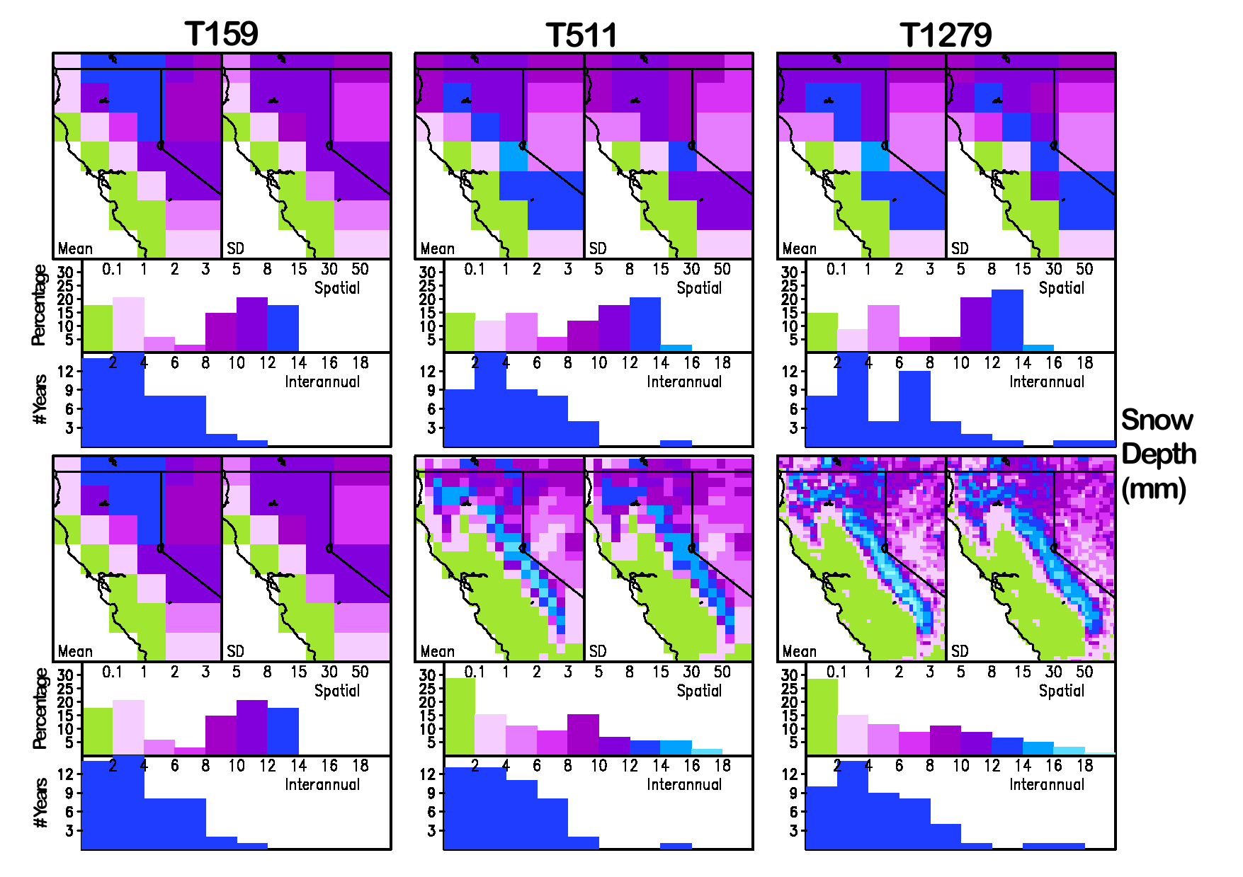
Reduced
Native
Decreasing Resolution Biases Distribution
Notes:
Busy slide but worth going into. Top row is reduced resolution, ie everything at T159. Panels are mean and SD. Histograms show percentage of pixels in each range

Slide 27
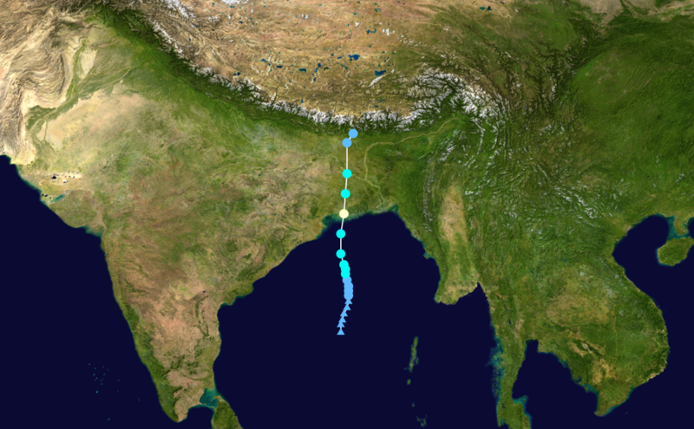
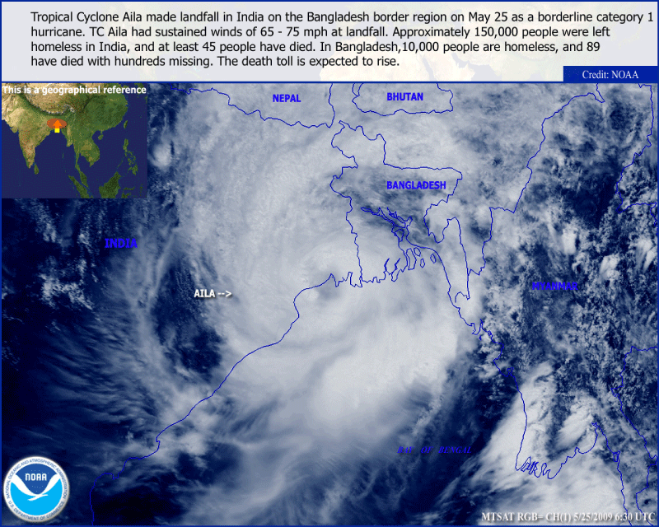
May 2009 - Tropical Cyclone Aila
Single case example:
NICAM simulation accurately predicted development, evolution and track of TC Aila over 5-day period
25May09
23May09
21May09

