Slide 1
Tropical Cyclones in IFS and NICAM
Julia V. Manganello
Center for Ocean-Land-Atmosphere Studies
(Many thanks to Kevin Hodges!)
Athena Workshop, 7-8 June 2010

Slide 2
Outline
Tracking and identification of tropical cyclones (TCs)
Experimental data and observations
Focus of the analysis:
Genesis and track densities
Intensity distribution
(Interannual variability of the North Atlantic TCs)
Domains:
North Atlantic
Northern Hemisphere
Conclusions
Athena Workshop, 7-8 June 2010
Slide 2

Slide 3
Tracking and Identification of TCs
Hodges Method for detection and tracking of tropical vortices:
850-hPa relative vorticity max (NH)
Lifetime ≥ 2 days
Cyclogenesis within 0 - 20N over land and 0 - 30N over oceans
TC Identification Criteria I (after Bengtsson et al. 2007):
(ξ_{i} / ξ_{v})*
ξ_{i} - 850-hPa relative vorticity threshold,
ξ_{v} - threshold for the difference in vorticity between 850 and 250-hPa
ξ_{i} / ξ_{v} must hold for at least 1 day
vorticity max must exist at each level between 850 and 250-hPa
This method requires calibration against observations
* For all IFS simulations, vorticity is at the N80 resolution
Athena Workshop, 7-8 June 2010
Slide 3

Slide 4
Tracking and Identification of TCs
TC Identification Criteria II:
Maximum surface wind speed of a TC must reach V_{m} (Tropical Storm threshold) adjusted for model resolution:
V_{m15} = V_{m10} = 0.88 * V_{m1},
where V_{m1} = 17.5 m/s (1-min ave.)
T1279: V_{m} = V_{m10} = 15.4 m/s
T511 adj. : V_{m} = 14.1 m/s
T159: time step is 1 hour; wind data is not analyzed
39 km
(from Walsh et al. 2007)
AND
Weak structural criteria of (1/1) applied
Athena Workshop, 7-8 June 2010
Slide 4
Notes:
This approach provides more direct comparison with OBS
Time duration requirement on II?
Can I and II be combined?

Slide 5
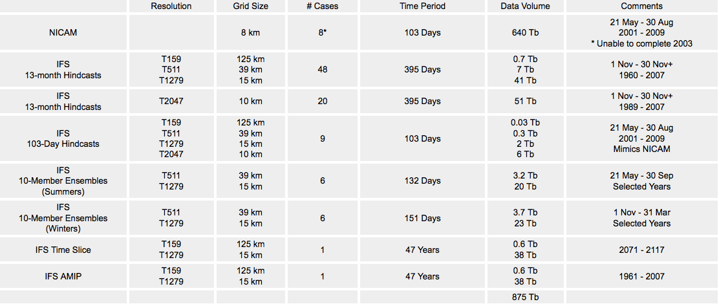
Experiments
Period of analysis: MJJASON of 1979-2008
OBS-ALL: all data from the International Best Track Archive for Climate Stewardship (IBTrACS); 10-min sustained surface winds are used
OBS: subset of tracks from IBTrACS with max 10-min sustained winds ≥ 30 kts (15.4 m/s) equivalent of the Tropical Storm strength
Athena Workshop, 7-8 June 2010
Slide 5

Slide 6
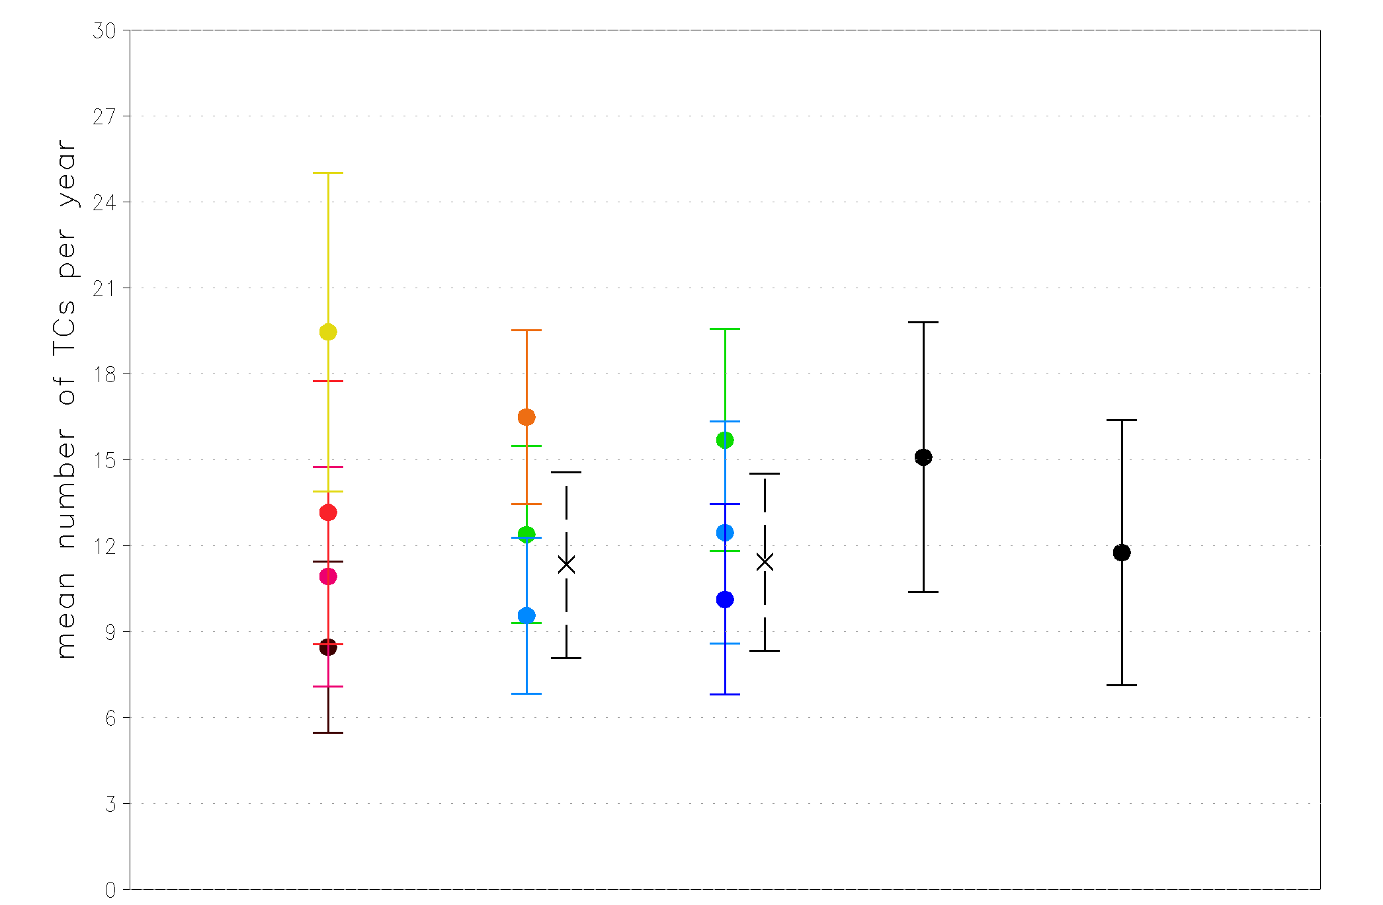
Tracking and Identification of TCs: North Atlantic
T159
T511
T1279
OBS-ALL
OBS
Athena Workshop, 7-8 June 2010
Slide 6

Slide 7
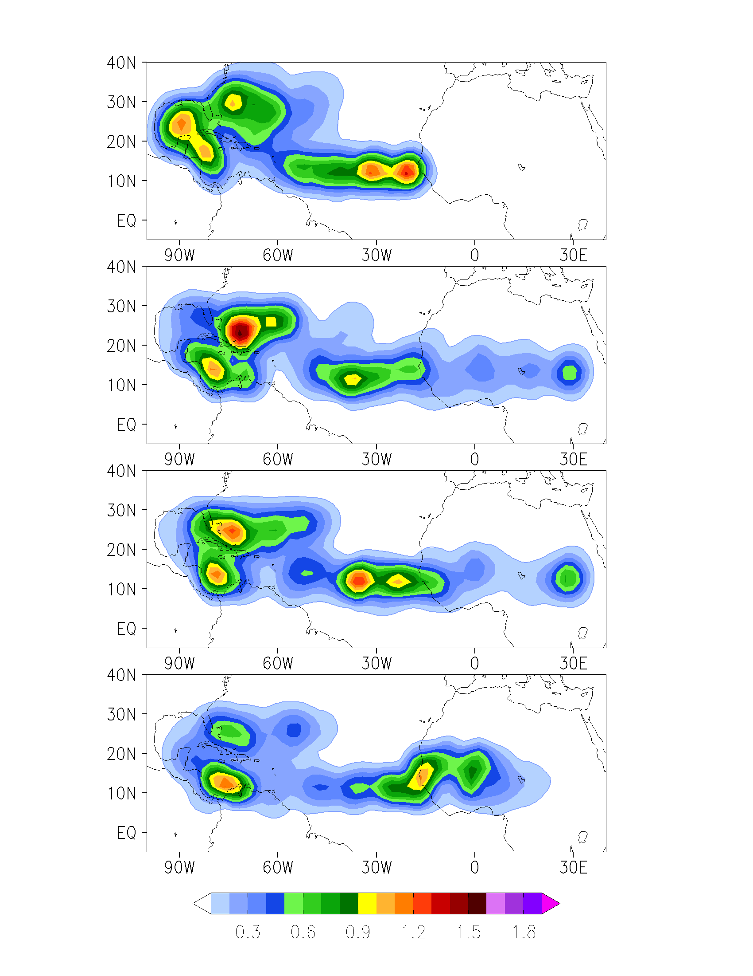
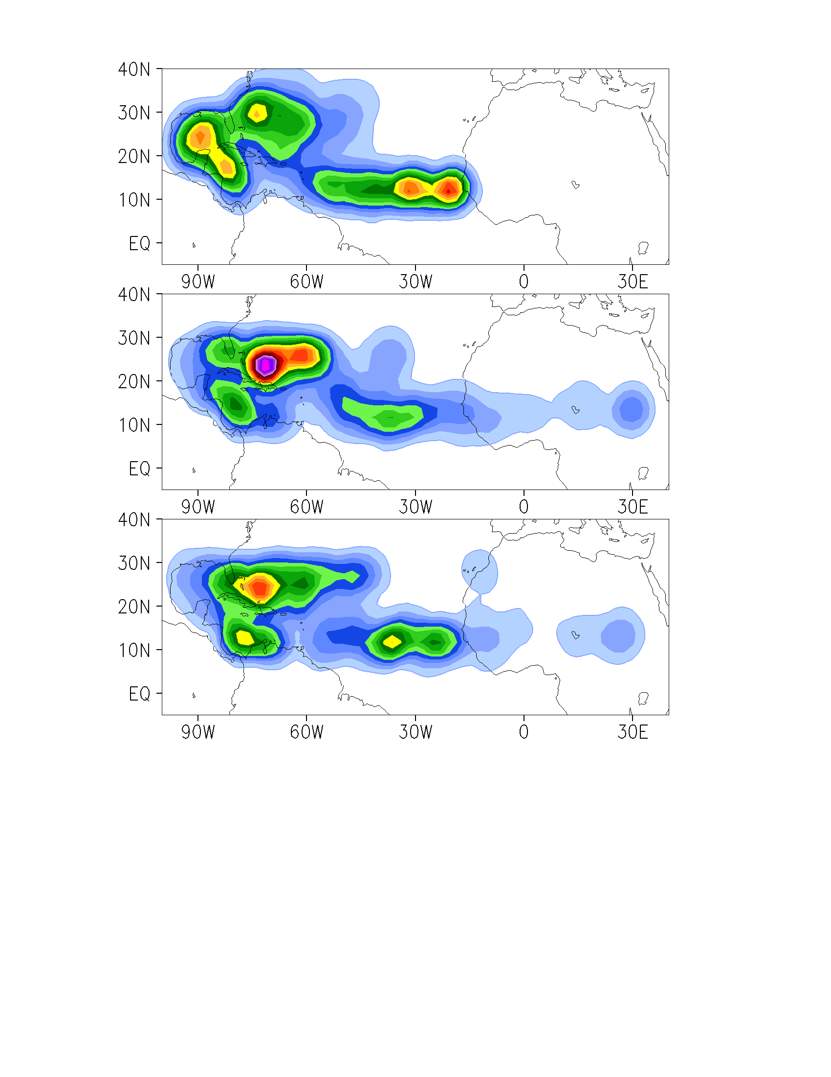
Genesis Density of TCs: North Atlantic
OBS
OBS
T1279 (12/10)
T1279 (SPD, 1/1)
T511 (12/6)
T511 (SPD, 1/1)
T159
(5/4)
Athena Workshop, 7-8 June 2010
Slide 7
Notes:
SE shift of Eatl and Caribbean centers is probably due to earlier detection of vortices in the model vs obs

Slide 8
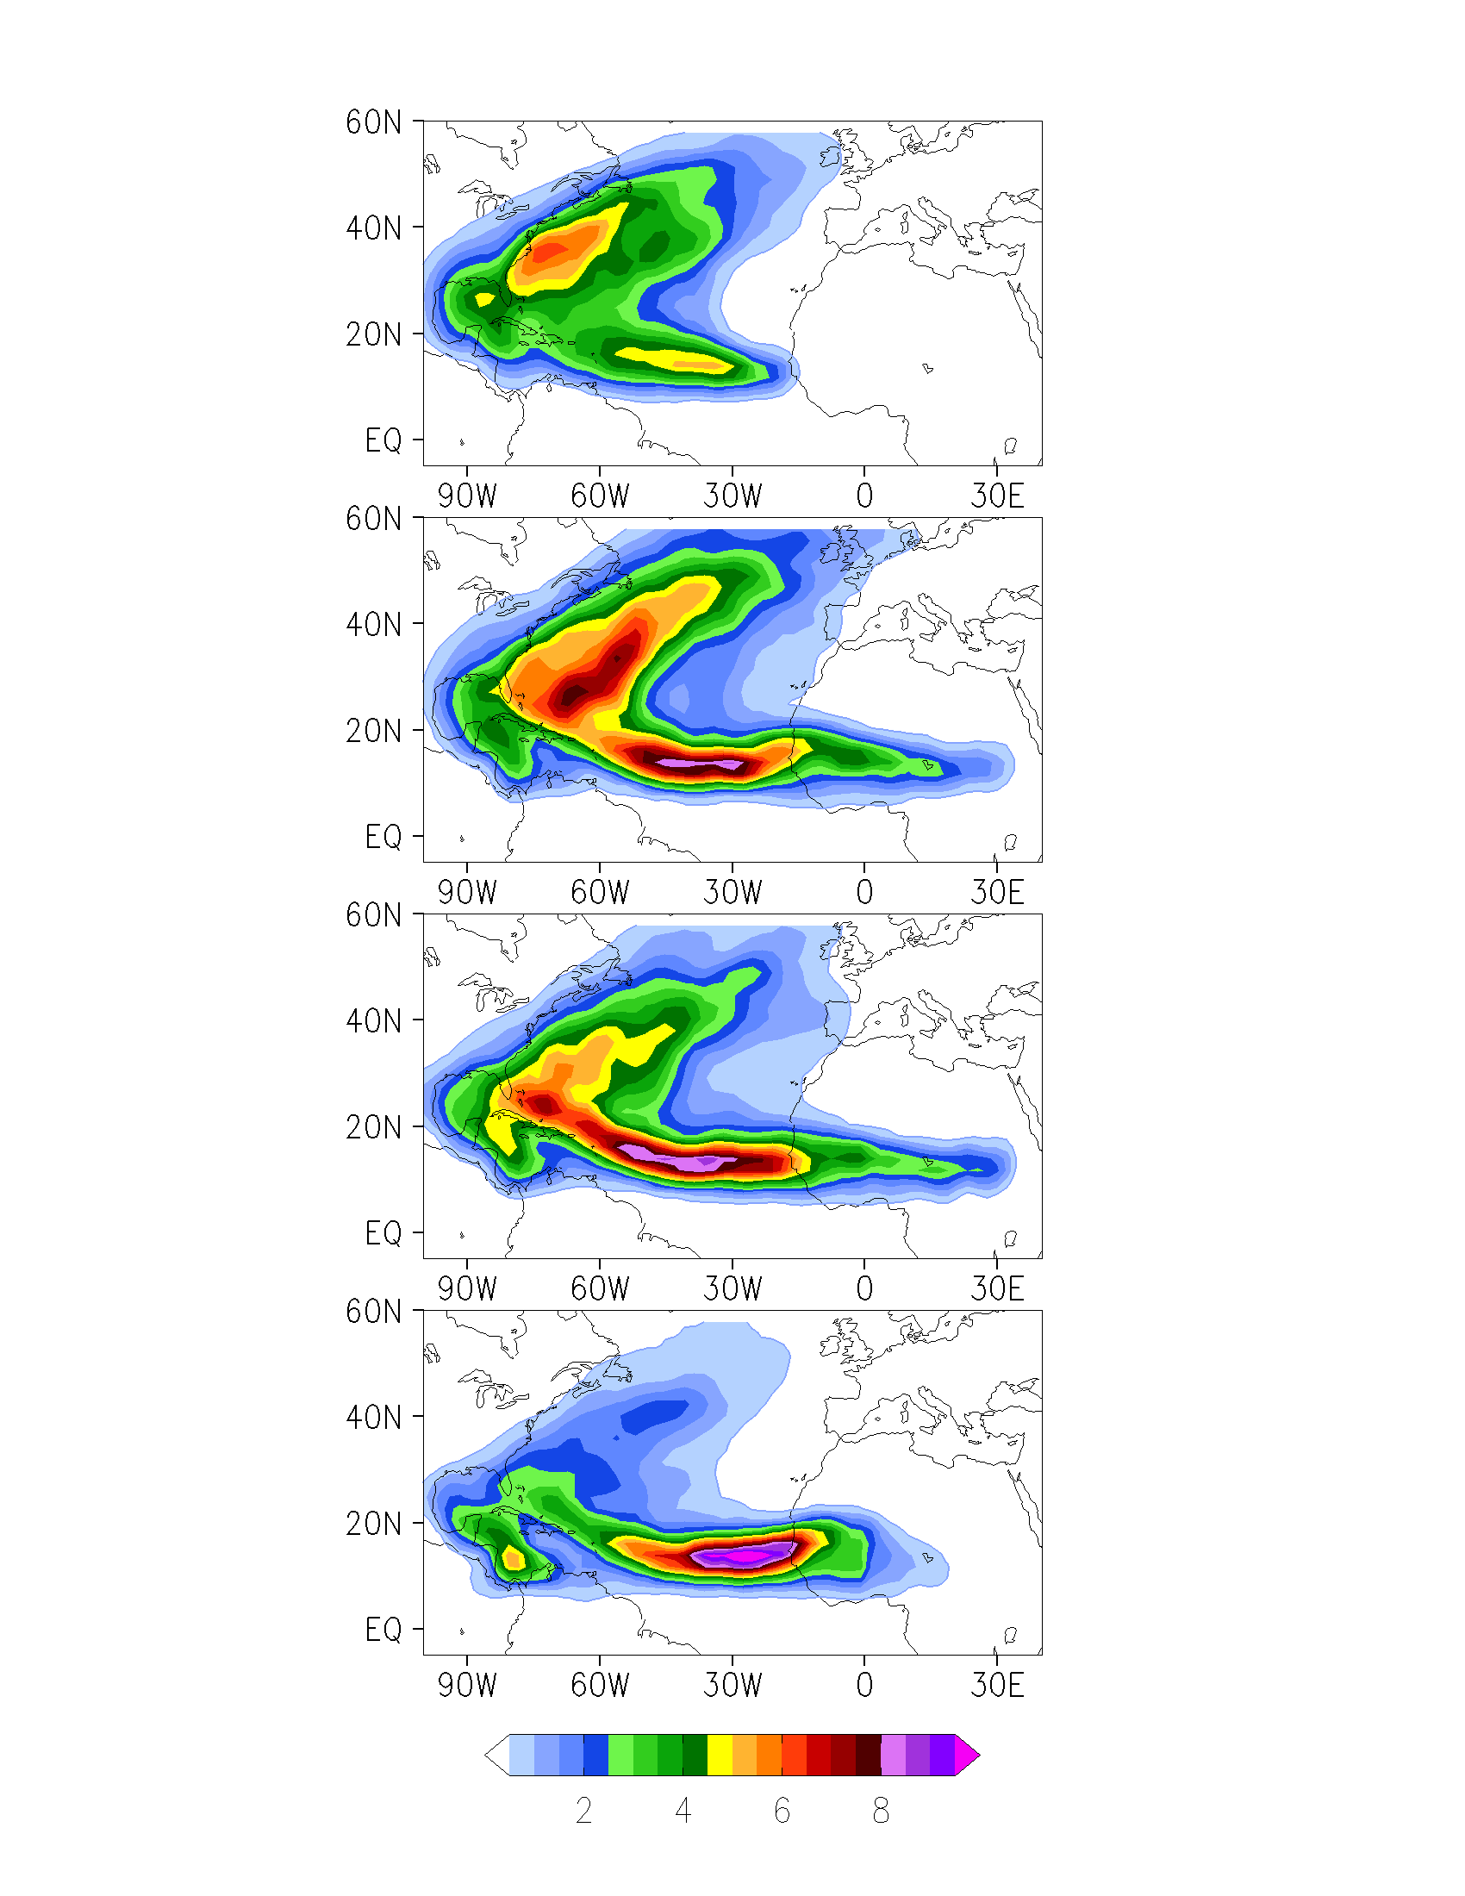
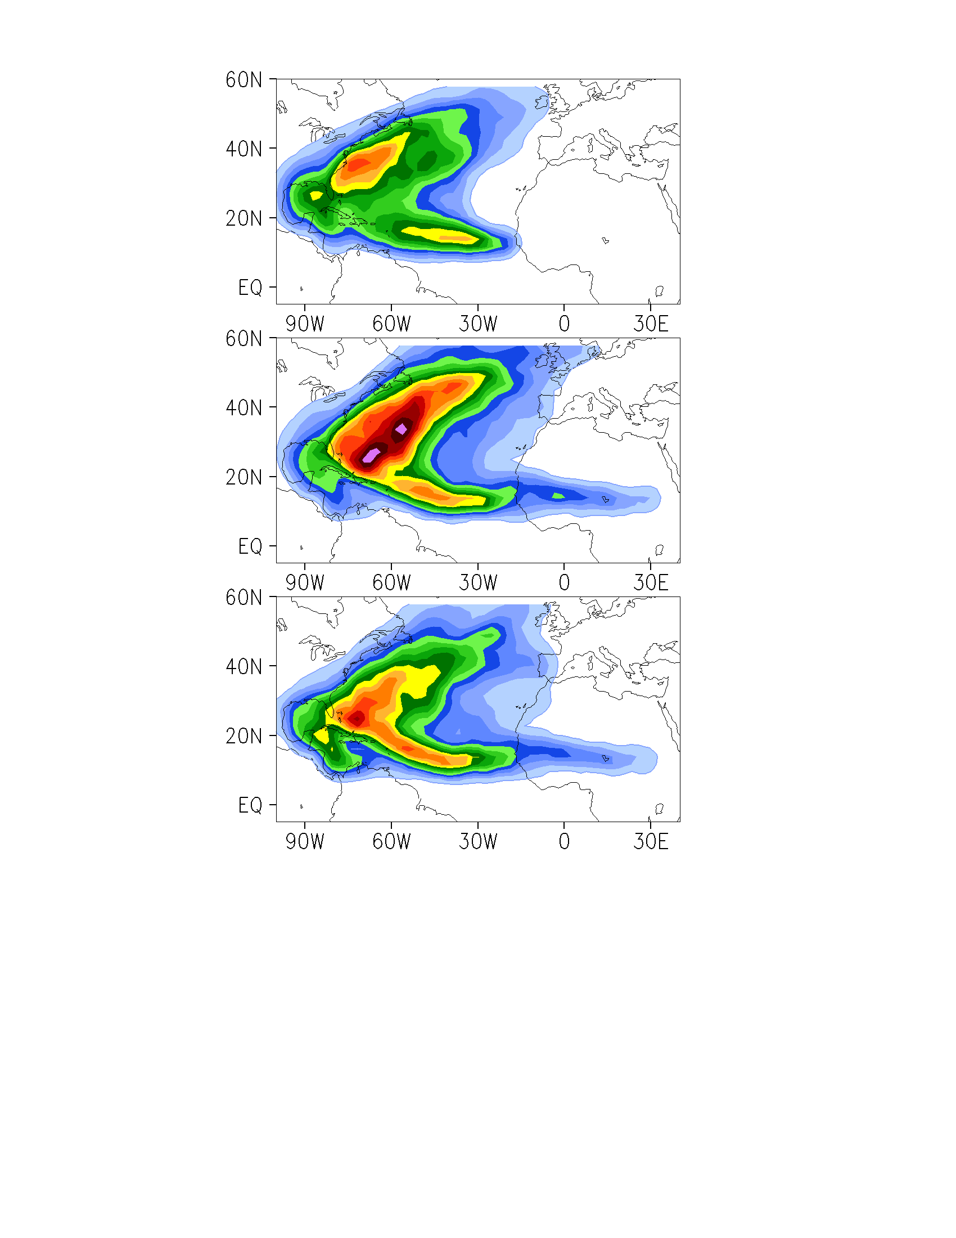
Track Density of TCs: North Atlantic
OBS
OBS
T1279 (12/10)
T1279 (SPD, 1/1)
T511 (12/6)
T511 (SPD, 1/1)
T159
(5/4)
Athena Workshop, 7-8 June 2010
Slide 8
Notes:
Storms are too far from the US coast befor recurving

Slide 9
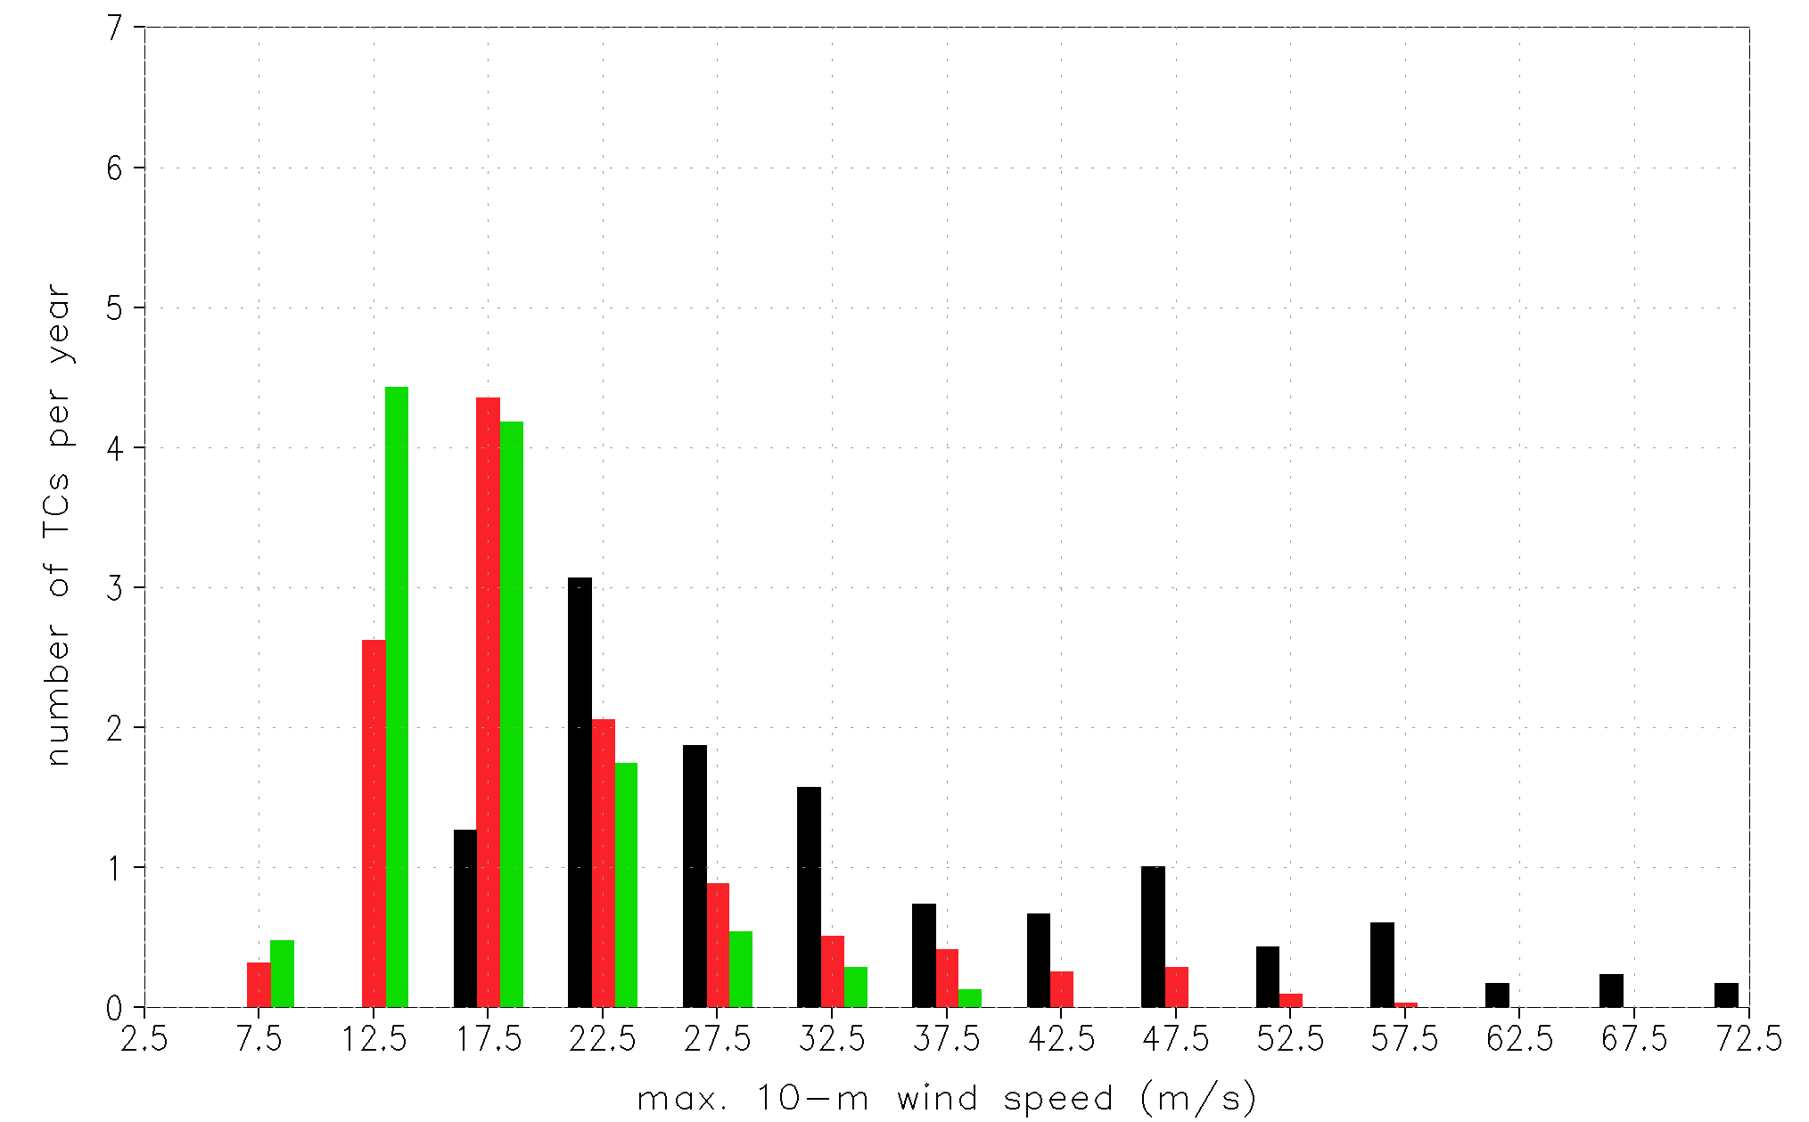
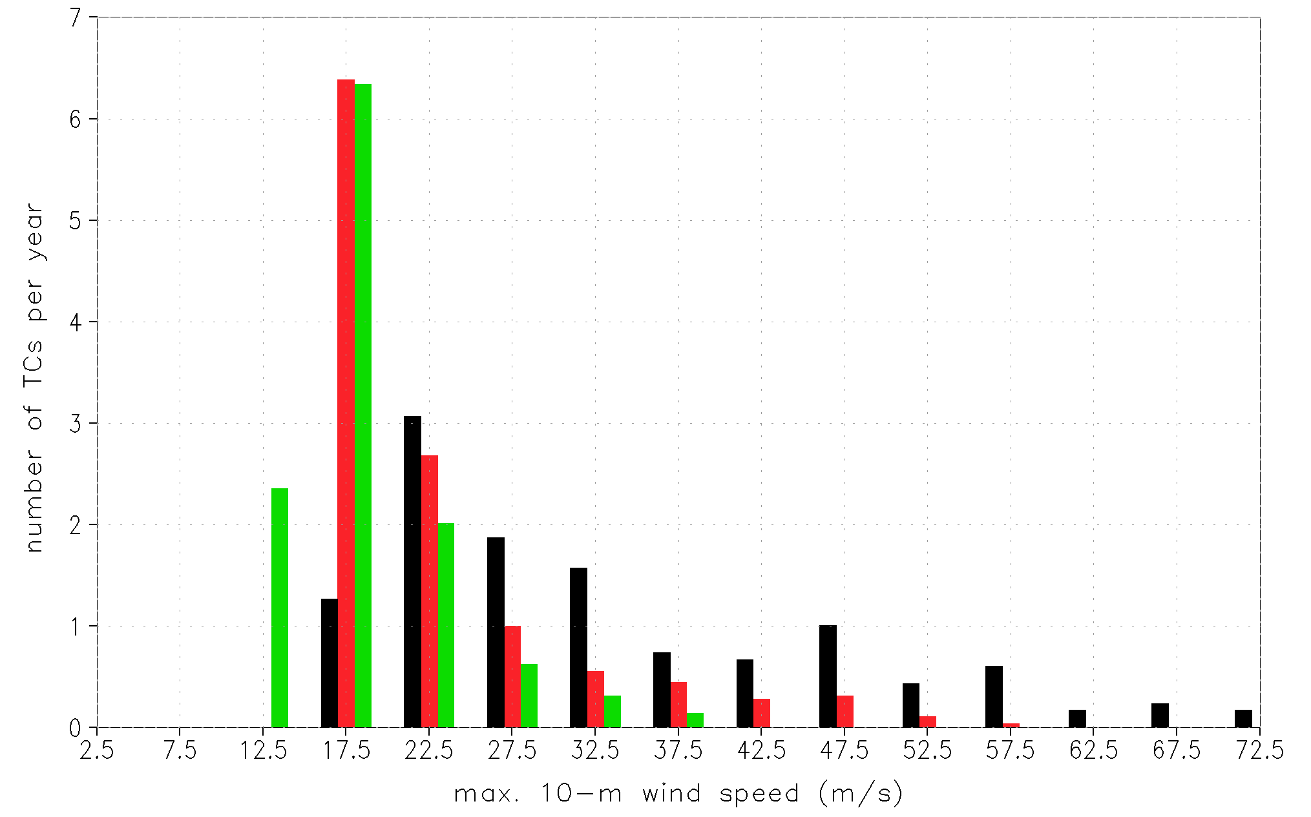
Intensity Distribution of TCs: North Atlantic
TS
OBS
CAT1
T1279 (12/10)
CAT2
T511 (12/6)
CAT3
CAT4
CAT5
OBS
T1279 (SPD, 1/1)
T511 (SPD, 1/1)
Athena Workshop, 7-8 June 2010
Slide 9
Notes:
Storms are weaker on average - Peak of distribution is at 12.5 m/s (T511), 17.5 m/s (T1279) vs 22.5 m/s (OBS)
No hurricanes have wind speeds higher than 60 m/s (T1279) and 40 m/s (T511), no CAT5 hurricanes!
At higher wind speeds, the difference between two choices of TC identification is small
(To increase AVE storm intensity – modify surface fluxes so as to change ratio of drag coeff for momentum and water vapor fluxes?)

Slide 10
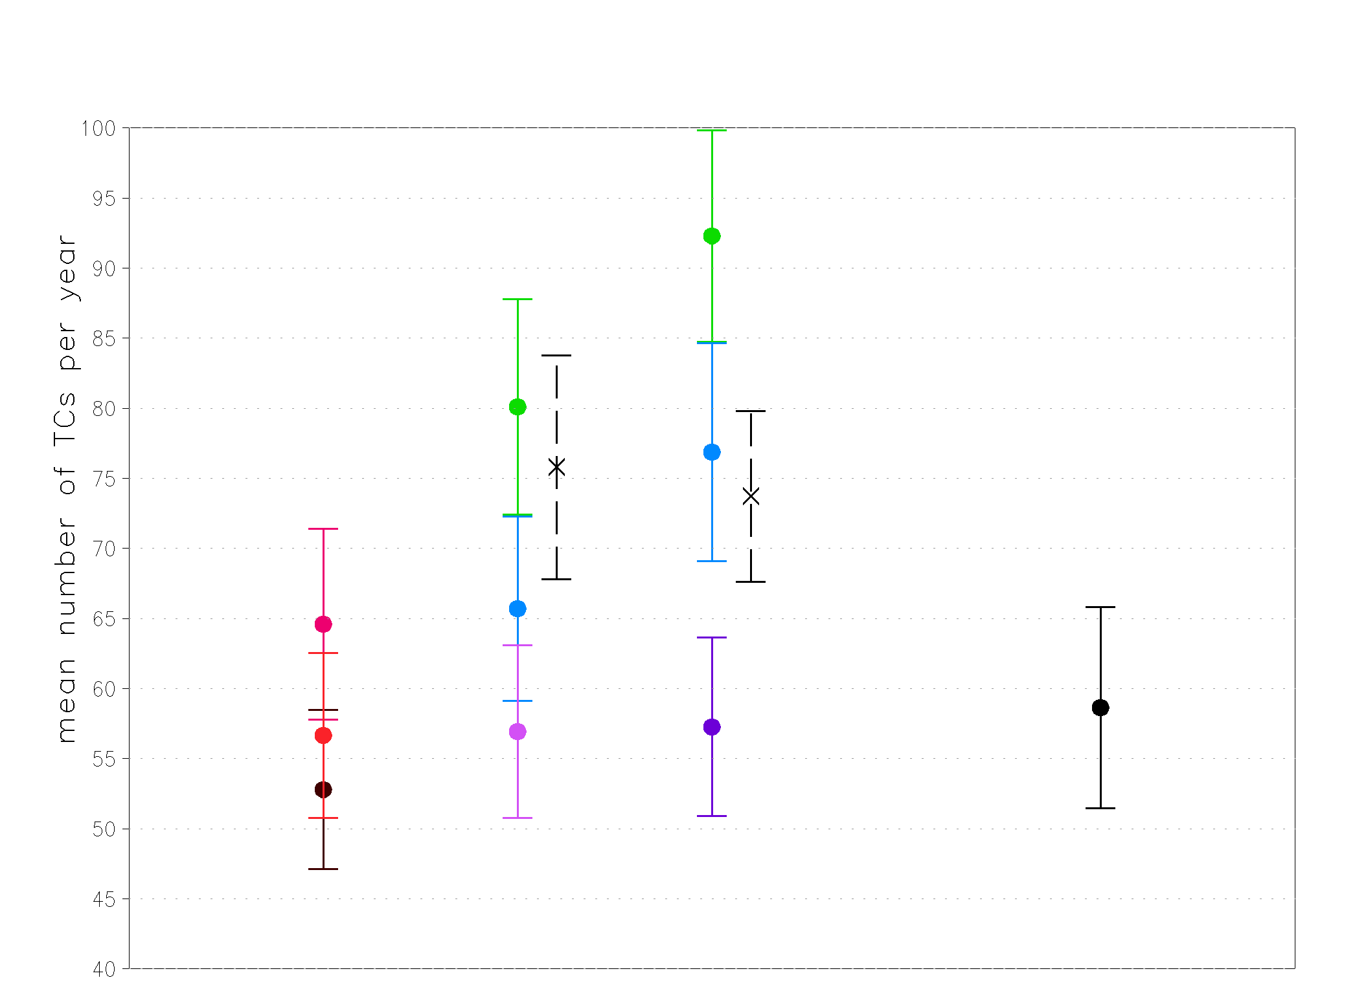
Tracking and Identification of TCs: Northern Hemisphere
T159
T511
T1279
OBS
Athena Workshop, 7-8 June 2010
Slide 10
Notes:
Overprediction of storms in the Pacific is common to other models (GFDL, ECHAM)

Slide 11
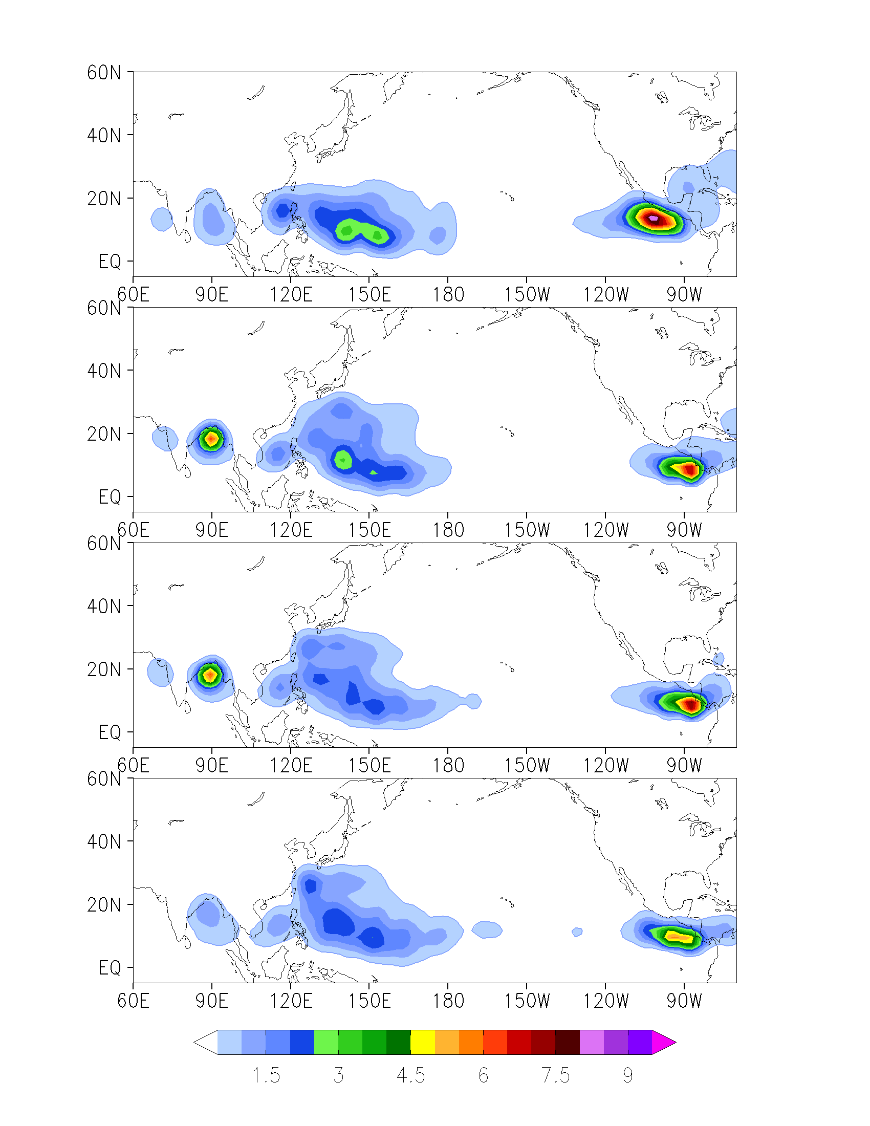
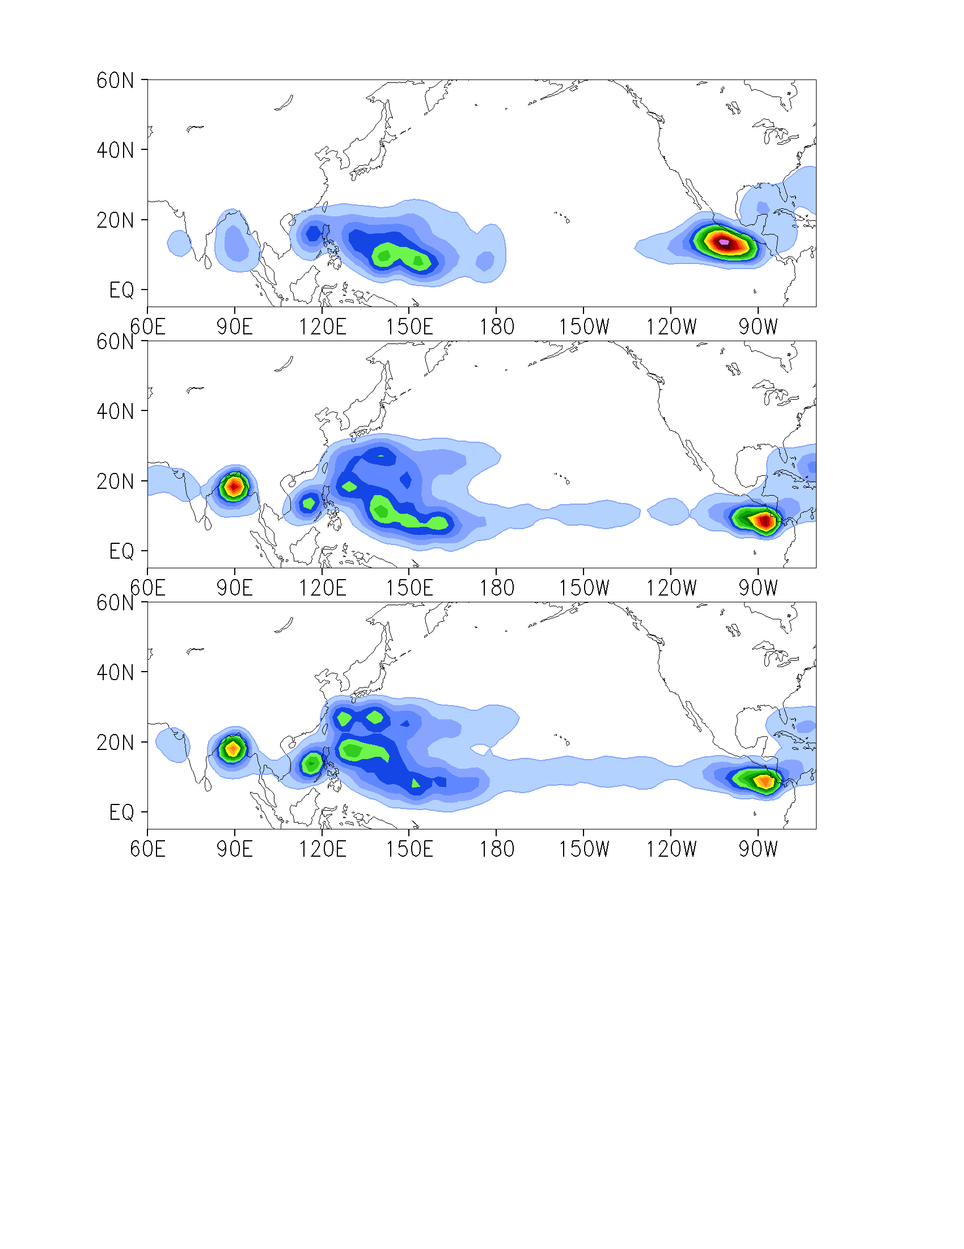
Genesis Density of TCs: Northern Hemisphere
OBS
OBS
T1279 (16/14)
T1279 (SPD, 1/1)
T511 (16/10)
T511 (SPD, 1/1)
T159
(6/4)
Athena Workshop, 7-8 June 2010
Slide 11
Notes:
SEPac genesis shifted to SE
WestPac and South China Sea centers become more realistic with higher resolution
In North Indian Ocean monsoon depressions are too strong (?), so that they get classified as TCs - more a problem with higher resolution!

Slide 12
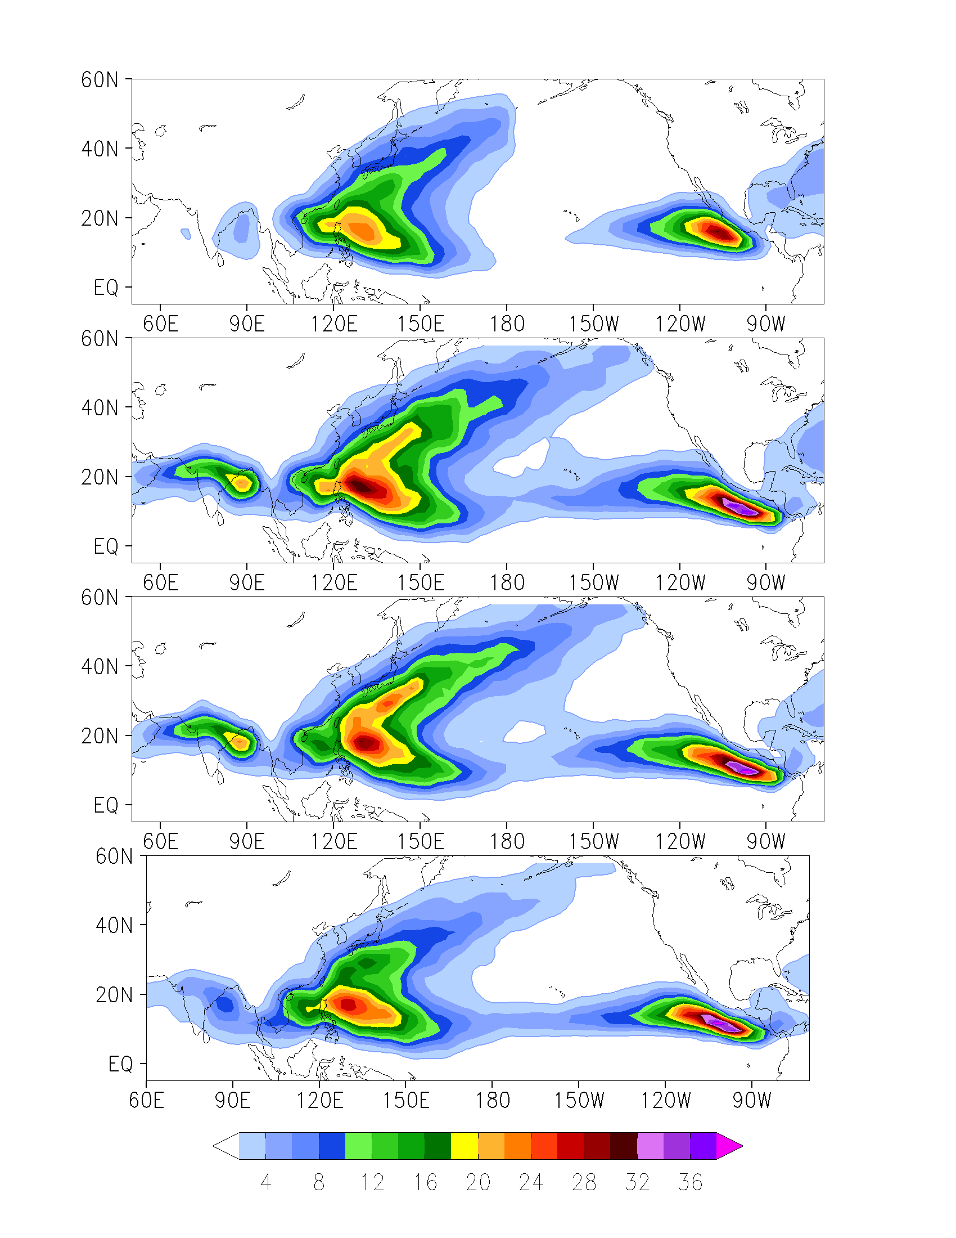
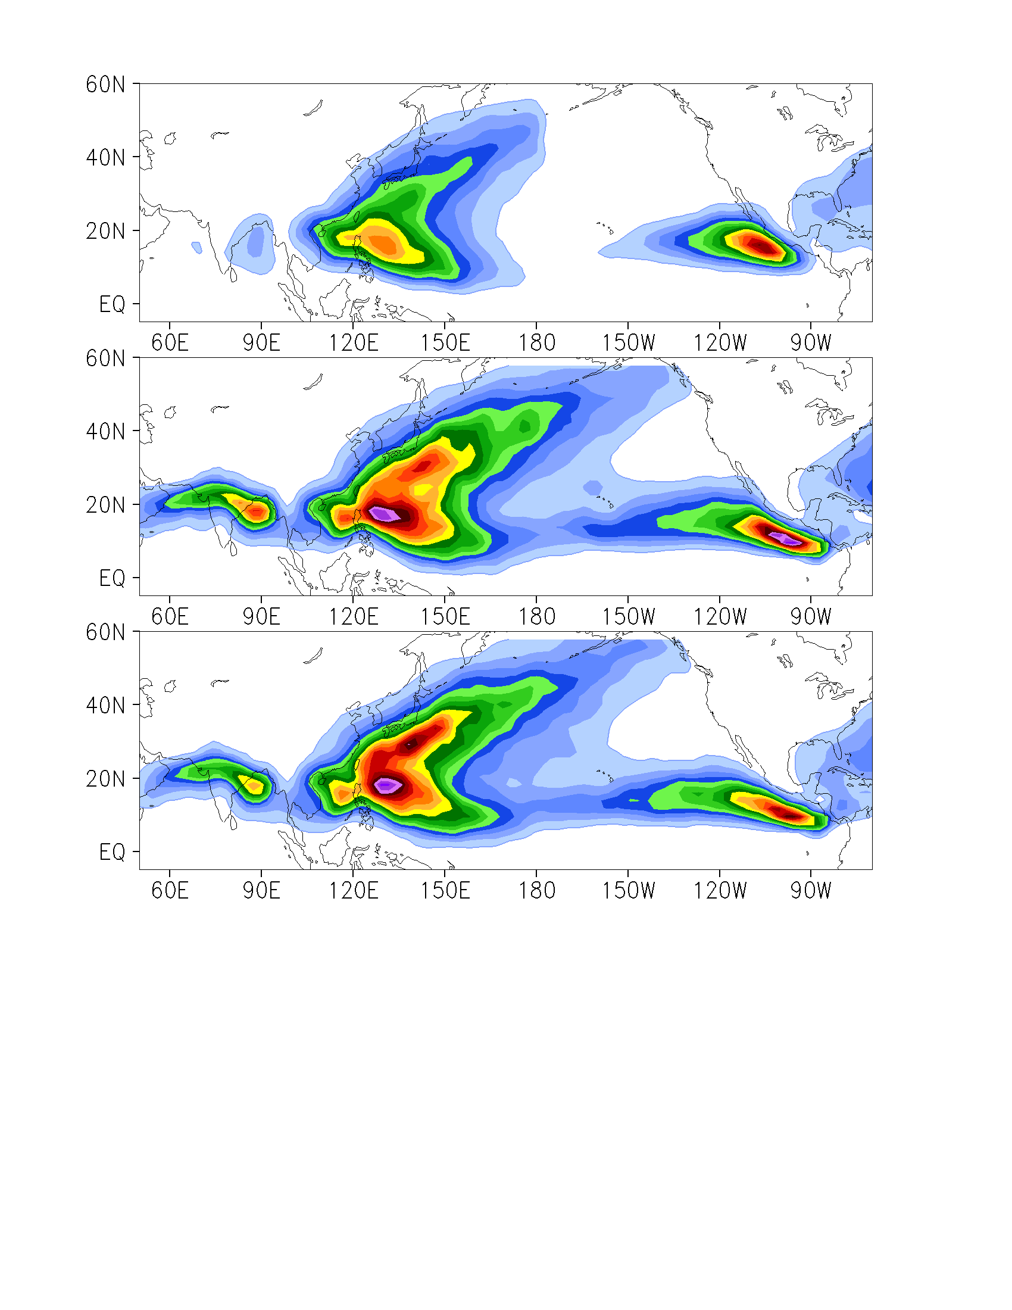
Track Density of TCs: Northern Hemisphere
OBS
OBS
T1279 (16/14)
T1279 (SPD, 1/1)
T511 (16/10)
T511 (SPD, 1/1)
T159
(6/4)
Athena Workshop, 7-8 June 2010
Slide 12

Slide 13
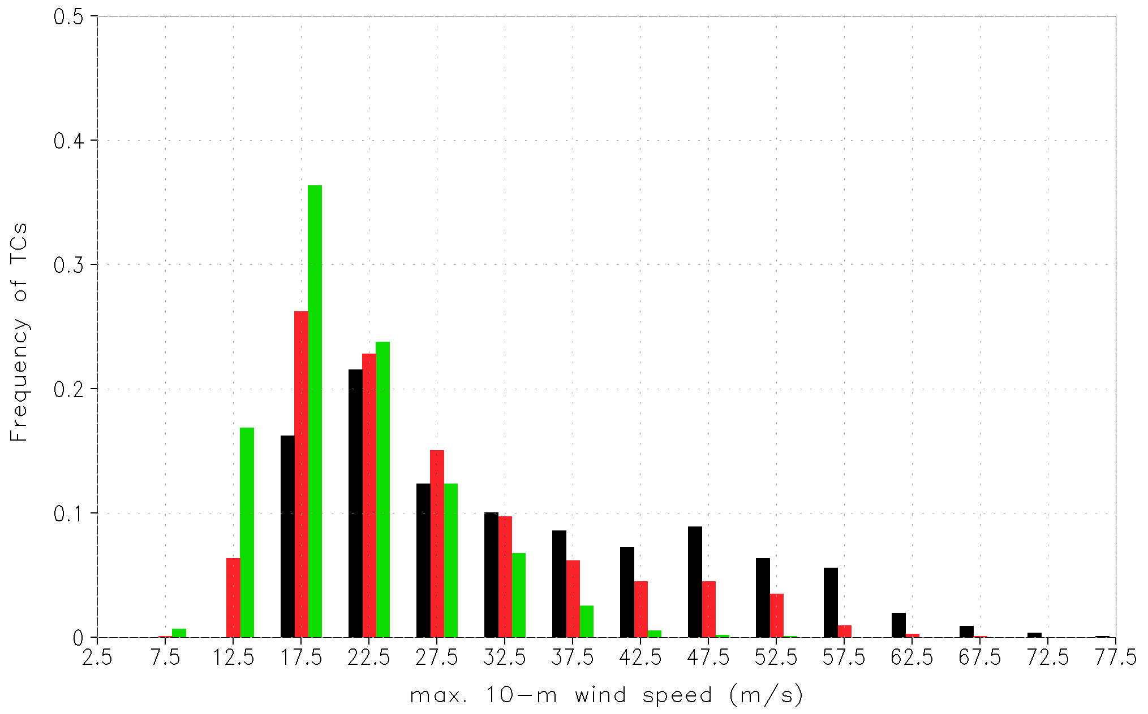
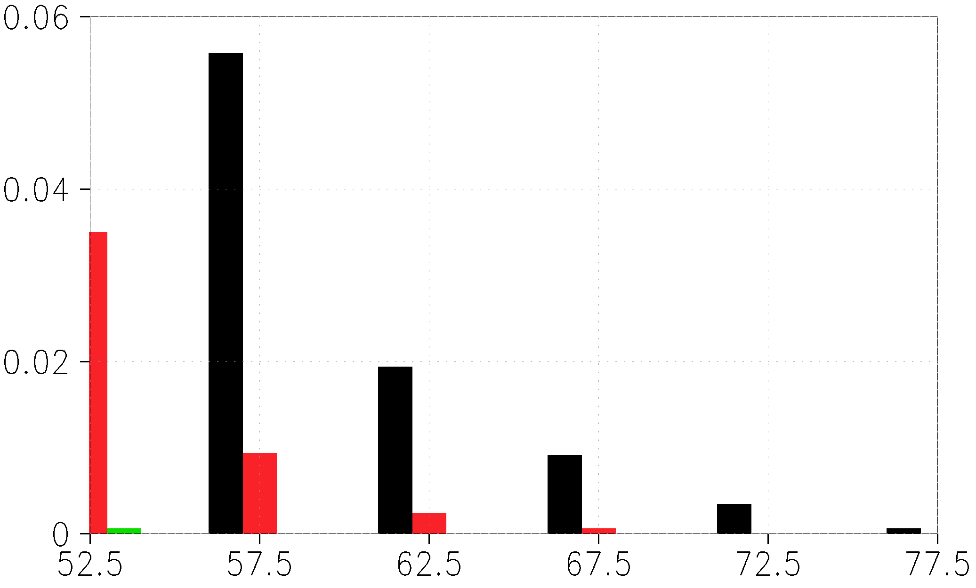
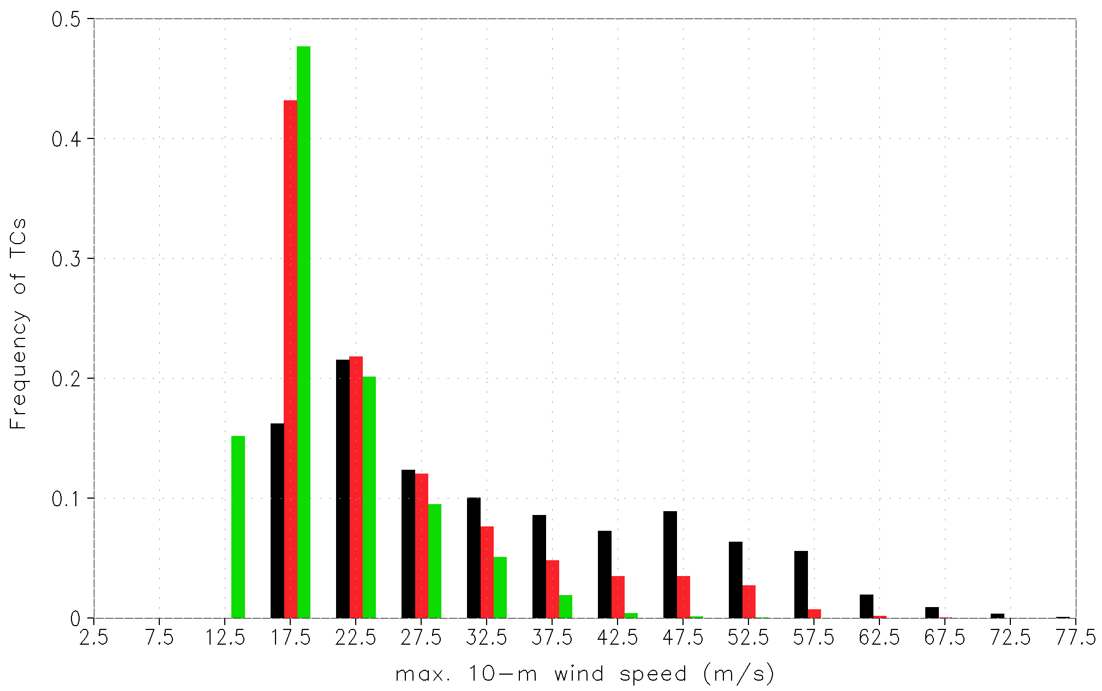
Intensity Distribution of TCs: Northern Hemisphere
OBS
T1279 (16/14)
T511 (16/10)
OBS
T1279 (SPD, 1/1)
T511 (SPD, 1/1)
Athena Workshop, 7-8 June 2010
Slide 13
Notes:
Upper T1279 results are quite realistic, although similar problems as for the Natl case

Slide 14
Experiments
Period of analysis: JJA of 2001-2002 & 2004-2008
TC Identification Criteria II is used
Total number of TCs:
OBS | IFS T2047 | IFS T1279 | NICAM gl10
189 (27/yr) | 212 (~30/yr) | 207 (~30/yr) | 226 (~32/yr)
Athena Workshop, 7-8 June 2010
Slide 14
Notes:
T2047 uses the same speed threshold as T1279 (no adj. For 7.5 min time step)
NICAM 30-sec wind is converted to 10-min one using IBTrACS formula

Slide 15
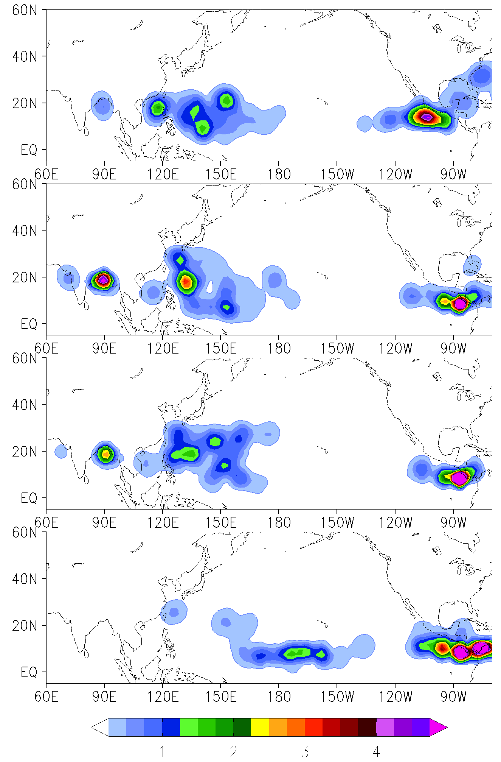
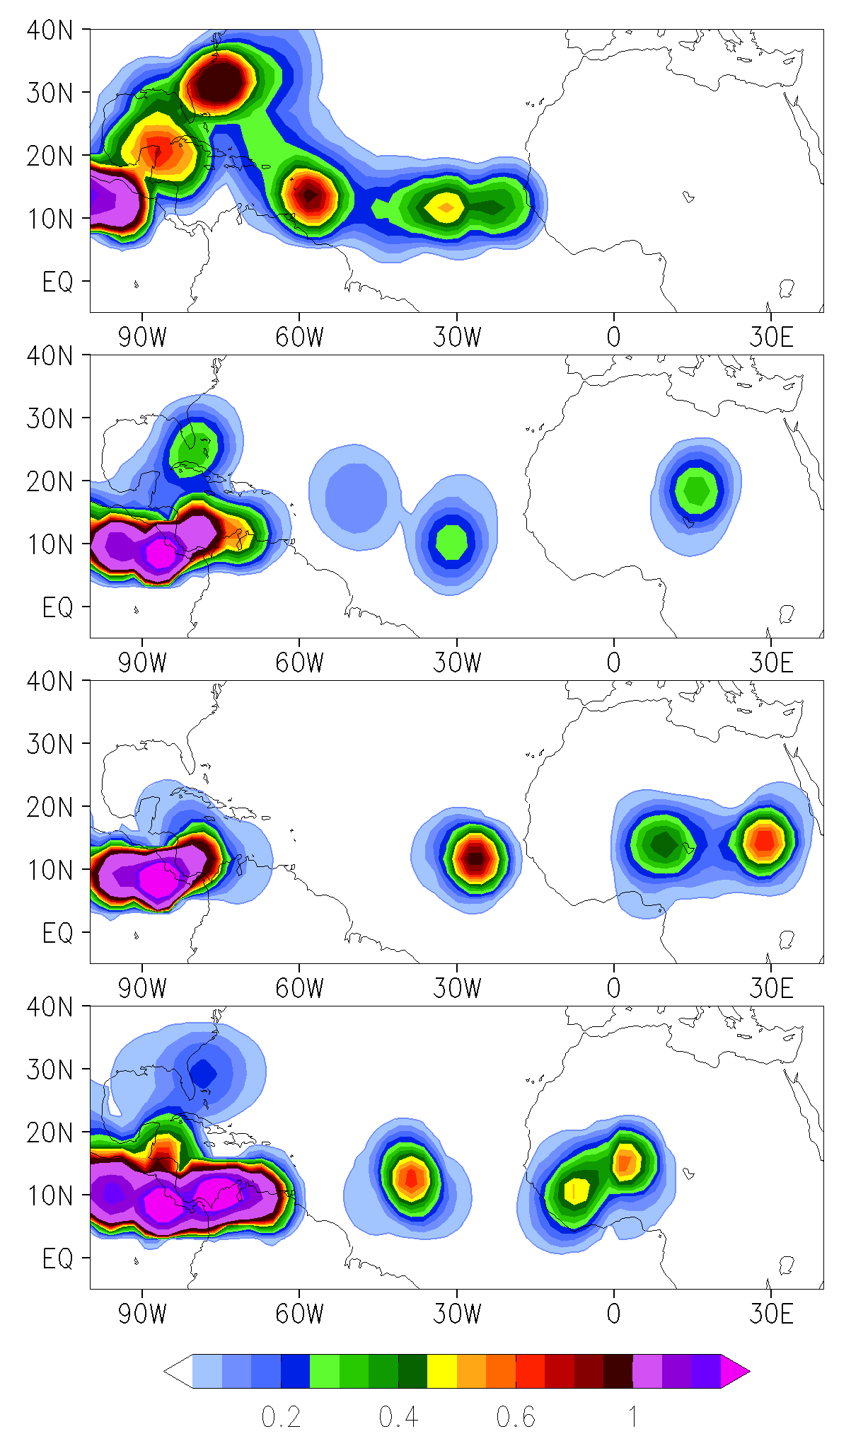
Genesis Density of TCs
OBS
IFS T2047
IFS T1279
NICAM
gl10
2 3 4
Athena Workshop, 7-8 June 2010
Slide 15
Notes:
SE Pac center is different from 13-mo. IFS runs!
West Atl center only in T2047 and NICAM!
No West Pac center in NICAM likely due to suppression of precip. there

Slide 16
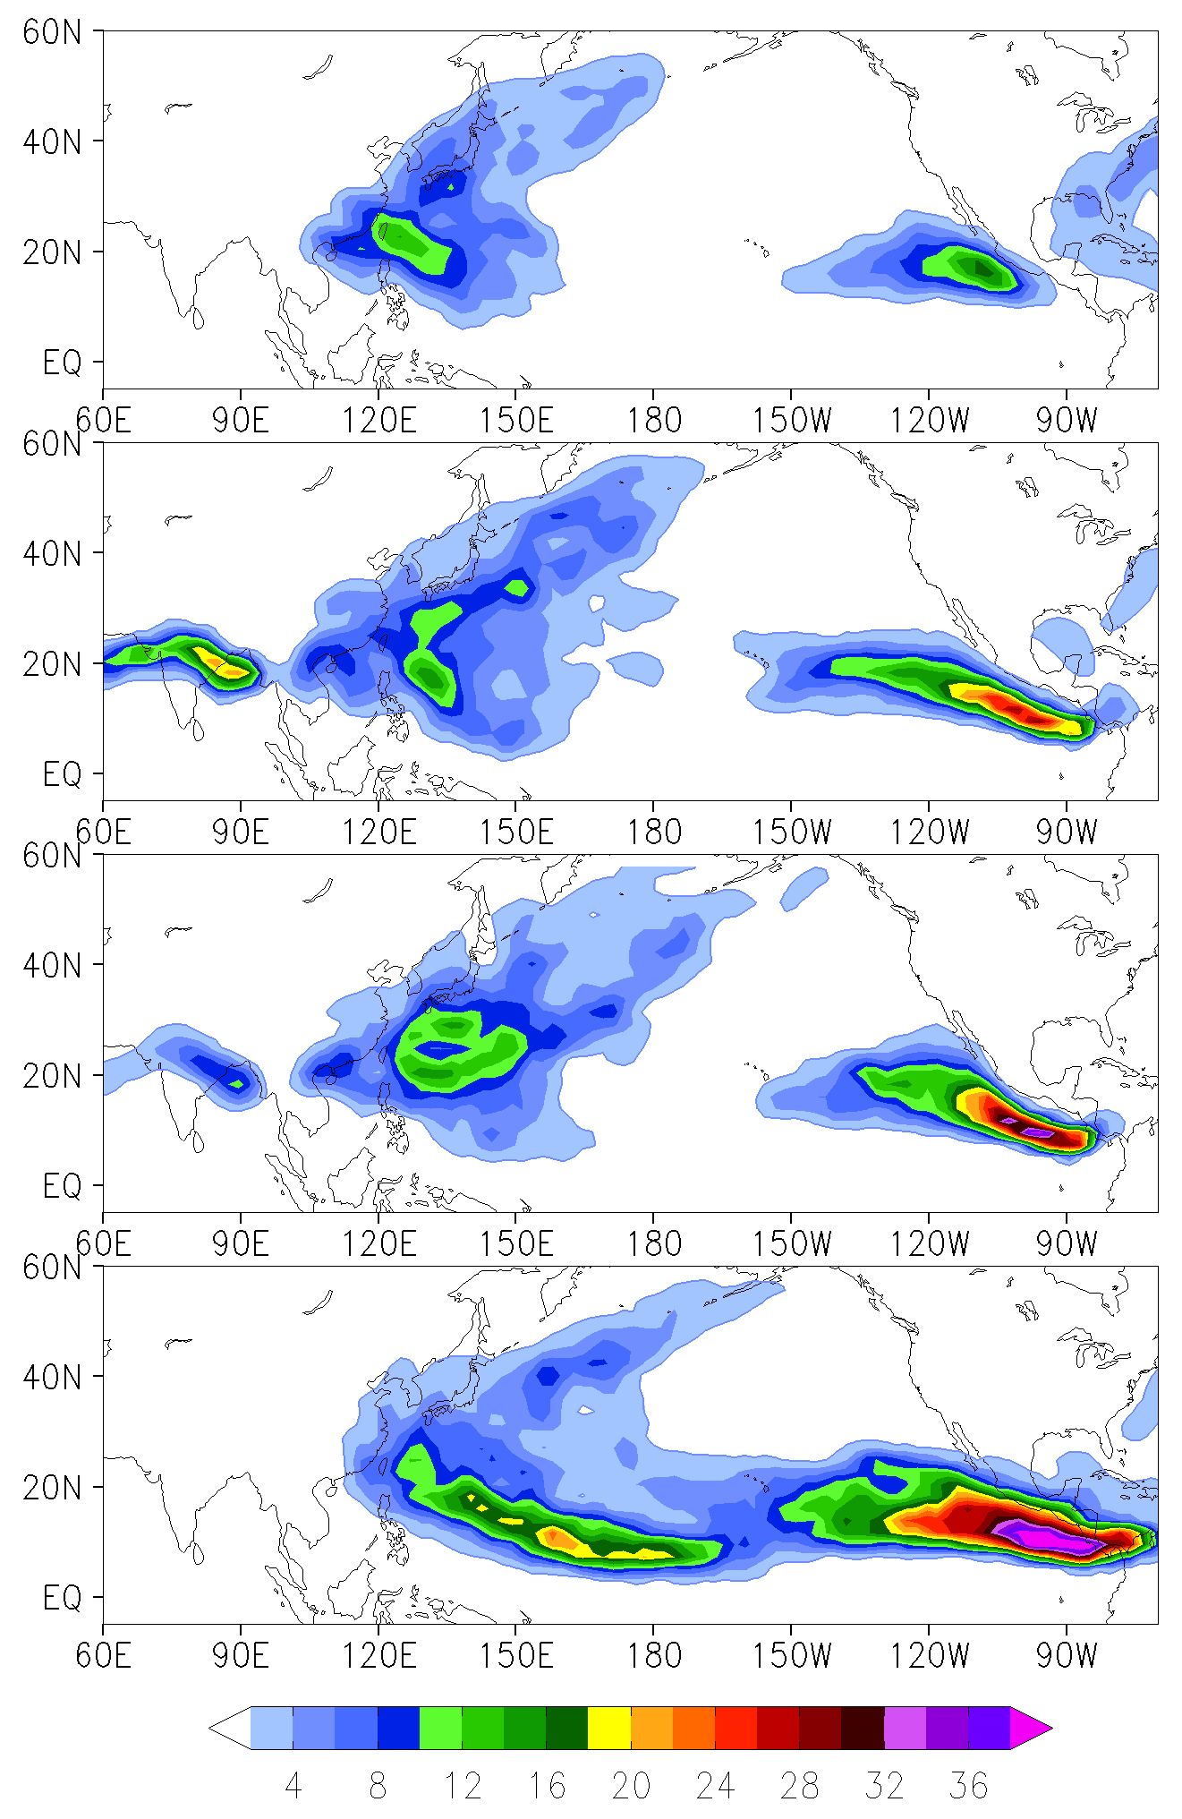
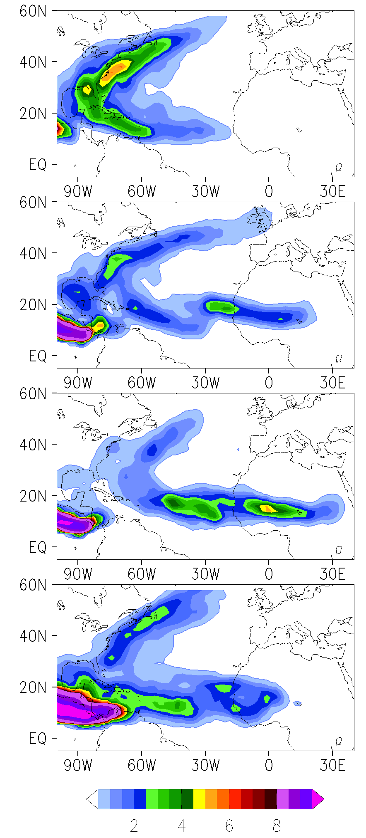
Track Density of TCs
OBS
IFS T2047
IFS T1279
NICAM
gl10
16 24 32
Athena Workshop, 7-8 June 2010
Slide 16
Notes:
At T2047 recurving of TCs in the Natl occurs closer to the US coast compared to T1279 and lower resolution 13-mo. runs!

Slide 17
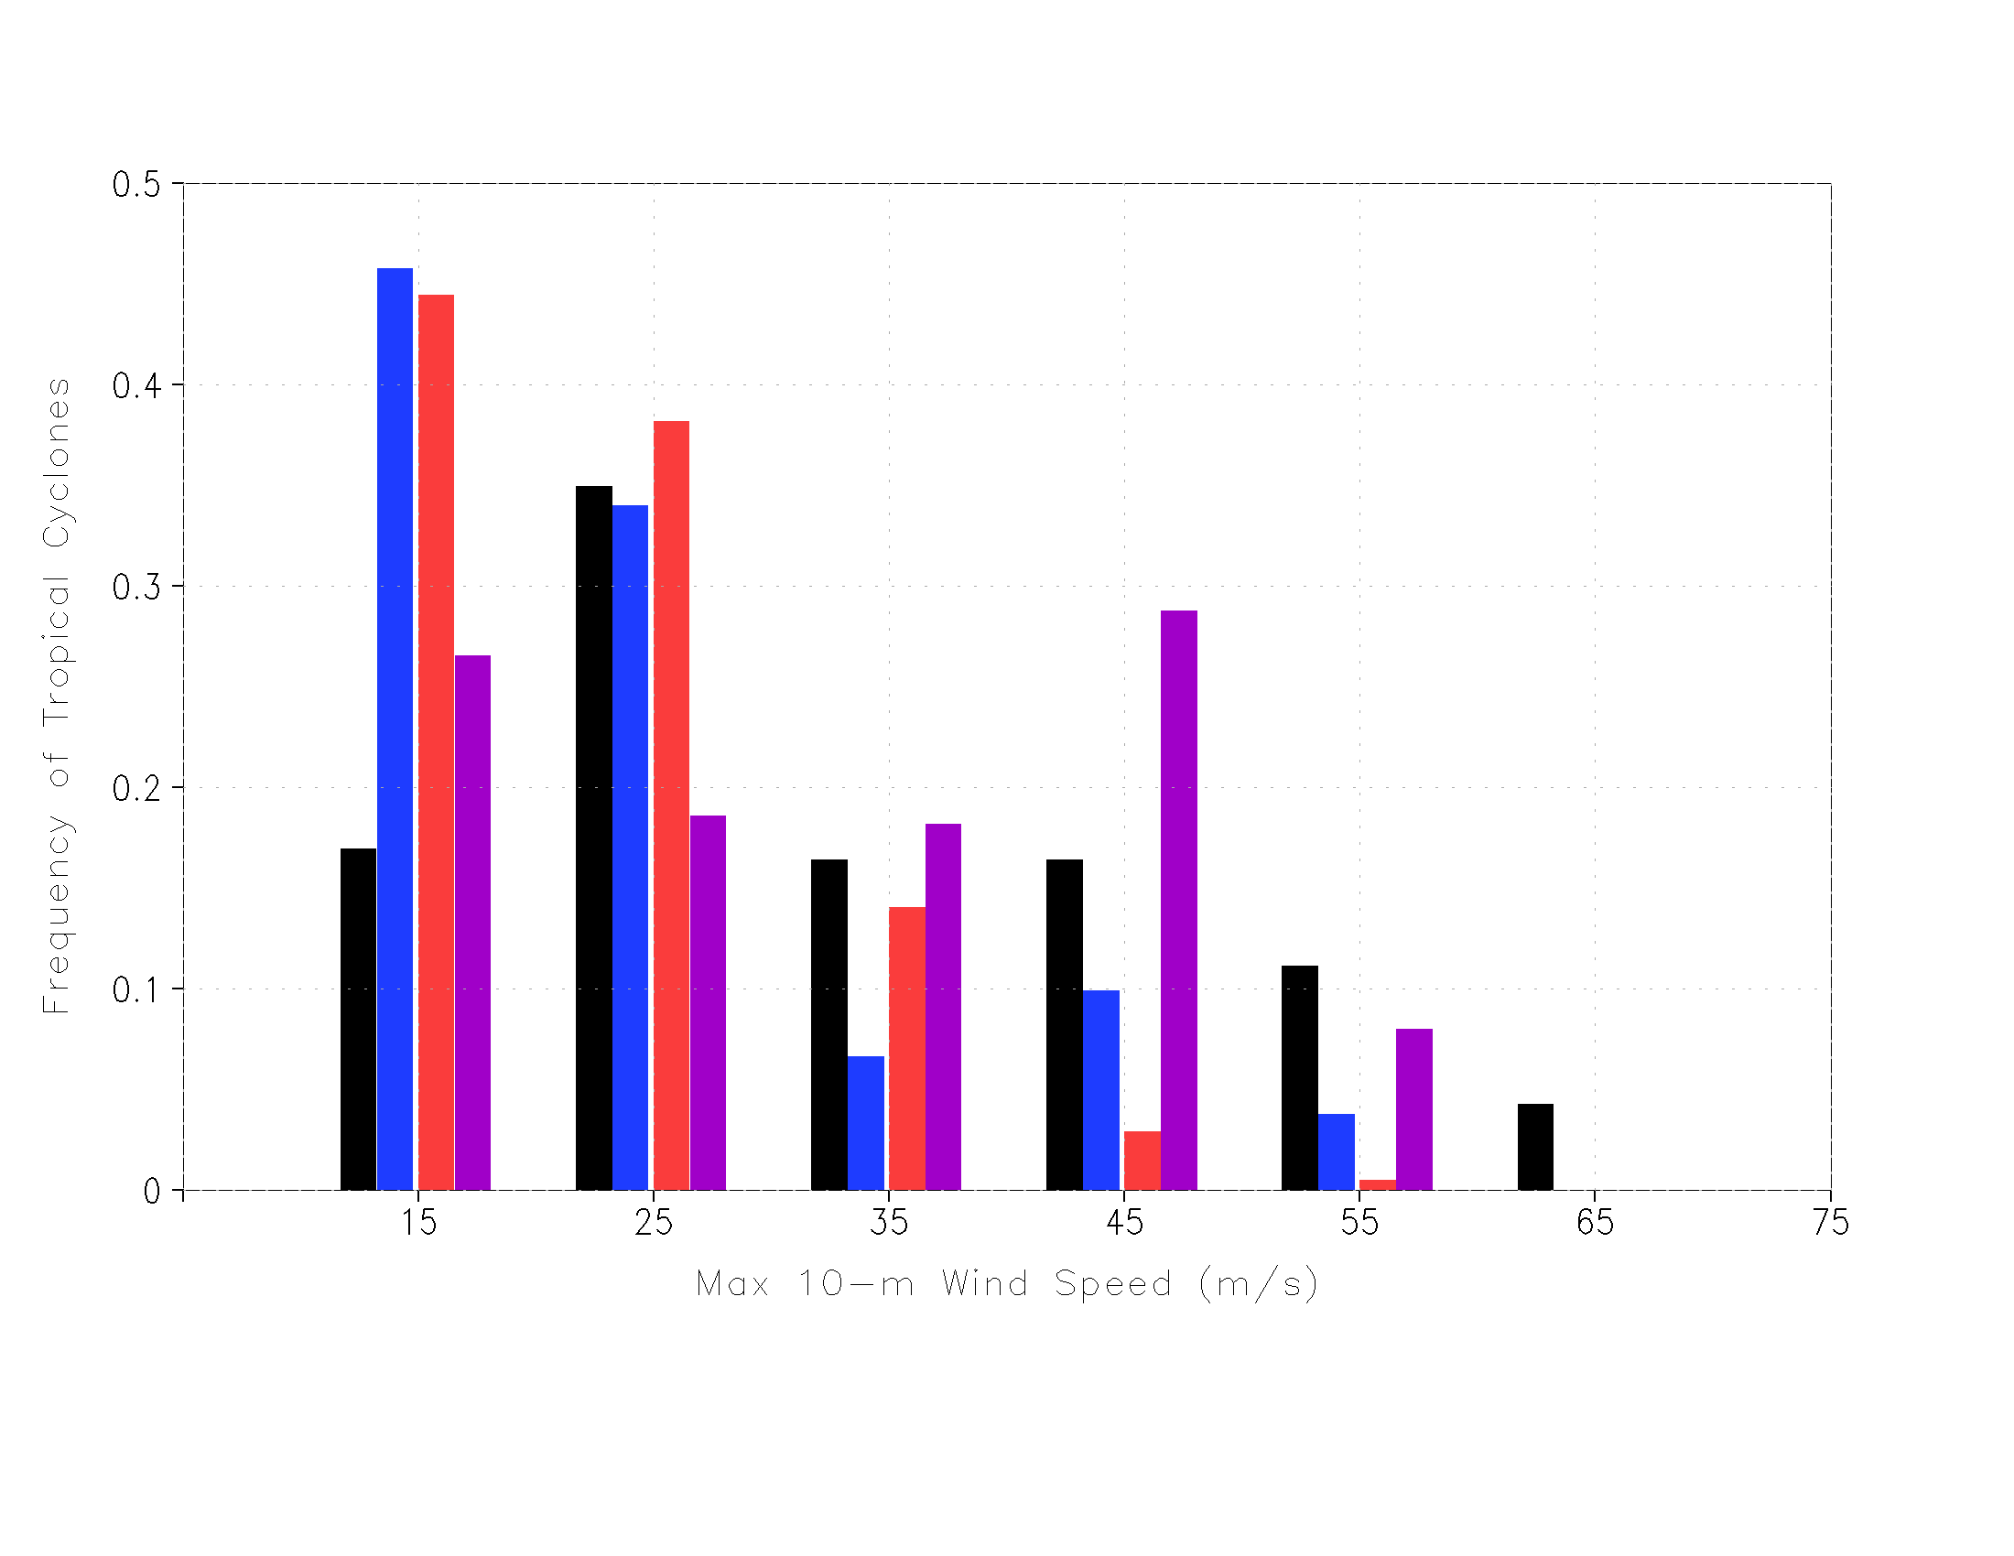
Intensity Distribution of TCs: Northern Hemisphere
OBS
IFS T2047
IFS T1279
NICAM gl10
Athena Workshop, 7-8 June 2010
Slide 17

Slide 18
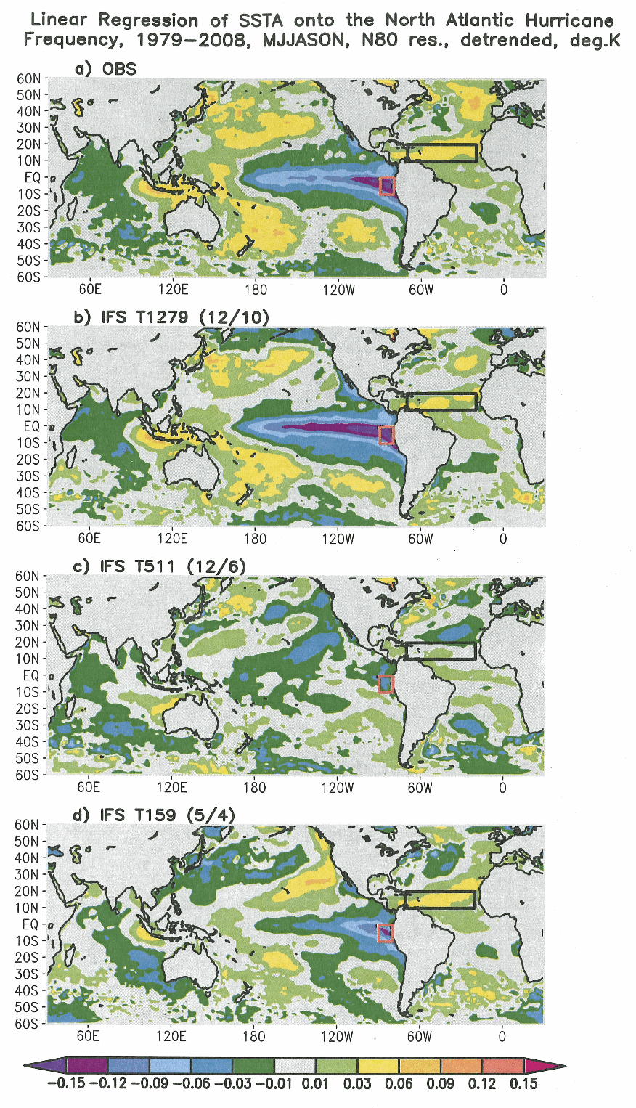
Interannual Variability of North Atlantic Hurricanes
Correlation of observed and simulated North Atlantic hurricane counts (detrended):
OBS
 | 14/12 | 12/10 | 12/6 | 10/6 | 5/5 | 5/4 | 4/4 | 3/3 | spd
T1279 | 0.53 | 0.60 | 0.54 |  |  |  |  |  | 0.35
T511 |  | 0.12 | 0.12 | 0.18 |  |  |  |  | 0.20
T159 |  |  |  |  | 0.37 | 0.37 | 0.27 | 0.46
IFS T1279
Blue color indicates results statistically significant at 95% confidence level
IFS T511
T511 time series have no trend!
IFS T159
Athena Workshop, 7-8 June 2010
Slide 18
Notes:
In 2005, T1279 generated 21 TCs, T511 - 16 and T159-19.

Slide 19
Conclusions
In the North Atlantic, increase of model resolution leads to the enhancement of cyclogenesis off the coast of Africa and east of Florida. Track density along the east coast of North America becomes more pronounced, although storms remain too far from the coast before recurving northeastward.
In the summer hindcast simulations, the center of cyclogenesis east of Florida is present only at the highest model resolutions. And tracks shift closer to the east coast of the U.S. in line with observations.
In the West Pacific, cyclogenesis becomes more realistic with the increase of model resolution, except for the NICAM simulations likely due to the suppression of convection in this region. Track density does not show much improvement, there are too many tracks in the central Pacific contrary to the observations.
At all resolutions, IFS generates too many TCs with peak sustained surface winds of less than 20 m/s and too few TCs at the highest intensities. In the NICAM simulations, this tendency is much less pronounced. Both IFS and NICAM do not reproduce peak intensities that are observed.
Athena Workshop, 7-8 June 2010
Slide 19

